Slide 1
Invyswell: A Hybrid Transactional Memory for Haswell’s Restricted Transactional Memory
Paper Reading (schedule):
April 24, 2015, Satoshi Matsushita
http://cs.brown.edu/~irina/papers/invyswell.pdf
PACT 2014
Authors:
Irina Calciu, Brown Univ. http://cs.brown.edu/~irina/
Justin Gottschlich, Intel labs : http://justingottschlich.com/
Tatiana Shpeisman, Intel Labs
Gilles Pokam, Intel Labs
Maurice Herlihy, Brown Univ.: https://cs.brown.edu/people/faculty/mph.html

Slide 2
Intel Transactional Synchronization Extensions (TSX)
Hardware Lock Elision (HLE)
Restricted Transactional Memory (RTM)
HLE
New prefix
RTM
prefix
Lock variable
xacquire lock xchg
xbegin fallback_code
time
Speculative
transactional
execution
Speculative
transactional
execution
xabort
xrelease mov mem,reg
xend
Cf. http://en.wikipedia.org/wiki/Transactional_Synchronization_Extensions

Slide 3
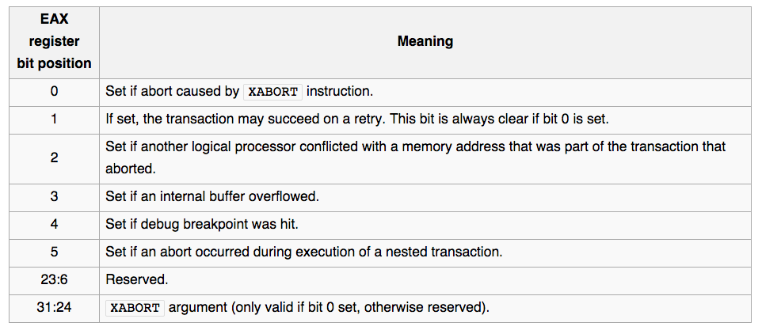
TSX: nest, abort
RTM
fallback_code1:
fallback_code2:
(imm, state) -> EAX
xbegin fallback_code1
xbegin fallback_code2
time
xabort imm
xend
xend

Slide 4
RTM: Restrictions
L1 Cache (32KB 8-assoc.) for transactional state store: need one cache line for ether read_set, or write_set
Aborted by state buff full, interrupt, context switch
Certain (uncommon) instr.s always cause abort
No forward progress guaranteed
No escape actions
Cf. http://www.hpts.ws/papers/2013/HTM.pdf

Slide 5
The paper..
Resolve limitation of RTM with Software and Hardware hybrid Transactional Memory (TM)
Due to ‘no escape’ RTM limitation, trying five TM strategies in sequence.
No crash, no fault tolerance
Higher performance with 5 strategies
SpecSW is closer to so called transaction. It consults Contention Manager for commit decision.
Simple commit with lock, considering lower impact to concurrently running RTM transaction
Modification of InvalSTM (software TM by the co-auther Gottschlich) to make it HTM hybrid.

Slide 6
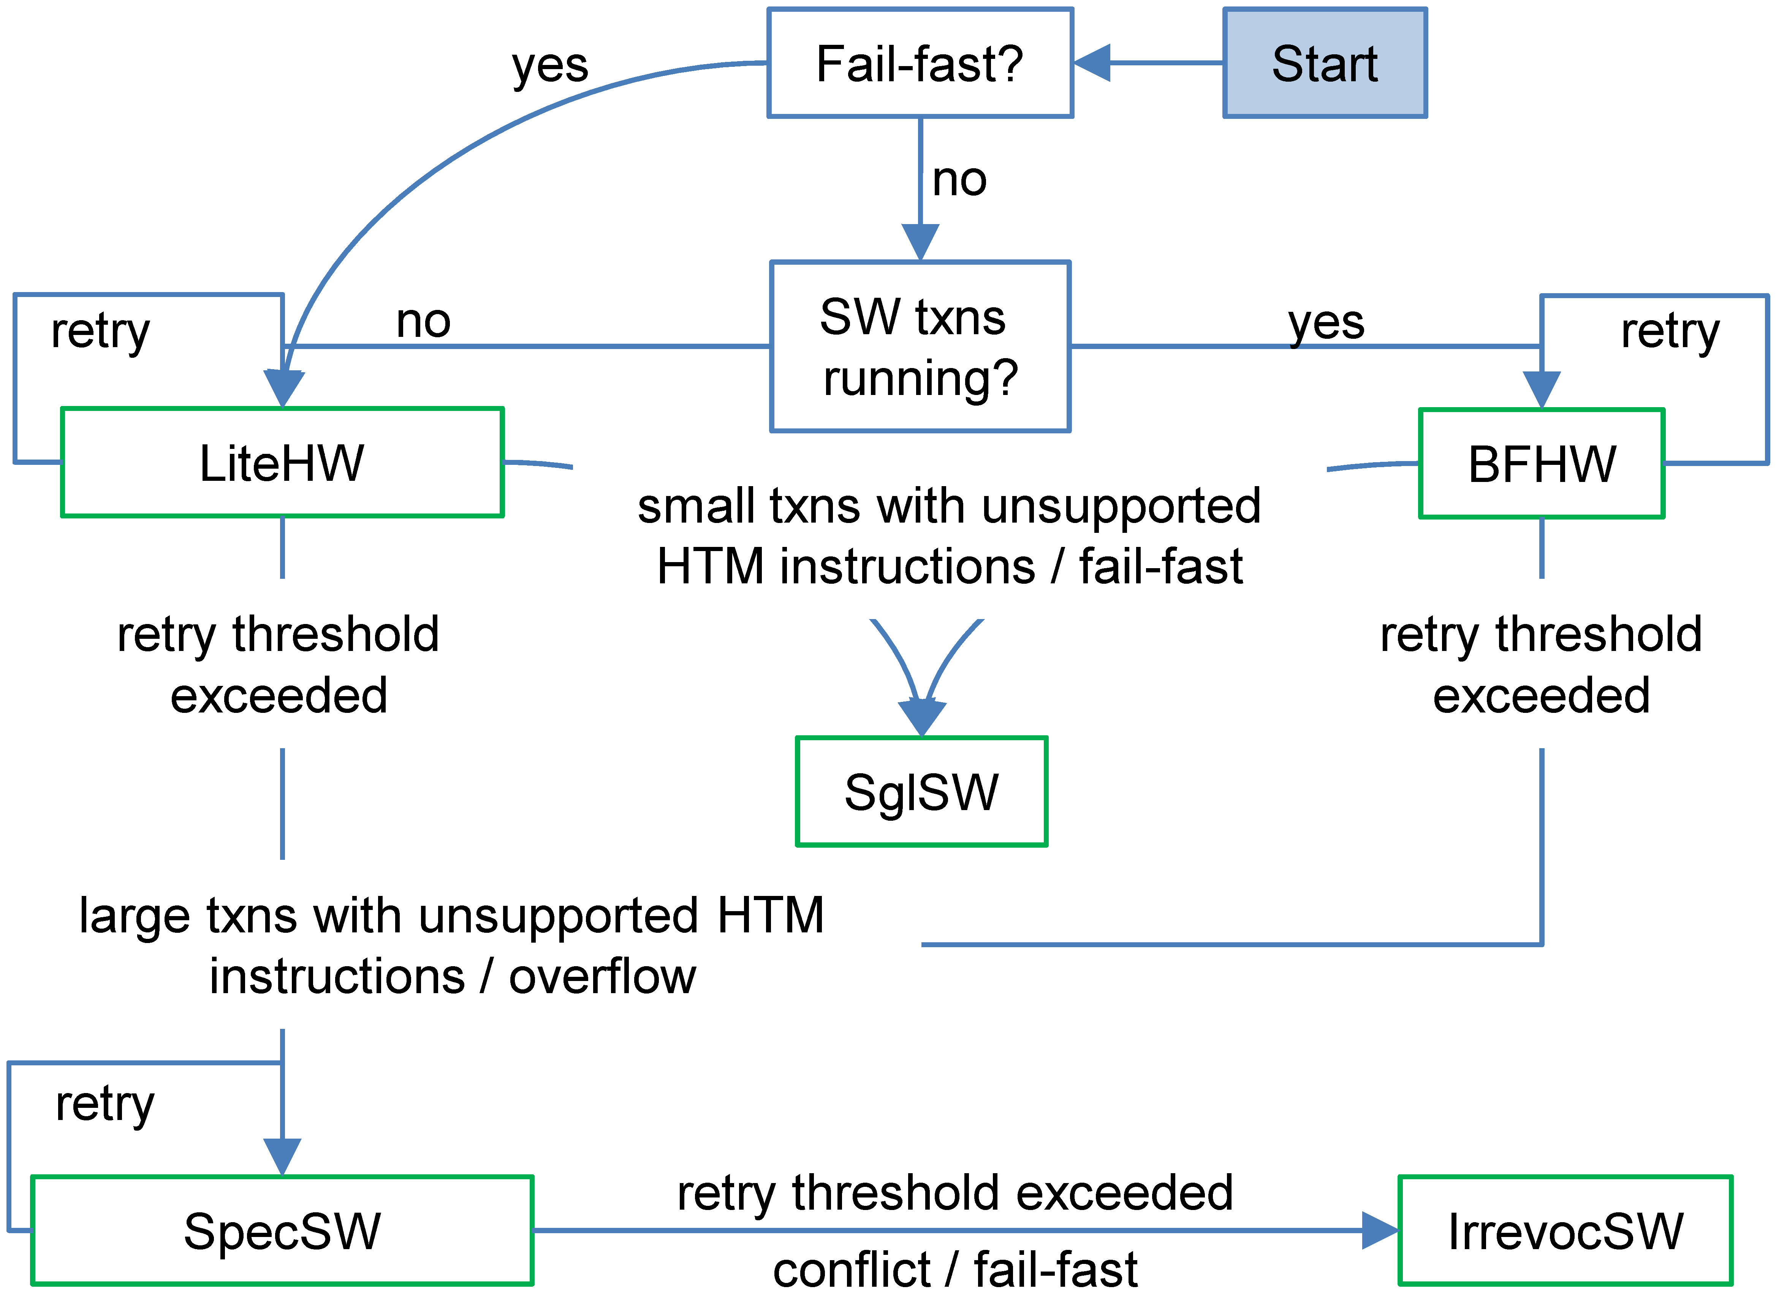
Invyswell Design
Hardware TM: LWHW(small Tx), BMHW
Software TM: SpecSW, IrrevocSW (always commit), SglSW (Giant lock)
Bloom Filter for
Conflict detection
r/w
Giant lock
read/write
write

Slide 7
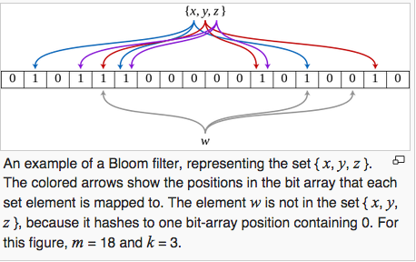
Bloom filter
Cf. http://en.wikipedia.org/wiki/Bloom_filter
False positive matches are possible, but false negatives are not
A strong space advantage: 1% error with ~9.6 bits/element. Additional ~4.8 bits/elem. reduces ~1% false-positive rate
O(k) for add items or to check
Can not remove an element

Slide 8
Optimization in specSW
Avoiding abort of inflight HW transaction
Reading lock for inflight transaction list aborts hardware transactions (RTM)
Using slotted array to eliminate lock in linked list
Reducing conflict
Changing commit order
Lock -> commit -> invalidate -> unlock
Recording read location in bloom filter if the read is not in write-set (RAW, True dependency: http://en.wikipedia.org/wiki/Data_dependency)
Other optimizations discussed in section 6.
Fail-Fast mode with priority, read-only transaction

Slide 9
Bug in RTM HW Sandboxing (Sec. 5.2)
“loop-hole”, an unlikely sequence of events in which
(1) mutually inconsistent reads cause a spurious memory write,
(2) which overwrite an address later used as the target of an indirect jump in that same transaction,
(3) thereby causing a jump to a location that happens to contain either an _xend (commit transaction) instruction, or immediate data that looks like one.
Executing this instruction without the final commit lock check could prematurely commit an inconsistent set of changes
Solution:
Check the commit_lock before doing an indirect jump (hand code)
No indirect jumps: also preventing buffer overflow vulnerability

Slide 10
Conclusion
Architecture researches sometimes direct to a brute forth or a combination of existing solution.
They may seem to show presence in evaluation of improvement in benchmarks, instead of proposing a novel algorithm. … 5% Club …
I think it is due to they do not want to change the important component ‘CPU, or LSI Chip’. Some have been trying it, ending with ‘Pie in the Sky’, except ones eventually introduced in real LSI.

Slide 11
References (except ones inline)
Haswell microarchitecture: http://en.wikipedia.org/wiki/Haswell_%28microarchitecture%29
Intel Haswell TSX page: https://software.intel.com/en-us/blogs/2012/02/07/transactional-synchronization-in-haswell
Haswell instruction set manual: https://software.intel.com/sites/default/files/m/9/2/3/41604
An Efficient Software Transactional Memory Using Commit-Time Invalidation, Justin E. Gottschlich, et.al:http://justingottschlich.com/content/cgo10_inval.pdf
An Evaluation of Intel’s Restricted Transactional Memory for CPAs: https://kar.kent.ac.uk/36939/1/9780956540973_020.pdf
Radix Tree: http://en.wikipedia.org/wiki/Radix_tree
Apaptive Radix Tree: ARTful http://www3.informatik.tu-muenchen.de/~leis/papers/ART.pdf

