Slide 1
Panel on Granular Computing

Slide 2
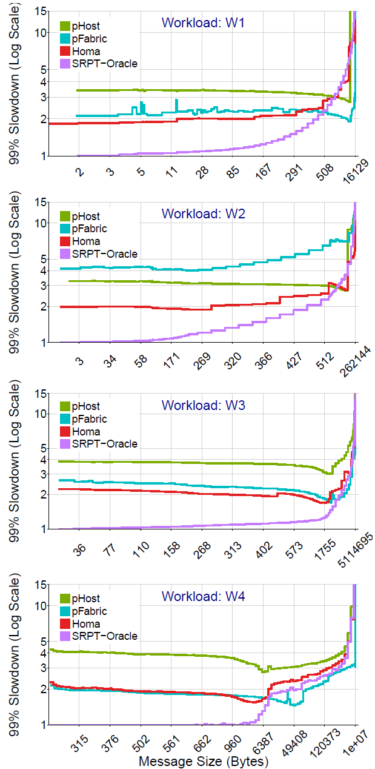
Homa: New Datacenter Transport
Consistent low latency for short messages:
99%-ile slowdown < 2.5x at 80% network load
Supports high network loads: 90%
Outperforms pFabric at high loads (and works with existing switches)
Key techniques:
Receivers schedule incoming packets
Minimize buffer occupancy
Use 4-8 network priority levels for preemption
New solution to bipartite matching problem: controlled buffering + priorities
Talk with Behnam Montazeri, Yilong Li

Slide 3
Arachne: New Thread/Core Mgmt
Start thread on new core: 130 ns
Wake up sleeping thread: 80 ns
Better core utilization for granular apps
Thread/core allocation entirely at user level
Application “owns” cores for long intervals (10-100 ms)?
Talk with Henry Qin, Jacqueline Speiser
Application
threads
Core Arbiter:
Uses Linux
Cpusets to
Allocate cores,
pin kernel
threads
Application 1
App 2
Cores
One kernel thread per hyper-twin

Slide 4
NanoLog
High-performance logging for low-latency systems
Supports log messages at granularity of 10-50ns
Stay tuned for Stephen Yang’s talk

Slide 5
Granular Notifications
Notifications: dual of remote procedure call (RPC)
RPC: sender-driven
Notifications: receiver-driven (subscribe to certain kinds of events)
Notifications are also potentially multicast
Likely to be important for Big Control (event driven)
New project to create high-performance notification mechanism:
Ultra-low latency
High throughput
Talk with Collin Lee

Slide 6
Audience Questions
What would you do with:
20 µs persistent remote task
500 ns local task
What advice would you give us? Concerns? Issues to address?

Slide 7
Questions/Discussion

