Slide 1
RAMCloud Overview and Update
SEDCL Retreat June, 2013
John Ousterhout
Stanford University

Slide 2
What is RAMCloud?
General-purpose storage system for large-scale applications:
All data is stored in DRAM at all times
Large scale: 1000+ servers, 100+ TB
Low latency: 5-10 µs remote access time
As durable and available as disk
Simple key-value data model (for now)
Project goal: enable a new class of data-intensive applications

Slide 3
RAMCloud Architecture
1000 – 100,000 Application Servers
Appl.
Appl.
Appl.
…
Appl.
Library
Library
Library
Library
High-speed networking:
5 µs round-trip
Full bisection bwidth
Datacenter Network
Coordinator
Commodity Servers
Master
Master
Master
…
Master
32-256 GB per server
Backup
Backup
Backup
Backup
1000 – 10,000 Storage Servers

Slide 4
Data Model: Key-Value Store
Tables
read(tableId, key) => blob, version
write(tableId, key, blob) => version
cwrite(tableId, key, blob, version) => version
delete(tableId, key)
Object
Key (≤ 64KB)
(Only overwrite if version matches)
Version (64b)
Blob (≤ 1MB)

Slide 5
Buffered Logging
Write request
Hash Table
Buffered Segment
Disk
Backup
Buffered Segment
Disk
Backup
Buffered Segment
Disk
In-Memory Log
Master
Backup
Log-structured: backup disk and master’s memory
No disk I/O during write requests
Log cleaning ~ generational garbage collection

Slide 6
Log-Structured Memory
Don’t use malloc for memory management
Wastes 50% of memory
Instead, structured memory as a log
Allocate by appending
Log cleaning to reclaim free space
Control over pointers allows incremental cleaning

Slide 7
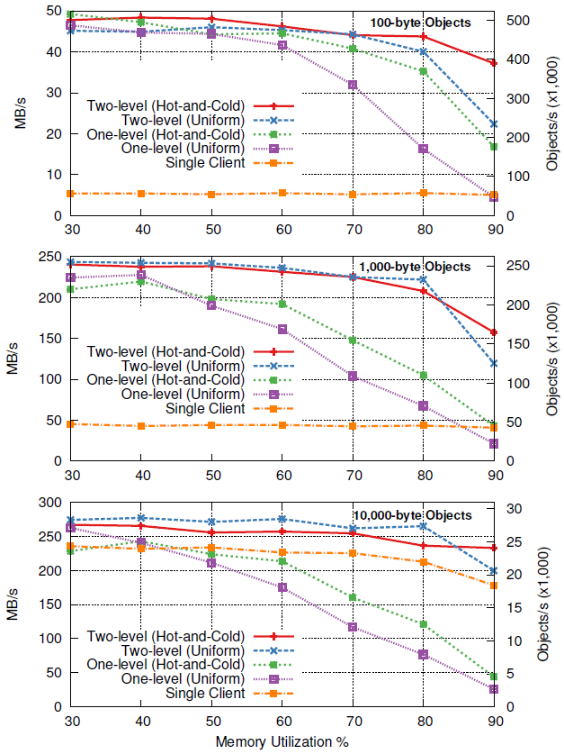
Log-Structured Memory, cont’d
Creates tradeoff:
Performance vs. utilization
Two-level cleaner:
Disk and memory
Memory only (compaction)
Concurrent cleaning
Multiple cleaner threads
80-90% memory utilization feasible
Paper under submission

Slide 8
RAMCloud RPC
Applications/Servers
RPC Stubs
TCP
Infiniband
Queue Pairs
Custom Datagram
Transports
UDP
InfUD
InfEth
Networks
Transport layer enables experimentation with different networking protocols/technologies
Basic Infiniband performance (one switch):
100-byte reads: 4.9 µs
100-byte writes (3x replication): 15.3 µs
Read throughput (100 bytes, 1 server): 700 Kops/sec

Slide 9
RAMCloud Crash Recovery
Each master scatters segment replicas across entire cluster
On crash:
Coordinator partitions dead master’s tablets.
Partitions assigned to different recovery masters
Log data shuffled from backups to recovery masters
Recovery masters replay log entries
Total recovery time: 1-2s
Recovery Masters
Backups
Crashed Master

Slide 10
Status at June 2012 Retreat
Major system components (barely) working:
RPC transports (timeout mechanism new)
Basic key-value store (variable-length keys new)
Log-structured memory management (log cleaner new)
Crash recovery (backup recovery new)
Coordinator overhaul just starting
Overall project goal: push towards a 1.0 release
“Least usable system” for real applications

Slide 11
Current Status
Core system becoming stable
Not quite at 1.0, but close!
First PhDs coming soon:
Ryan Stutsman: crash recovery
Steve Rumble: log-structured memory
Many research opportunities still left
About to start new projects:
Higher-level data model
New RPC mechanism
Cluster management

Slide 12
Progress Towards RAMCloud 1.0
Fault-tolerant coordinator (Ankita Kejriwal):
Server and tablet configuration info now durable
LogCabin configuration manager (Diego Ongaro)
Additional recovery mechanisms (Ryan Stutsman):
Simultaneous server failures
Cold start
Overhaul of backup storage management
RPC retry (John Ousterhout)
Overhaul of cluster membership management (Stephen Yang)
More robust
Better performance

Slide 13
Progress Towards 1.0, cont’d
New in-memory log architecture (Steve Rumble)
Automated crash tester (Arjun Gopalan):
Synthetic workload with consistency checks
Force servers to crash randomly
Multiple simultaneous failures, coordinator failures
Goal: run crash tester for a few weeks with no loss of data
Current status:
Can survive some coordinator and master failures
Others causing crashes
Working through bugs

Slide 14
Configuration Management
External system for durable storage of top-level configuration information:
Cluster membership
Tablet configuration
Typically consensus-based:
Chubby (Google)
ZooKeeper (Yahoo/Apache)
Unhappy with ZooKeeper, so decided to build our own (Diego Ongaro):
Development started before last year’s retreat
Initial plan: use Paxos protocol
Backup Coordinator
Coordinator
Configuration Management Servers

Slide 15
New Consensus Algorithm: Raft
Paxos is “industry standard”, but:
Very hard to understand
Not a good starting point for real implementations
Our new algorithm: Raft
Primary design goal: understandability
Also must be practical and complete
Result: new approach to consensus
Design for replicated log from start
Strong leader
User study shows that Raft is significantly easier to understand than Paxos (stay tuned ...)
Paper under submission

Slide 16
API for Consensus
Key-value store (Chubby, ZooKeeper)?
Applications really want a log?
Why build a log on a key-value-store on a log?
Collection of logs (LogCabin)?
First approach for RAMCloud, based on Raft
Used in current coordinator implementation
However, log turned out not to be convenient after all
TreeHouse: key-value store on Raft?
Export API for replicated state machine?
?API?
Replicated State Machine
Replicated Log

Slide 17
New Work: Data Model
Goal: higher-level data model than just key-value store:
Secondary indexes?
Transactions spanning multiple objects and servers?
Graph-processing primitives (sets)?
Can RAMCloud support these without sacrificing
Latency
Scalability
Design work just getting underway (Ankita Kejriwal)

Slide 18
New Work: Datacenter RPC
Complete redesign of RAMCloud RPC
General purpose (not just RAMCloud)
Latency:
Even lower latency?
Explore alternative threading strategies
Scale:
Support 1M clients/server (minimal state/connection)
Network protocol/API:
Optimize for kernel bypass
Minimize buffering
Congestion control: reservation based?

Slide 19
Current Status
Core system becoming stable
Not quite at 1.0, but close!
First PhDs coming soon:
Ryan Stutsman: crash recovery
Steve Rumble: log-structured memory
Many research opportunities still left
About to start new projects:
Higher-level data model
New RPC mechanism
Cluster management

