Slide 1
Log-Structured Memory for DRAM-Based Storage
Stephen Rumble and John Ousterhout
Stanford University

Slide 2
Introduction
Storage allocation: the impossible dream
Fast allocation/deallocation
Efficient use of memory
Handle changing workloads
RAMCloud: log-structured allocator
Incremental garbage collector for both disk and DRAM
Two-level approach to cleaning (separate policies for disk and DRAM)
Concurrent cleaning
Results:
High performance even at 80-90% memory utilization
No pauses
Handles changing workloads

Slide 3
RAMCloud Overview
Datacenter storage system
Key-value store
All data in DRAM at all times
Disk/flash for backup only
Large scale:
1000-10000 servers
100TB - 10PB capacity
Low latency:
5µs remote access
1000 – 100,000 Application Servers
Appl.
Appl.
Appl.
…
Appl.
Library
Library
Library
Library
Datacenter Network
Coordinator
Master
Master
Master
…
Master
Backup
Backup
Backup
Backup
1000 – 10,000 Storage Servers

Slide 4
Workload Sensitivities
Allocators waste memory if workloads change:
E.g., W2 (simulates schema change):
Allocate 100B objects
Gradually overwrite with 130B objects
All existing allocators waste at least 50% of memory under some conditions

Slide 5
Non-Copying Allocators
Blocks cannot be moved once allocated
Result: fragmentation
Current memory layout:
Space needed
Free areas

Slide 6
Copying Allocators
Garbage collector moves objects, coalesces free space
Expensive, scales poorly:
Must scan all memory to find and update pointers
Only collect when there is lots of free space
State of the art: 3-5x overallocation of memory
Long pauses: 3+ seconds for full GC
Before collection:
After collection:

Slide 7
Storage System Goals
Use memory efficiently even with workload changes (80-90% utilization)
Must use a copying approach
Must be able to collect free space incrementally:
Pick areas with most free space
Avoid long pauses
Key advantage: restricted use of pointers
Pointers stored in index structures
Easy to locate pointers for a given memory block

Slide 8
Log-Structured Storage
Master Server
Hash Table
Log head: add next object here
{table id, object key}
Log
8 MB Segments
B17
B86
B22
B3
B72
B66
B49
B3
B16
Each segment replicated on disks of 3 backup servers

Slide 9
Log Cleaning
Pick segments with lots of free space
Copy live objects (survivors) into new segment(s)
Free cleaned segments (use for new objects)
Cleaning is incremental

Slide 10
Cleaning Cost
Cleaning cost increases with memory utilization
U: fraction of bytes still live in cleaned segments
Conflict between disk and memory
Initial RAMCloud implementation: clean disk and memory together
Better to run disk at low utilization to reduce cleaning costs
But, this would mean low utilization of DRAM too
Bytes copied by cleaner | U | 0.5 | 0.8 | 0.9 | 0.99
Bytes freed | 1-U | 0.5 | 0.2 | 0.1 | 0.01
Bytes copied/byte freed | U/(1-U) | 1.0 | 4.0 | 9.0 | 99.0

Slide 11
Two-Level Cleaning
DRAM
Disk
Compaction:
Clean single segment in memory
Free unused memory space
No change to disk log
DRAM
Disk
Combined Cleaning:
Clean multiple segments
Write new survivor segments (disk & memory)
Free old segments (disk & memory)
DRAM
Disk

Slide 12
Two-Level Cleaning, cont’d
Best of both worlds:
Optimize utilization of memory (can afford high bandwidth cost for compaction)
Optimize disk bandwidth (can afford extra disk space to reduce cleaning cost)

Slide 13
Parallel Cleaning
Cleaner runs concurrently with normal requests
Log is immutable (no updates in place)
Survivor data written to “side log”
No competition for log head
Synchronization points:
Updates to hash table (cleaner moves object while being read/written)
Adding survivor segments to log
Freeing cleaned segments (wait for active requests to complete)
...
Log Head
Survivor
Segments
...
Log Head
...
Log Head

Slide 14
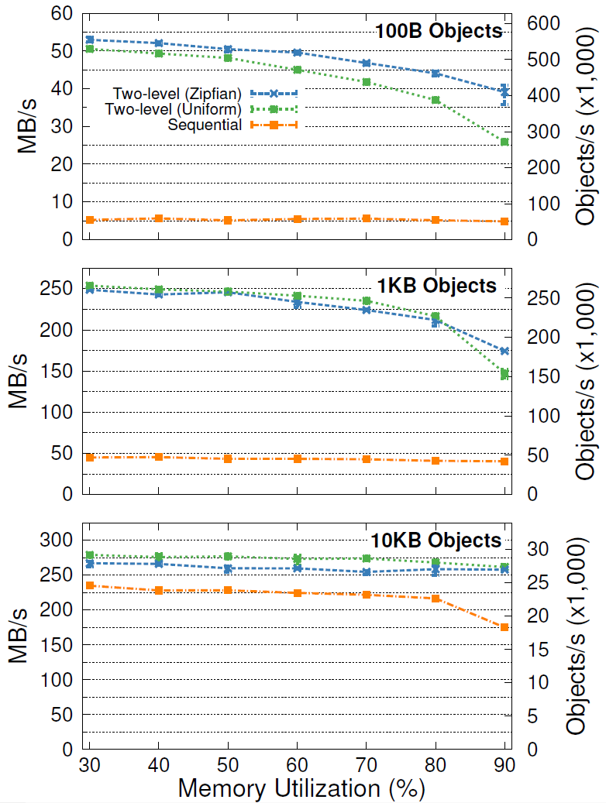
Client Write Throughput
Memory Performance
Utilization Degradation
80% 17-27%
90% 26-49%
80% 14-15%
90% 30-42%
80% 3-4%
90% 3-6%

Slide 15
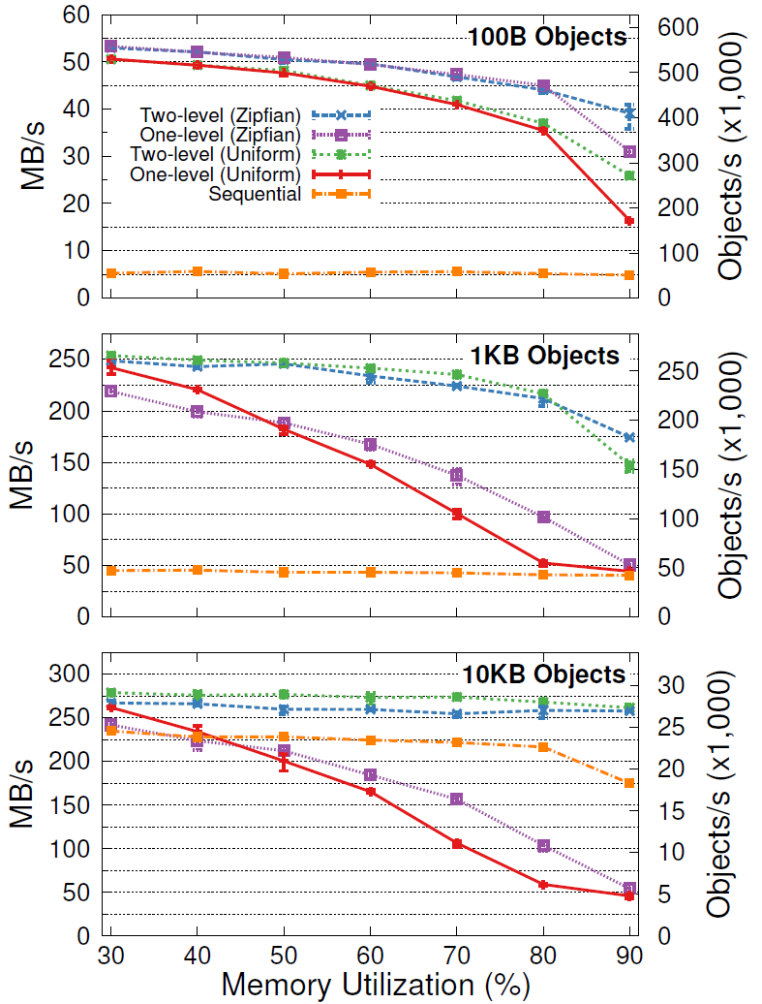
1-Level vs. 2-Level Cleaning
One-Level
Cleaning

Slide 16
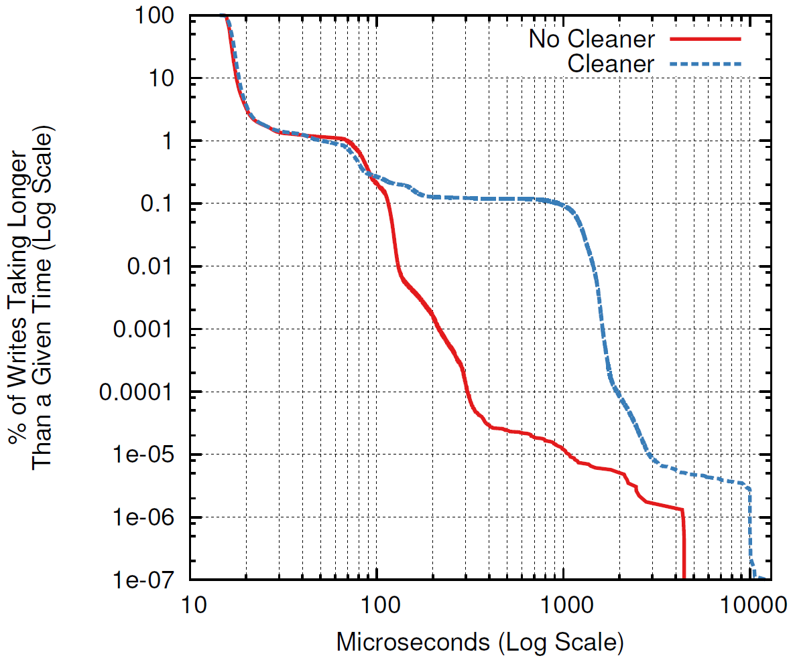
Cleaner’s Impact on Latency
100B overwrites, no locality
Median:
With cleaning: 16.70µs
No cleaner: 16.35µs
99.9%:
With cleaning: 900µs
No cleaner: 115µs

Slide 17
Conclusion
Logging approach to storage allocation works well if pointers are restricted
Allows 80-90% memory utilization
Good performance independent of workload
Supports concurrent cleaning: no pauses
Works particularly well in RAMCloud
Manage both disk and DRAM with same mechanism
Also makes sense for other DRAM-based storage systems (see paper for details)

Slide 18
Client Throughput
80%: 17-27% degradation
90%: 26-49% degradation
80%: 14-15% degradation
90%: 30-42% degradation
80%: 3-4% degradation
90%: 3-6% degradation

Slide 19
Tombstones
Server crash? Replay log on other servers to reconstruct lost data
Tombstones identify deleted objects:
Written into log when object deleted or overwritten
Info in tombstone:
Table id
Object key
Version of dead object
Id of segment where object stored
When can tombstones be deleted?
After segment containing object has been cleaned (and replicas deleted on backups)
Note: tombstones are a mixed blessing

