Slide 1
Log-Structured Memory for DRAM-Based Storage
Stephen Rumble, Ankita Kejriwal, and John Ousterhout
Stanford University

Slide 2
Introduction
Traditional memory allocators can’t provide all of
Fast allocation/deallocation
Handle changing workloads
Efficient use of memory
RAMCloud: log-structured allocator
Incremental copying garbage collector
Two-level approach to cleaning (separate policies for disk and DRAM)
Concurrent cleaning (no pauses)
Results:
High performance even at 80-90% memory utilization
Handles changing workloads
Makes sense for any DRAM-based storage system

Slide 3
RAMCloud Overview
1000 – 100,000 Application Servers
Appl.
Appl.
Appl.
…
Appl.
5µs RTT for small RPCs
Library
Library
Library
Library
Datacenter Network
Durable replica storage for crash recovery
Coordinator
Master
Master
Master
…
Master
Backup
Backup
Backup
Backup
Key-value store 32-256 GB DRAM
1000 – 10,000 Storage Servers
All data in DRAM at all times

Slide 4
Workload Sensitivities
glibc malloc: 20 GB memory to hold 10 GB data under workload W8:
Allocate many 50-150B objects
Then delete 90%, write new 5-15KB objects
7 memory allocators, 8 workloads
Total live data constant (10 GB)
But workload changes (except W1)
All allocators waste at least 50% of memory in some situations

Slide 5
Non-Copying Allocators
Blocks cannot be moved once allocated
Result: fragmentation
Free areas

Slide 6
Copying Garbage Collectors
Before collection:
After collection:
Must scan all memory to update pointers
Expensive, scales poorly
Wait for lots of free space before running GC
State of the art: 3-5x overallocation of memory
Long pauses: 3+ seconds for full GC

Slide 7
Allocator for RAMCloud
Requirements:
Must use copying approach
Must collect free space incrementally
Storage system advantage: pointers restricted
Pointers stored in index structures
Easy to locate pointers for a given memory block
Enables incremental copying
Can achieve overall goals:
Fast allocation/deallocation
Insensitive to workload changes
80-90% memory utilization

Slide 8
Log-Structured Storage
Master Server
Hash Table
Log head: add next object here
{table id, object key}
Immutable Log
8 MB Segments
B17
B86
B22
B3
B72
B66
B49
B3
B16
Each segment replicated on disks of 3 backup servers

Slide 9
Log Cleaning
Pick segments with lots of free space:
Copy live objects (survivors):
Free cleaned segments (and backup replicas)
Cleaning is incremental
Log
Log
Log

Slide 10
Cleaning Cost
U: fraction of live bytes in cleaned segments
0.5
0.9
0.99
Bytes copied by cleaner (U)
0.5
0.5
1.0
0.9
0.1
9.0
0.99
0.01
99.0
Bytes freed (1-U)
Bytes copied/byte freed (U/(1-U))
Capacity
Bandwidth
Memory
expensive
cheap
Conflicting Needs:
Disk
cheap
expensive
Need different policies for cleaning disk and memory

Slide 11
Two-Level Cleaning
DRAM
Backups
Compaction:
Clean single segment in memory
No change to replicas on backups
DRAM
Backups
Combined Cleaning:
Clean multiple segments
Free old segments (disk & memory)
DRAM
Backups

Slide 12
Two-Level Cleaning, cont’d
Best of both worlds:
Optimize utilization of memory (can afford high bandwidth cost for compaction)
Optimize disk bandwidth (can afford extra disk space to reduce cleaning cost)

Slide 13
Parallel Cleaning
...
Survivor data written to “side log”
No competition for log head
Different backups for replicas
Synchronization points:
Updates to hash table
Adding survivor segments to log
Freeing cleaned segments
Log Head
Survivor
Segments
...
Log Head
...
Log Head

Slide 14
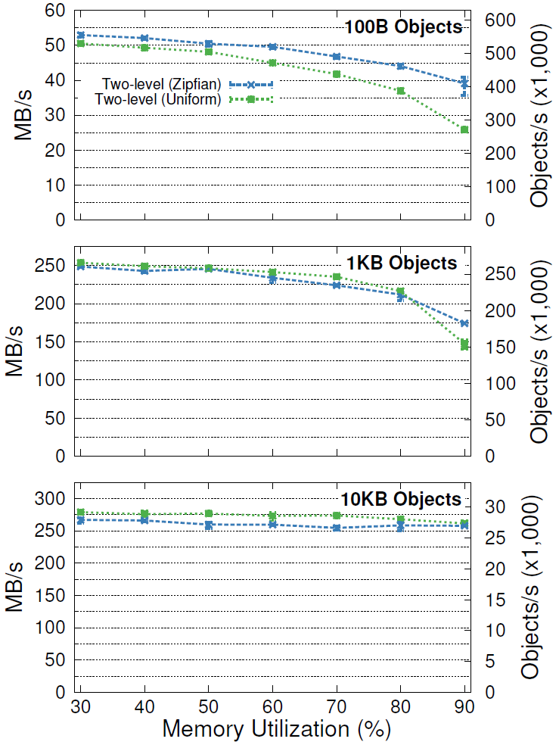
Throughput vs. Memory Utilization
Memory Performance
Utilization Degradation
80% 17-27%
90% 26-49%
80% 14-15%
90% 30-42%
80% 3-4%
90% 3-6%
1 master,
3 backups,
1 client,
concurrent multi-writes

Slide 15
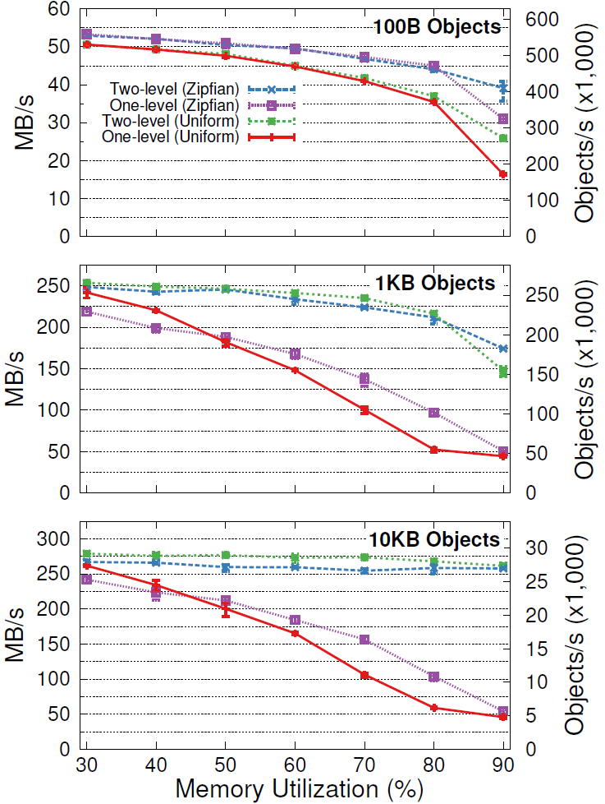
1-Level vs. 2-Level Cleaning
One-level Cleaning

Slide 16
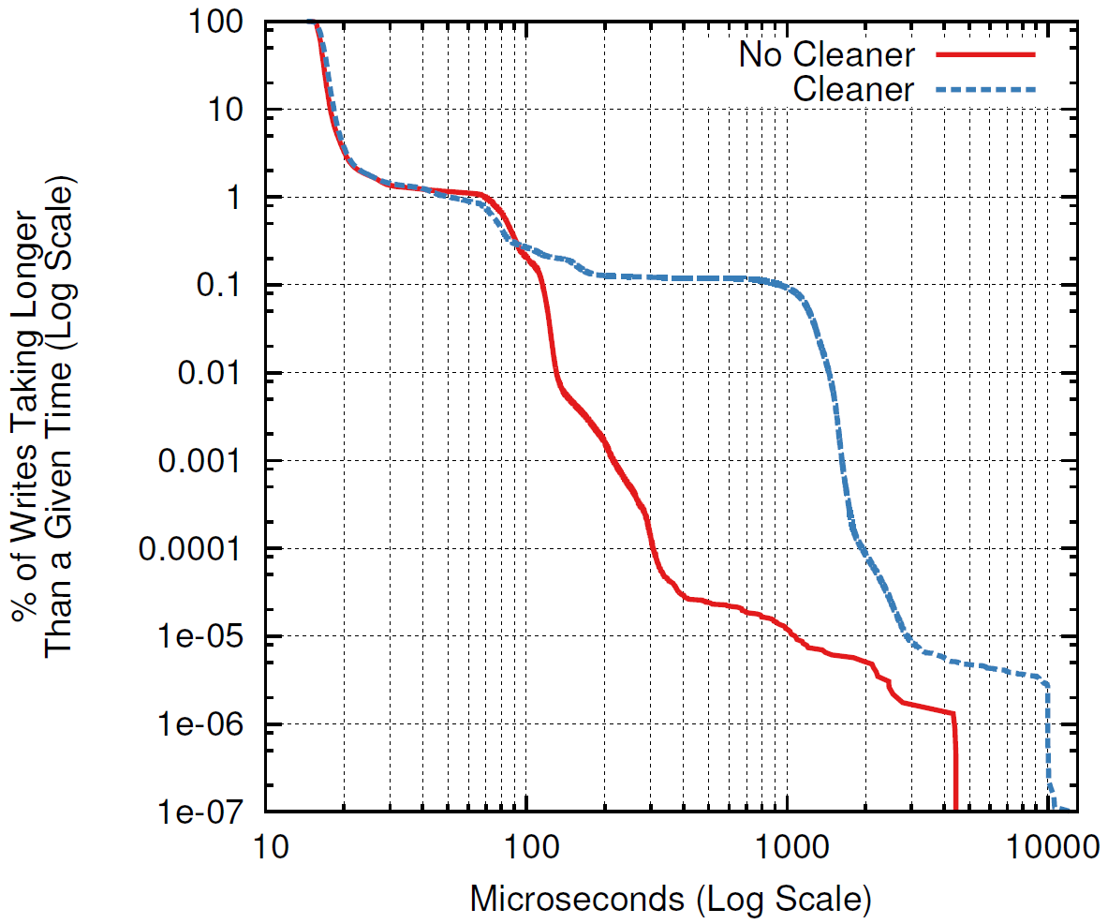
Cleaner’s Impact on Latency
1 client, sequential 100B overwrites, no locality, 90% utilization
Median:
With cleaning: 16.70µs
No cleaner: 16.35µs
99.9th %ile:
With cleaning: 900µs
No cleaner: 115µs

Slide 17
Additional Material in Paper
Tombstones: log entries to mark deleted objects
Mixed blessing: impact cleaner performance
Preventing memory deadlock
Need space to free space
Fixed segment selection defect in LFS
Modified memcached to use log-structured memory:
15-30% better memory utilization
3% higher throughput
Negligible cleaning cost (5% CPU utilization)
YCSB benchmarks vs. HyperDex and Redis:
RAMCloud better except vs. Redis under write-heavy workloads with slow RPC.

Slide 18
Related Work
Storage allocators and garbage collectors
Performance limited by lack of control over pointers
Some slab allocators almost log-like (slab <=> segment)
Log-structured file systems
All info in DRAM in RAMCloud (faster, more efficient cleaning)
Other large-scale storage systems
Increasing use of DRAM: Bigtable/LevelDB, Redis, memcached, H-Store, ...
Log-structured mechanisms for distributed replication
Tombstone-like objects for deletion
Most use traditional memory allocators

Slide 19
Conclusion
Logging approach is an efficient way to allocate memory (if pointers are restricted)
Allows 80-90% memory utilization
Good performance (no pauses)
Tolerates workload changes
Works particularly well in RAMCloud
Manage both disk and DRAM with same mechanism
Also makes sense for other DRAM-based storage systems

Slide 20
Tombstones
Server crash? Replay log on other servers to reconstruct lost data
Tombstones identify deleted objects:
Written into log when object deleted or overwritten
Info in tombstone:
Table id
Object key
Version of dead object
Id of segment where object stored
When can tombstones be deleted?
After segment containing object has been cleaned (and replicas deleted on backups)
Note: tombstones are a mixed blessing

