Slide 1
What We Have Learned From RAMCloud
John Ousterhout
Stanford University
(with Asaf Cidon, Ankita Kejriwal, Diego Ongaro, Mendel Rosenblum, Stephen Rumble, Ryan Stutsman, and Stephen Yang)

Slide 2
Introduction
A collection of broad conclusions we have reached during the RAMCloud project:
Randomization plays a fundamental role in large-scale systems
Need new paradigms for distributed, concurrent, fault-tolerant software
Exciting opportunities in low-latency datacenter networking
Layering conflicts with latency
Don’t count on locality
Scale can be your friend

Slide 3
RAMCloud Overview
Harness full performance potential of large-scale DRAM storage:
General-purpose key-value storage system
All data always in DRAM (no cache misses)
Durable and available
Scale: 1000+ servers, 100+ TB
Low latency: 5-10µs remote access
Potential impact: enable new class of applications

Slide 4
RAMCloud Architecture
1000 – 100,000 Application Servers
Appl.
Appl.
Appl.
…
Appl.
Library
Library
Library
Library
High-speed networking:
5 µs round-trip
Full bisection bwidth
Datacenter Network
Coordinator
Commodity Servers
Master
Master
Master
…
Master
32-256 GB per server
Backup
Backup
Backup
Backup
1000 – 10,000 Storage Servers

Slide 5
Randomization
Randomization plays a fundamental role in large-scale systems
Enables decentralized decision-making
Example: load balancing of segment replicas. Goals:
Each master decides where to replicate its own segments: no central authority
Distribute each master’s replicas uniformly across cluster
Uniform usage of secondary storage on backups
Masters
M1, S2
M2, S1
M3, S9
M1, S3
M2, S4
M3, S11
M1, S8
M3, S12
M3, S13
Backups
M1, S8
M3, S12
M3, S12
M2, S1
M1, S3
M2, S4
M3, S13
M2, S4
M1, S3
M1, S8
M1, S2
M3, S9
M2, S1
M3, S11
M1, S2
M3, S9
M3, S11
M3, S13

Slide 6
Randomization, cont’d
Choose backup for each replica at random?
Uneven distribution: worst-case = 3-5x average
Use Mitzenmacher’s approach:
Probe several randomly selected backups
Choose most attractive
Result: almost uniform distribution

Slide 7
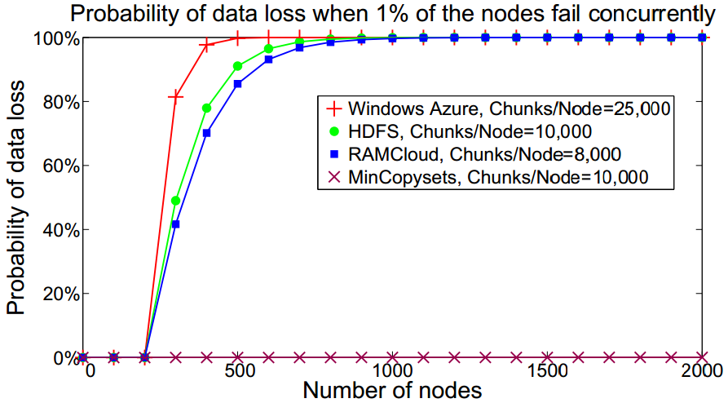
Sometimes Randomization is Bad!
Select 3 backups for segment at random?
Problem:
In large-scale system, any 3 machine failures results in data loss
After power outage, ~1% of servers don’t restart
Every power outage loses data!
Solution: derandomize backup selection
Pick first backup at random (for load balancing)
Other backups deterministic (replication groups)
Result: data safe for hundreds of years
(but, lose more data in each loss)

Slide 8
DCFT Code is Hard
RAMCloud often requires code that is distributed, concurrent, and fault tolerant:
Replicate segment to 3 backups
Coordinate 100 masters working together to recover failed server
Concurrently read segments from ~1000 backups, replay log entries, re-replicate to other backups
Traditional imperative programming doesn’t work
Result: spaghetti code, brittle, buggy
Must “go back”
after failures

Slide 9
DCFT Code: Need New Pattern
Experimenting with new approach: more like a state machine
Code divided into smaller units
Each unit handles one invariant or transition
Event driven (sort of)
Serialized access to shared state
These ideas are still evolving
Shared State

Slide 10
Low-Latency Networking
Datacenter evolution, phase #1: scale
Datacenter evolution, phase #2: latency
Typical round-trip in 2010: 300µs
Feasible today: 5-10µs
Ultimate limit: < 2µs
No fundamental technological obstacles, but need new architectures:
Must bypass OS kernel
New integration of NIC into CPU
New datacenter network architectures (no buffers!)
New network/RPC protocols: user-level, scale, latency (1M clients/server?)

Slide 11
Layering Conflicts With Latency
Most obvious way to build software: lots of layers
For low latency, must rearchitect with fewer layers
Application
Developed bottom-up
Problems:
Complex
High latency
Layers typically “thin”
Network
Application
Harder to design (top-down and bottom-up)
But, better architecturally (simpler)
Network

Slide 12
Don’t Count On Locality
Greatest drivers for software and hardware systems over last 30 years:
Moore’s Law
Locality (caching, de-dup, rack organization, etc. etc.)
Large-scale Web applications have huge datasets but less locality
Long tail
Highly interconnected (social graphs)
Traditional applications
Frequency
Web applications
Items

Slide 13
Make Scale Your Friend
Large-scale systems create many problems:
Manual management doesn’t work
Reliability is much harder to achieve
“Rare” corner cases happen frequently
However, scale can be friend as well as enemy:
RAMCloud fast crash recovery
Use 1000’s of servers to recover failed masters quickly
Since crash recovery is fast, “promote” all errors to server crashes
Windows error reporting (Microsoft)
Automated bug reporting
Statistics identify most important bugs
Correlations identify buggy device drivers

Slide 14
Conclusion
Build big => learn big
My pet peeve: too much “summer project research”
2-3 month projects
Motivated by conference paper deadlines
Superficial, not much deep learning
Trying to build a large system that really works is hard, but intellectually rewarding:
Exposes interesting side issues
Important problems identify themselves (recurrences)
Deeper evaluation (real use cases)
Shared goal creates teamwork, intellectual exchange
Overall, deep learning

