Slide 1
Platform Lab Overview and Update
John Ousterhout
Faculty Director

Slide 2
Thank You, Sponsors!

Slide 3
Special Thanks To...

Slide 4
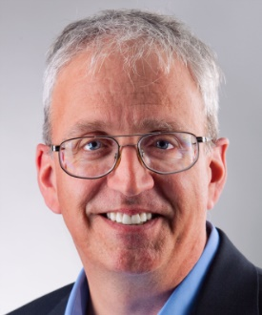
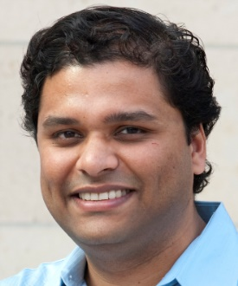
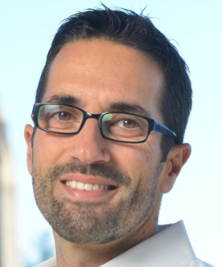
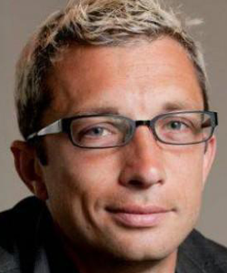
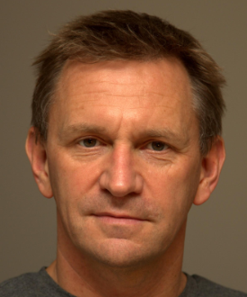
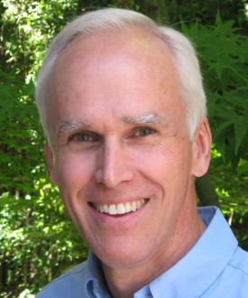
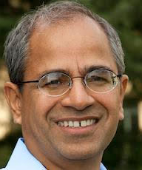
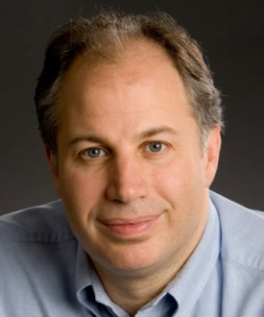
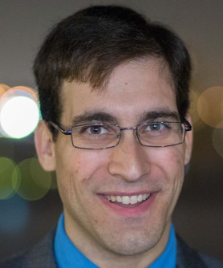
Platform Lab Faculty
Bill Dally
Sachin Katti
Christos Kozyrakis
Phil Levis
Nick McKeown
John Ousterhout Faculty Director
Guru Parulkar Executive Director
Mendel Rosenblum
Keith Winstein

Slide 5
Platform Lab Overview
Platform: general-purpose substrate
Software and/or hardware
Makes it easier to build applications or higher-level platforms
Solves significant problems
Usually introduces some restrictions
Recent examples
HTTP + HTML + Javascript
GFS + MapReduce
Smart phones + GPS
OpenFlow
New platforms enable new applications

Slide 6
Platform Lab Mission
Create the next generation of platforms Stimulate new classes of applications
Variety of projects
Mostly focused on computing at scale:
Datacenters
Networks
One or two flagship projects
Magnets for collaboration
Current flagship: Big Control

Slide 7
Lab History
VMware challenge: think big!
Transition retreat:
SEDCL, PL
NSF Expedition pre-proposal: Big Control
Founding gift from VMURF
Winter Review
2014
2015
2016
Discussions
with VMware
Other companies join lab as affiliates
Kickoff faculty retreat
Today: 2016 Retreat

Slide 8
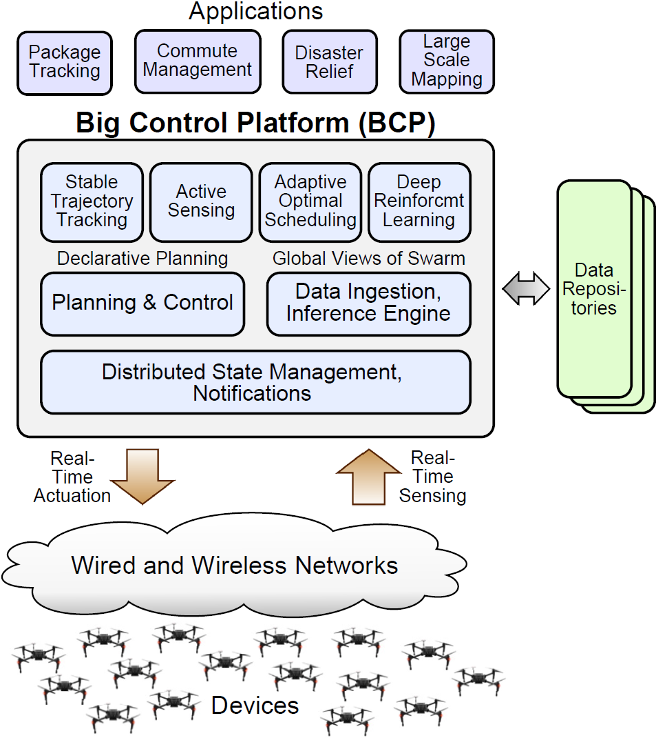
Flagship Project: Big Control
Infrastructure for collaborative device swarms
Many related research challenges:
Networking (wide area, datacenter)
Low-latency datacenter technologies
State management, notifications
Data ingestion, inference
Declarative planning
Security
Applications
Submitted NSF Expedition proposal
Includes other faculty in CS, EE, Aero/Astro
Next talk will discuss in detail

Slide 9
Major Research Thrusts
Programmable fabrics (Cisco, Google, Facebook, VMware)
Pisces: P4 front-end for OVS scheduling (Choi)
PIFO: new abstraction for packet scheduling
Low-latency datacenter (Facebook)
Homa network protocol for RPCs (Montazeri)
Core-aware thread scheduling (Qin)
IX operating system (Belay)
Indexes and transactions in RAMCloud (Kejriwal, Lee, Park, Yang)
Cliffhanger: better memcached memory allocation (Cidon, Eisenman)
Scalable control planes (VMware)
Discussion group (Stanford, VMware, ONLab)

Slide 10
Major Research Thrusts, cont’d
Resource-efficient datacenters
ML and dynamic control in cluster management (Delimitrou)
Starling HPC scheduler (Qu, Mashayekhi, Terei)
IX operating system (Belay)
Flash disaggregation (Klimovic, Litz)
XFabric: bandwidth allocation in datacenters (Nagaraj, Bharadia)
Hardware support for deep neural networks
Pruning, compression, acceleration (Han, Liu)
In-memory graph processing systems
Grazelle (Grossman)
TorcDb (Ellithorpe)

Slide 11
Major Research Thrusts, cont’d
Application-transport codesign for better networking performance (Facebook):
DrCloud: cluster job planner (Terei, Mashtizadeh, Qu)
ExCamera: massively distributed video encoder (Fouladi, Wahby)
Koho: utility-maximizing transport for the developing world (Hill, Yan)

Slide 12
Recent/Soon-To-Be Graduates
Adam Belay OSes for low latency and high throughput MIT
Dinesh Bharadia Full-duplex radios Postdoc
Christina Delimitrou Resource-efficient datacenter management Cornell
Subhasis Das Cache (re)placement policies Zoox
Kiran Joshi Sensing using wireless signals startup
Ankita Kejriwal Secondary indexes for RAMCloud
Rakesh Misra Low latency control for wireless networks startup
Milad Mohadammi Energy-efficient out-of-order execution Apple
Nic McDonald Service-oriented NIC architectures
Yiannis Yiakoumis User-defined networks

Slide 13
Retreat Agenda Highlights
Numerous technical talks
Breakout discussions:
Applications for Big Control (today)
Technologies for Big Control (tomorrow)
Lightning talks and poster session (today)
Long break for recreation/discussion (tomorrow)
Industrial feedback (tomorrow)

Slide 14
Conclusion
Momentum continues to build
Expect new projects to start over the next year
More aligned with Big Control
Initial projects likely to be exploratory, possibly throw-away
Looking for opportunities to collaborate on Big Control

Slide 15
Questions/Discussion

Slide 16
Groups for Breakout #1
Group #1
Stephen Choi
E. Cidon
B. Dally
C. Delimitrou
S. Park
G. Parulkar
H. Qu
S. Rao
I. Tarazi
B. Welch
Group #2
W-P. Chen
Sean Choi
R. Clewett
S. Katti
H. Litz
M. Rosenblum
J. Speiser
Y. Turakhia
K. Voruganti
Y. Wang
Group #3
M. Aguilera
J. Ellithorpe
S. Grossman
S. Han
T. Ikeuchi
P. Levis
S. Matsushita
H. Qin
A. Takacs
K. Winstein
Group #4
P. Bailis
M. Bansal
A. Kejriwal
J. Kempf
N. McKeown
M. Morimoto
P. Palacharla
C. Ramming
S. Yang
Group #5
T. Herbert
K. Malladi
C. Lee
J. Ousterhout
O. Mashayekhi
B. Prabhakar
A. Schulman
R. Sriram
P. Subrahmanyam

Slide 17
Groups for Breakout #2
Group #1
M. Aguilera
P. Bailis
W-P. Chen
Stephen Choi
P. Levis
K. Malladi
M. Morimoto
G. Parulkar
A. Schulman
J. Speiser
Group #2
M. Bansal
Sean Choi
E. Cidon
B. Dally
J. Ellithorpe
C. Lee
S. Matsushita
P. Palacharla
H. Qu
P. Subrahmanyam
Group #3
R. Clewett
S. Grossman
S. Katti
A. Kejriwal
J. Ousterhout
H. Qin
S. Rao
C. Ramming
K. Voruganti
R. Sriram
Group #4
C. Delimitrou
S. Han
J. Kempf
O. Mashayekhi
B. Prabhakar
A. Takacs
I. Tarazi
Y. Wang
K. Winstein
Group #5
T. Herbert
T. Ikeuchi
H. Litz
N. McKeown
S. Park
M. Rosenblum
Y. Turakhia
B. Welch
S. Yang

