Slide 1
SEDCL/Platform Lab Retreat
John Ousterhout Stanford University

Slide 2
Transition
SEDCL
Platform Lab
More faculty
More students
Existing projects will carry over
Broader research agenda

Slide 3
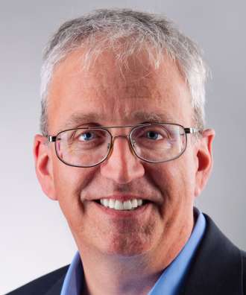
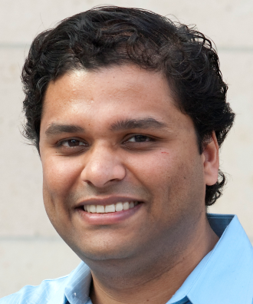
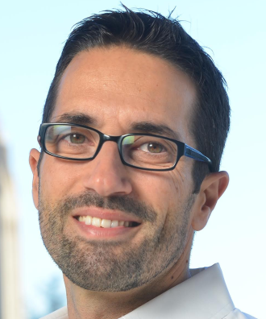
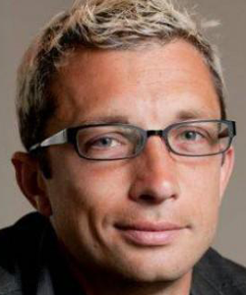
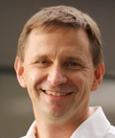
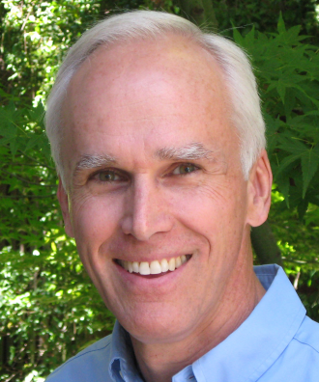
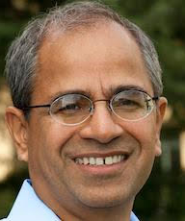
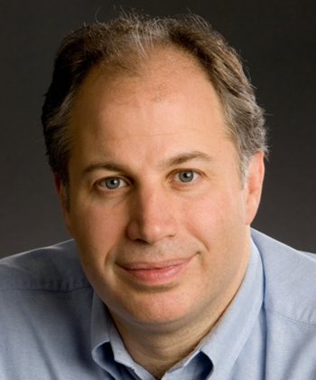
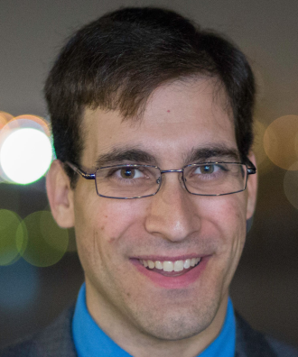
Platform Lab Faculty
Bill Dally
Sachin Katti
Christos Kozyrakis
Phil Levis
Nick McKeown
John Ousterhout Faculty Director
Guru Parulkar Executive Director
Mendel Rosenblum
Keith Winstein

Slide 4
Platform Lab Vision
New platforms enable new applications
Platforms
Large Systems
Collaboration

Slide 5
What is a Platform?
General-purpose substrate
Makes it easier to build applications or higher-level platforms
Solves significant problems
Usually introduces some restrictions
Software and/or hardware
Example: Map/Reduce computational model
Simplifies construction of applications that use hundreds of servers to compute on large datasets
Hides communication latency: data transferred in large blocks
Automatically handles failures & slow servers
Restrictions: 2 levels of computation, sequential data access

Slide 6
New Platforms Enable New Applications
1980’s:
Platform: relational database
Applications: enterprise applications
1990’s:
Platform: HTTP + HTML + JavaScript
Applications: online commerce
2000’s:
Platform: GFS + MapReduce
Applications: large-scale analytics
2010’s:
Platform: smart phones + GPS
Applications: Uber and many others

Slide 7
“Seed Platforms” for the Platform Lab
Software-defined networking:
Separates network control and data planes
Makes it easier to build novel control/management applications
RAMCloud:
High-speed key-value store for datacenters
All data in DRAM for low-latency access
Makes it easier to build applications using DRAM-based storage

Slide 8
Large Systems
Most universities can’t do large systems projects
Fragmented funding model
Promotions determined by paper counts, not impact
Result: short-term outlook
Why universities should do large systems projects:
Companies don’t have time to evaluate, find best approach
Universities can lead the market
Produce better graduates
Goal for Platform Lab:
Create environment where large systems projects flourish

Slide 9
Collaboration
Forces against collaboration:
Faculty overcommitment
Diversity of interests
Physical space
Best way to generate collaboration:
Shared research goals
Large projects require collaboration
Other ways to stimulate collaboration
Events: seminars, reading groups, group lunches, etc.
Physical space

Slide 10
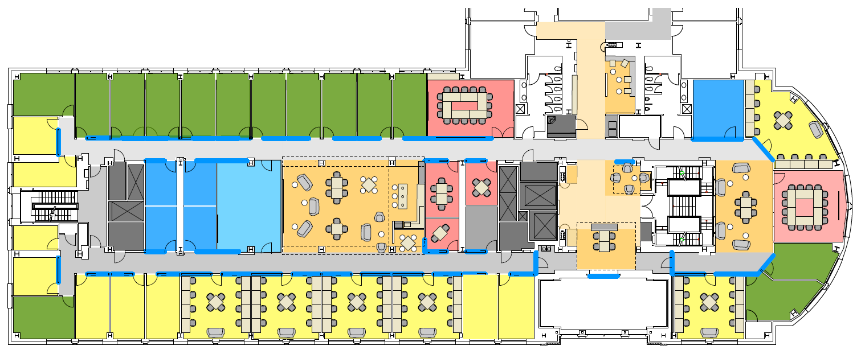
Collaboration, cont’d
Can physical space help?
Planning major renovation of Gates 3A:
Nothing but glass from window to window
Sight lines between researchers
Open space for casual conversation

Slide 11
Faculty Retreat, April 3-4
Attendees
Platform Lab faculty (9)
Non-lab faculty
Mark Horowitz
Chris Re
Friends from industry:
Keith Adams (Facebook)
Mahesh Balakrishnan (VMware)
Jeff Dean (Google)
Goals
Brainstorm possible research topics
Discuss lab organization: how to maximize collaboration

Slide 12
Fundamental Challenges
Achieve physical limits
Heterogeneity and specialization
General-purpose systems fundamentally inefficient
Scalability and elasticity
Raise the floor for developer productivity

Slide 13
Research Areas to Explore
Programmable network fabrics (Katti, Levis, McKeown, Ousterhout, Parulkar)
Low-latency datacenter (Dally, Katti, Kozyrakis, Levis, Ousterhout)
Infrastructure for scalable control planes (Katti, Ousterhout, Parulkar)
New memory/storage systems for the 21st Century (Dally, Kozyrakis, Levis)

Slide 14
Agenda for this Retreat
Future-looking faculty talks
Break-out sessions for discussing research topics
Student talks
Long break for outdoor activities, informal discussions
Last session: industrial feedback

Slide 15
Transition Details for Affiliates
Lab structure similar to SEDCL
Existing SEDCL agreements carry over
All results released open-source
Two levels of affiliate membership
Base level similar to SEDCL Associate
New premium level for companies interested in higher level of engagement

Slide 16
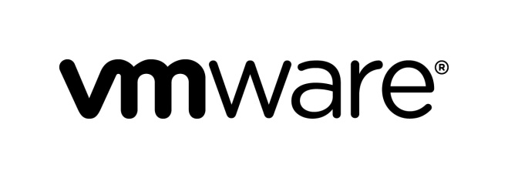
Thanks to our Affiliate Sponsors!

Slide 17
Extra Slides

Slide 18
Palette

Slide 19
What is a Platform?
General-purpose substrate
Makes it easier to build applications or higher-level platforms
Solves significant problems
Usually introduces some restrictions
Software and/or hardware
Example: Map/Reduce computational model
Simplifies construction of applications that use ~1000 servers on large datasets
Hides communication latency: data transferred in large blocks
Automatically handles failures & slow servers
Restrictions: 2 levels of computation, sequential data access
Computation
Data

