Slide 1
2016 Winter Review: Lab Overview and Update
John Ousterhout
Faculty Director

Slide 2
Thank You, Sponsors!
(soon...)

Slide 3
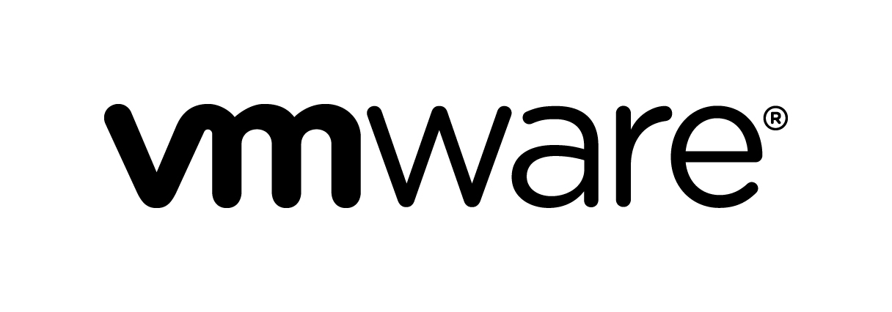
Special Thanks To...

Slide 4
Platform Lab Motivation
New platforms enable new applications
Platform: general-purpose substrate
Software and/or hardware
Makes it easier to build applications or higher-level platforms
Solves significant problems
Usually introduces some restrictions
Example: Map/Reduce computational model
Simplifies construction of applications that use hundreds of servers to compute on large datasets
Hides communication latency: data transferred in large blocks
Masks failures & slow servers
Restrictions: 2 levels of computation, sequential data access

Slide 5
Platform Lab Mission
Create the next generation of platforms to stimulate new classes of applications
Platforms
Large Systems
Collaboration

Slide 6
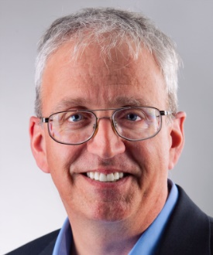
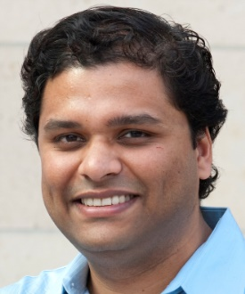
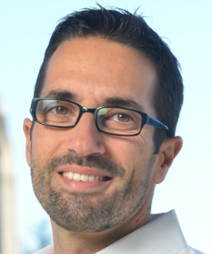
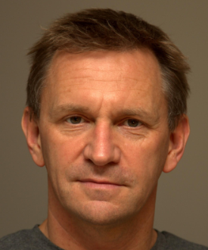
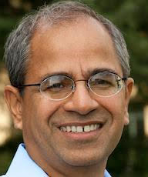
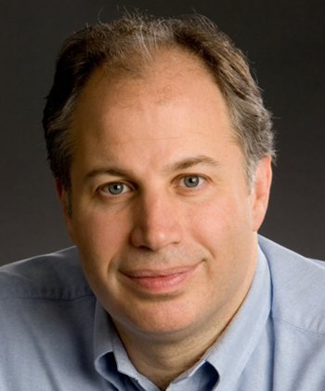
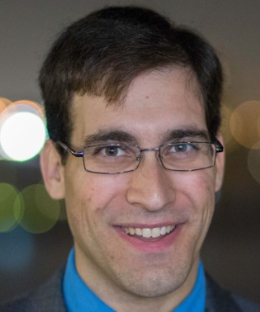
Platform Lab Faculty
Bill Dally
Sachin Katti
Christos Kozyrakis
Phil Levis
Nick McKeown
John Ousterhout Faculty Director
Guru Parulkar Executive Director
Mendel Rosenblum
Keith Winstein

Slide 7
Drivers For New Platforms
Goals:
Ease of Use (Raise productivity)
??
High Performance (Achieve physical limits)
Techniques:
Scalability and elasticity
Build large systems out of many small, cheap components
Vary scale by adding/removing components
Challenges:
Fault tolerance
Scale-independent architectures
Specialization and heterogeneity
Special-purpose components much more efficient than general-purpose
Build future systems out of heterogeneous collections?
Challenges:
High design cost of components
Integration

Slide 8
Lab Progress
Identify an over-arching goal: Swarm Control Infrastructure
Initiate a few flagship projects:
Scalable control planes
??
??
Create a more collaborative environment
Weekly Platform Lab Seminar
Connect with application experts

Slide 9
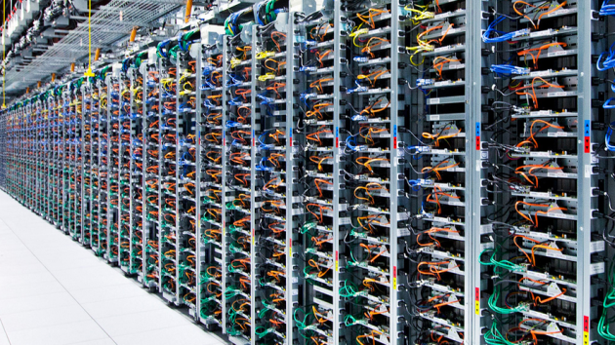
Opportunity: New Datacenter Clusters
Increasing Core Density
Specialized Components
Low Latency Interconnects
Large Nonvolatile Memories

Slide 10
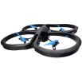
Opportunity: Swarms of Devices
Cell Phones
Switches/Routers
(SDN)
Self-Driving Cars
Drones
Internet of Things
Game Changers:
More and larger swarms
Increasing collaboration (more centralized management)

Slide 11
Opportunity: Changing Interconnects
Separation of Control and Data Planes
Increasing Bandwidth
Wired/Wireless Networks
Software Defined Control and Data Planes
Decreasing Latency
Open Source Implementations of Infrastructure

Slide 12
Uber-Goal: Swarm Control Infrastructure
Wired/Wireless Networks
Next-Generation
Datacenter Cluster
Device Swarms

Slide 13
Research Projects
RAMCloud Storage System
Programmable Network Fabrics
Self-Incentivizing Networks
Wired/Wireless Networks
Scalable Control Planes
Next-Generation
Datacenter Cluster
New Memory/ Storage Systems
IX Operating System
Device Swarms
Low-Latency Software Stack

Slide 14
Lab Progress
Identify an over-arching goal: Swarm Control Infrastructure
Initiate a few flagship projects:
Scalable control planes
??
??
Create a more collaborative environment
Weekly Platform Lab Seminar
Connect with application experts

Slide 15
Other News
PhD students interviewing this year:
Adam Belay: IX operating system
Ankita Kejriwal: secondary indexes in RAMCloud
Yiannis Yiakoumis
We even have a logo!

Slide 16
Conclusion
Momentum is building:
People
Ideas
Projects
Collaborations
Next steps:
Define additional flagship project(s)
Learn more about applications
Continue to develop collaborations

Slide 17
Questions/Discussion

