Slide 1
2017 Winter Review

Slide 2
2017 Winter Review: Lab Overview and Update
John Ousterhout
Faculty Director

Slide 3
Thank You, Sponsors!

Slide 4
Special Thanks To...

Slide 5
Platform Lab Vision
New platforms enable new applications:
Relational databases → Enterprise applications
HTTP + HTML + JavaScript → Internet commerce
GFS + MapReduce → Big Data (large-scale analytics)
Smart phones + GPS → Google Maps, Uber, …
Mission:
Define the next generation of platforms
Stimulate new classes of applications
One or two flagship projects at any given time
Current focus: platforms for large-scale control
Big Control Platform
Granular Computing Platform

Slide 6
What is a Platform?
General-purpose hardware or software substrate
Simplifies construction of a class of applications (or higher-level platforms)
Solves common problems
Usually introduces (simplifying) restrictions
Example: MapReduce
Applications: large-scale analytics
Problems solved: hides latency, handles slow/crashed servers
Simplifying restrictions: two-phase decomposition, large sequential accesses

Slide 7
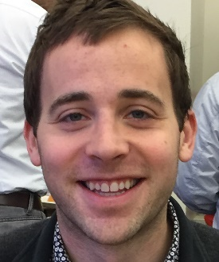
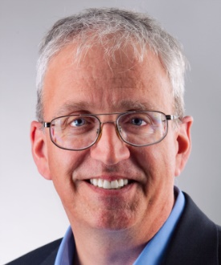
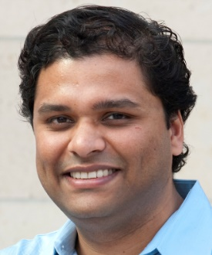
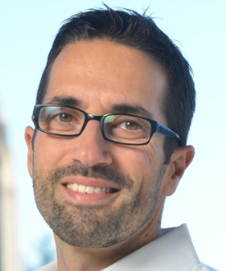
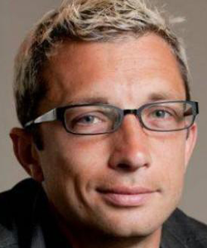
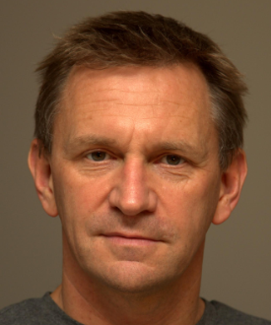
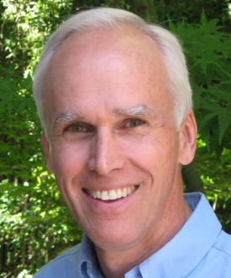
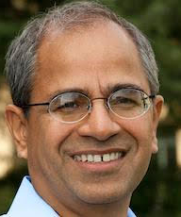
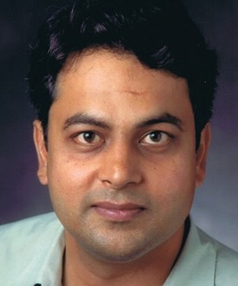
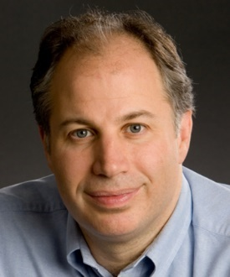
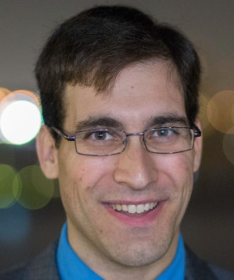
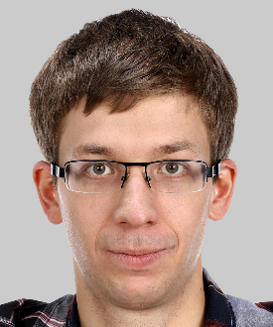
Platform Lab Faculty
Peter
Bailis
Bill
Dally
Sachin
Katti
Christos
Kozyrakis
Phil
Levis
Nick
McKeown
John
Ousterhout
(Fac. Director)
Guru
Parulkar
(Exec. Director)
Balaji
Prabhakar
Mendel
Rosenblum
Keith
Winstein
Matei
Zaharia

Slide 8
Platform Lab News
Additional faculty:
Peter Bailis (Big Data, databases)
Balaji Prabhakar (Networking)
Matei Zaharia (Big Data, systems, Spark creator)
NSF Expedition proposal on Big Control
Promoted to second round
Definition of granular computing platform
Promotions and awards:
Sachin Katti: tenure
Christos Kozyrakis: ACM Fellow
Dinesh Bharadia: MIT TR35, Marconi Young Scholar
Best paper awards: ISCA, MOBICOM, Sensys (runner-up)

Slide 9
Recent/Soon-To-Be Graduates
Ankita Kejriwal Secondary indexes for RAMCloud Google
Camilo Moreno Communication in many-core chips Intel Labs
Kanthi Nagaraj Programmable network fabrics
Hang Qu Task scheduling for cloud analytics

Slide 10
Big Control
Enormous swarms of devices:
Collaborative
Centrally controlled
The morning commute
1M+ self-driving cars
Large distribution center
10,000+ indoor drones
Disaster recovery
1000+ drones, automated ground-based vehicles
Coordinated mapping and search
Data integration
Mobilized response

Slide 11
Big Control, cont’d
Interesting properties:
Scale
Collaboration
Latency
Control will become more centralized:
Easier application development
More powerful features (e.g., integrate back-end datasets)
More robust!
Lab goal: define and enable the Big Control paradigm
Create two new platforms:
Big Control Platform (BCP)
Granular Computing Platform

Slide 12
Multi-Level Control Loops
Datacenter
Directed Mapping: 1 Hz
DC Network
Wired Network
Formation Flying: 10 Hz
Edge
Cloud
Attitude Stabilization: 1000 Hz
Wireless Network
Devices

Slide 13
System Overview
Big Control Platform
(BCP)
Package
Tracking
Commute Management
Disaster
Relief
Large Scale
Mapping
Directed
Info
Gathering
Deep Reinforcmt
Learning
Adaptive
Optimal
Sched.
Stable
Trajectory
Planning
Big Control Platform (BCP)
Data
Repositories
Data Ingestion,
Fusion, Inference
Declarative
Planning
Granular Computing
Platform
Cluster Scheduling
Geometric Data Structures,
Distributed State Management
Real-Time
Sensing
Real-Time
Actuation
Wired and Wireless Networks
Low-Latency
RPC
Scalable
Notifications
Thread/App
Mgmt
Hardware
Accelerators
Low-Latency
Storage
Devices
Granular Computing
Platform

Slide 14
Big Control Platform
What is MapReduce for control?
Solve common problems
Simple framework
Example: declarative planning
Specify plans in high-level language (~ SQL)
Generate device-specific commands automatically (~ query optimizer)
Schwager
Kochenderfer
Directed
Info
Gathering
Deep Reinforcmt
Learning
Adaptive
Optimal
Sched.
Stable
Trajectory
Planning
Planning
Fusion, Inference
Data Ingestion,
Fusion, Inference
Declarative
Planning
Bailis
Levis
Geometric Data Structures,
Distributed State Management
Control
Data
Collection
Ousterhout,
Parulkar
Winstein

Slide 15
Granular Computing
Big Data: process data in large sequential chunks
Big Control: process data in very small chunks
Example: 10,000 devices, updates all-to-all every second
Each device notification triggers internal events for fusion, inference
Granular computing:
Support tasks lasting 10ms → 1µs
Efficient instantiation, communication
Short duration => large numbers
Highly elastic
Must coexist with traditional large tasks
Related trends: micro-services, lambdas

Slide 16
Granular Computing Examples
Remote task with durable results: 20 µs
Local task with volatile results: 500 ns
Fanout to 100+ threads, interactive results:
Real-time event-driven inference
Exploratory data analysis
Instant video encoding

Slide 17
Granular Computing Platform
Zaharia
Winstein
Applications
Levis
Kozyrakis
Cluster Scheduling
Low-Latency
RPC
Scalable
Notifications
Ousterhout
Ousterhout
Thread/App
Mgmt
Hardware
Accelerators
Low-Latency
Storage
Kozyrakis

Slide 18
Networking Platform
Rearchitect the network for control applications:
Ultra-reliable
Ultra-low and predictable latency
Secure, robust
Slicing architecture:
Decouple control and data planes
Virtualize network substrate (multiple control/data planes)
New algorithms for allocating resources among competing slices
Datacenter
DC Network
Wired Network
Edge
Cloud
Wireless Network
Devices

Slide 19
Project Plan
Phase 1 (Years 1-2): exploration, infrastructure
Simple control applications for learning
Prototypes of BCP subsystems, Granular Computing Platform
Milestone: ready to design BCP
Phase 2 (Years 3-4): BCP version 1
Integrated version of BCP
Revisions to Granular Computing Platform
Port a few applications
Milestone: BCP runs a few simple applications
Phase 3 (Year 5): capstone demonstration
Disaster recovery demo, possibly others
Continued evolution of BCP, Granular Computing Platform
Milestone: capstone demo

Slide 20
Next Steps: More Students!
Long lead-time (new PhD admits commit early)
Planning for heavy recruiting this spring
Students rotate in 2017-2018, align in Spring 2018
Big Control seminar in Fall 2017
Also: funding always a challenge; hoping to win Expedition competition

Slide 21
Agenda
9:15 — 10:30am Big Control Platform (BCP) Abstractions and Services
Directed Information Gathering — Riccardo Spica
Deep Reinforcement Learning for Device Control — Blake Wulfe
Distributed Geometric Data Structures — Philip Levis
10:30am — 11:00am Break
11:00 — 12:15pm Self Driving Programmable Networks
Data Driven Networking — Sachin Katti
Self Driving Networks — Balaji Prabhakar
Weld: Fast Data Analytics on Modern Hardware — Shoumik Palkar
12:15 — 12:45pm Lightning Talks by Students
12:45 — 2:00pm Lunch and Poster Session

Slide 22
Agenda, Cont’d
2:00 — 2:45pm Invited Sponsor Talks
Network Management beyond SDN — Jeff Mogul, Google
Potential Big Control Use Cases — Ayush Sharma, Huawei
2:45 — 3:45 pm Panel on Granular Computing Keith Winstein, Christos Kozyrakis, Philip Levis, John Ousterhout
3:45 - 4:15pm Break
4:15pm — 5:30pm Granular Computing Platform
NanoLog: A Nanosecond Scale Logger — Stephen Yang
RAIL: Predictable, Low Tail Latency for Flash-based SSDs — Heiner Litz
TETRIS: Scalable and Efficient Neural Network Acceleration with 3D Memory — Mingyu Gao
5:30 — 5:45 pm Wrap up
5:45 — 7:00pm Reception

Slide 23
Conclusion
Platform Lab program now fully formed
Time to execute
How can we collaborate with industry for this research agenda?

Slide 24
Questions/Discussion

