Slide 1
Introducing the Platform Lab
John Ousterhout
Stanford University

Slide 2
Background
SEDCL history:
Formed Spring of 2010, first retreat in June of 2011
Brought together research on networking (Prabhakar), storage (Ousterhout and Rosenblum)
Additional faculty joined over time: Dally, Kozyrakis, Levis
Original SEDCL projects are finishing
Spring 2014:
VMware interested in expanding relationship with Stanford
Challenged us to “think big”
Discussions among faculty → Platform Lab proposal
December 2014:
Grant from VMware University Research Fund provides core funding to start lab

Slide 3
Platform Lab Vision
New platforms enable new applications
Platform = general-purpose substrate
Recent examples:
Storage: GFS, BigTable, Hadoop, Cassandra, RAMCloud
Computation: MapReduce, Spark
Communication: Software-Defined Networking
Development frameworks: Ruby on Rails, Django, node.js
Virtual machines
Platform lab goal: Create environment in which major new platforms can be developed and evaluated

Slide 4
Platform Lab Vision, cont’d
Most universities can’t do large systems projects
Fragmented funding model
Short-term outlook
Promotions determined by paper counts, not impact
Why universities should do large systems projects:
Companies don’t have time to evaluate, find best approach
Can lead the market
Produce better-trained graduates
Large systems require:
Collaboration between faculty
Unconstrained long-term funding (projects last 5-10 years)
Infrastructure (equipment, staff)
Platform
Lab

Slide 5
Lab Structure
Medium-size group of faculty
Large enough for critical mass, resource pooling, collaboration
Small enough for sense of community
4-8 faculty “two feet in”
(Sachin Katti, Christos Kozyrakis, Nick McKeown, John Ousterhout, Phil Levis, Mendel Rosenblum, ...)
2-4 faculty “one foot in”
(Bill Dally, ...)
Management:
Executive Director: Guru Parulkar
Faculty Director: John Ousterhout
30-50 graduate students

Slide 6
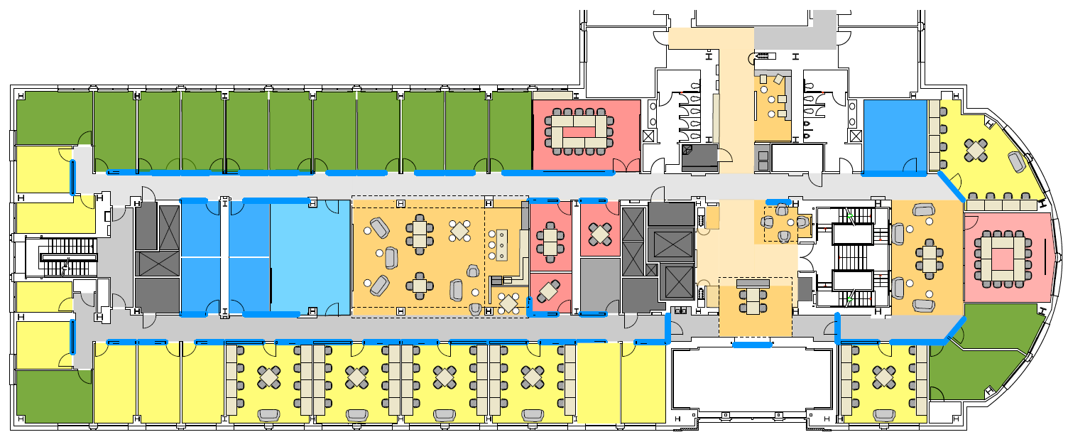
Lab Structure, cont’d
Funding the lab:
Primarily through industrial affiliates (unrestricted grants provide crucial flexibility)
Supplemented with traditional federal support
Fostering deep collaboration:
Our biggest challenge
Best forcing function for collaboration: shared goals
Bring faculty and students together physically

Slide 7
A Few Platform Ideas...
New networking architecture for datacenters:
Programmable network switches (McKeown)
Software-defined datacenter transport (Katti, Alizadeh)
Manage complex/conflicting application-layer requirements
New RPC architecture for large-scale low-latency applications (Ousterhout)
Replace TCP/IP on the wire (better congestion control, latency)
New threading architecture for applications
Secure platforms:
New OS for Internet of Things (Levis)
Datacenters (Kozyrakis)
Programming models and runtimes for low-latency applications (Kozyrakis, Ousterhout)

Slide 8
Rollout
1H 2015:
Create lab administrative structure
Brainstorm about projects, how to collaborate
May 28-29, 2015: joint SEDCL/Platform Lab retreat
2H 2015:
SEDCL projects transition to Platform Lab
New Platform Lab projects start
December 31, 2015: SEDCL concludes
2016 and beyond:
Exciting new platforms emerge as lab gains momentum

Slide 9
What this Means for Affiliates
Same general structure as SEDCL:
$150K annual gift for membership
2 meetings/year
All research results freely available
Advantages of the Platform Lab:
More faculty than SEDCL
More/larger research projects
More graduate students
We hope you will find the Platform Lab even more attractive than SEDCL!

Slide 10
Questions/Comments?

