Slide 1
RAMCloud 1.0
John Ousterhout
Stanford University
(with Arjun Gopalan, Ashish Gupta, Ankita Kejriwal, Collin Lee, Behnam Montazeri, Diego Ongaro, Seo Jin Park, Henry Qin, Mendel Rosenblum, Stephen Rumble, and Ryan Stutsman)

Slide 2
Overview
RAMCloud project in transition
Phase 1 complete:
RAMCloud 1.0 released
Key-value store
Memory management
Fast crash recovery
First PhD students graduating
Phase 2 starting up:
New projects:
Higher-level data models
Datacenter RPC revisited
Many new students

Slide 3
RAMCloud Architecture
1000 – 100,000 Application Servers
Appl.
Appl.
Appl.
…
Appl.
Library
Library
Library
Library
High-speed networking:
5 µs round-trip
Full bisection bwidth
Datacenter Network
Coordinator
Commodity Servers
Master
Master
Master
…
Master
64-256 GB per server
Backup
Backup
Backup
Backup
1000 – 10,000 Storage Servers

Slide 4
Data Model: Key-Value Store
Basic operations:
read(tableId, key) => blob, version
write(tableId, key, blob) => version
delete(tableId, key)
Other operations:
cwrite(tableId, key, blob, version) => version
Enumerate objects in table
Efficient multi-read, multi-write
Atomic increment
Not currently available:
Atomic updates of multiple objects
Secondary indexes
Tables
(Only overwrite if version matches)
Object
Key (≤ 64KB)
Version (64b)
Blob (≤ 1MB)

Slide 5
Performance
Using Infiniband networking
24 Gb/sec effective bandwidth
Kernel bypass
Can also use other networking, but slower
Reads:
100B objects: 5µs
10KB objects: 10µs
Single-server throughput (100B objects): 700 Kops/sec.
Small-object multi-reads: 1-2M objects/sec.
Writes:
100B objects: 15µs
10KB objects: 40µs

Slide 6
Steve Rumble’s Dissertation
How to manage objects in DRAM?
High write performance
High memory efficiency (80-90% utilization)
Uniform log structure for all info (both DRAM and disk)
Log cleaner => incremental generational garbage collector
Innovative aspects:
2-level cleaning (different policies for DRAM, disk)
Parallel cleaning (hides cost of cleaning)
Improved LFS segment selection formula
Paper in FAST 2014, dissertation nearing completion; Steve is working at Google Zurich

Slide 7
Existing Allocators Waste Memory
Allocators waste memory if workloads change:
E.g., W2 (simulates schema change):
Allocate 100B objects
Gradually overwrite with 130B objects
All existing allocators waste at least 50% of memory under some conditions

Slide 8
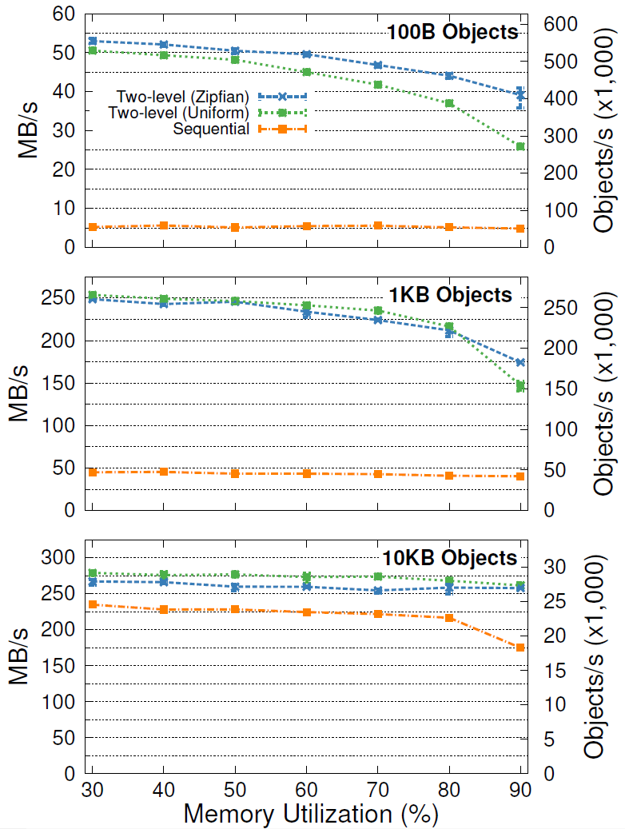
Client Write Throughput
Memory Performance
Utilization Degradation
80% 17-27%
90% 26-49%
80% 14-15%
90% 30-42%
80% 3-4%
90% 3-6%

Slide 9
Ryan Stutsman’s Dissertation
Durability and availability for data in DRAM
Fault-tolerant log for each master:
Decentralized log management
Finding log after crashes
Restoring redundancy after backup crashes
Fast crash recovery:
Use thousands of servers concurrently to reload data from a crashed master
1-2 second recovery
Handling simultaneous master/backup failures
Dissertation filed December 2013 Ryan is now a post-doc at Microsoft Research

Slide 10
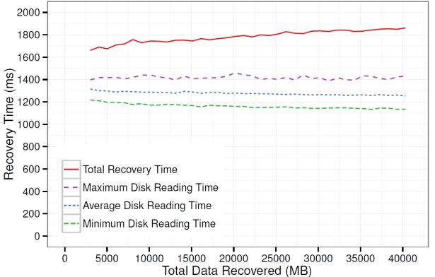
Recovery Scalability
1 master
2 backups
2 SSDs
500 MB
80 masters
160 backups
160 SSDs
40 GB
Will improve with newer machines
More cores (our nodes: 4 cores)
More memory bandwidth (our nodes: 11 GB/sec)
Bottom line: recover 500 MB/sec/server

Slide 11
Coordinator Crash Recovery
Active/standby model
Use replicated external storage for configuration data:
Cluster membership
Table metadata
Distributed “commit” mechanism:
Record intent in storage
Notify relevant servers
(Eventually) mark storage “completed”
During restart, find and finish uncompleted ops
Standby Coordinator
Active Coordinator
Standby Coordinator
ZooKeeper

Slide 12
Missing from RAMCloud 1.0
Table configuration management:
Tablets not moved after creation
RAMCloud has mechanisms for splitting, migrating tablet
No policy code yet
Crude reconfiguration: crash server!
Tablets split among many other servers

Slide 13
New Project: Data Model
Goal: higher-level data model than just key-value store:
Secondary indexes
Transactions spanning multiple objects and servers
Graph-processing primitives (sets)
Can RAMCloud support these without sacrificing
Latency?
Scalability?
First project: secondary indexes (SLIK) (Arjun Gopalan, Ashish Gupta, Ankita Kejriwal)
Design complete, implementation underway
Ankita will discuss design issues

Slide 14
New Work: Datacenter RPC
Complete redesign of RAMCloud RPC
General purpose (not just RAMCloud)
Latency:
Analyze, reduce latency
Explore alternative threading strategies
Optimize for kernel bypass
Scale:
Support 1M clients/server (minimal state/connection)
Congestion control: reservation based?
Initial projects underway (Behnam Montazeri, Henry Qin)
Analyze latency of existing RPCs
Support for pFabric, SolarFlare NIC

Slide 15
Other Projects
Raft: new consensus protocol (Diego Ongaro)
Graph processing on RAMCloud (Jonathan Ellithorpe)
Using a rule-based approach for distributed, concurrent, fault-tolerant code (Collin Lee, Ryan Stutsman)

Slide 16
Conclusion
We now have a usable system
Still many open research problems
Real usage should generate additional information, ideas

