Slide 1
The RAMCloud Storage System
John Ousterhout
Platform Lab
Stanford University
Slides available for download at http://goo.gl/13zote

Slide 2
DRAM in Storage Systems
Facebook: 200 TB total data 150 TB cache!
memcached
Web indexes entirely in DRAM
Main-memory databases
Large file caches
UNIX buffer cache
Main-memory DBs, again
1970
1980
1990
2000
2010

Slide 3
DRAM in Storage Systems
DRAM usage specialized/limited
Clumsy (manual backing store management)
Lost performance (cache misses, backing store)
Facebook: 200 TB total data 150 TB cache!
memcached
Web indexes entirely in DRAM
Main-memory databases
Large file caches
UNIX buffer cache
Main-memory DBs, again
1970
1980
1990
2000
2010

Slide 4
RAMCloud
General-purpose DRAM-based storage for large-scale applications:
All data is stored in DRAM at all times
As durable and available as disk
Simple key-value data model
Large scale: 1000+ servers, 100+ TB
Low latency: 5-10 µs remote access time
Potential impact: enable new class of applications
Notes:
Make it easy to achieve performance potential of DRAM-based storage
Take idea to the extreme
Favor latency over bandwidth

Slide 5
Performance (Infiniband)
Read 100B object 4.7 µs
Read bandwidth (large objects, 1 client) 2.7 GB/s
Write 100B object (3x replication) 13.5 µs
Write bandwidth (Iarge objects, 1 client) 430 MB/s
Single-server throughput:
Read 100B objects 900 Kobj/s
Multi-read 100B objects 6 Mobj/s
Multi-write 100B objects 450 Kobj/s
Log replay for crash recovery 800 MB/s or
2.3 Mobj/s
Crash recovery time (40 GB data, 80 servers) 1.9 s

Slide 6
Tutorial Outline
Part I: Motivation, Potential Impact
Part II: Overall Architecture
Part III: Log-Structured Storage
Part IV: Low-Latency RPCs
Part V: Crash Recovery
Part VI: Status and Limitations
Part VII: Application Experience
Part VIII: Lessons Learned
Notes:
Mention papers for more detail

Slide 7
Part I: Motivation, Potential Impact

Slide 8
Lowest TCO
10000
Disk
1000
100
Flash
Dataset Size (TB)
10
DRAM
1
0.1
0.1
1
10
100
1000
Query Rate (Mops/sec)
from "Andersen et al., "FAWN: A Fast Array of Wimpy Nodes", Proc. 22nd Symposium on Operating System Principles, 2009, pp. 1-14.
Notes:
Explain boundary point
All of the lines are moving up

Slide 9
Why Does Latency Matter?
Traditional Application
Web Application
UI
UI
App. Logic
Application Servers
App. Logic
Storage Servers
Data Structures
Single machine
Datacenter
<< 1µs latency
0.5-10ms latency
Large-scale apps struggle with high latency
Random access data rate has not scaled!
Facebook: can only make 100-150 internal requests per page
Notes:
Web apps stateless
Uneven scaling

Slide 10
MapReduce
Computation
...
Data
...
...
...
...
...
...
Sequential data access → high data access rate
Not all applications fit this model
Offline
Notes:
Stages of computation
Large datasets processed sequentially

Slide 11
Goal: Scale and Latency
Traditional Application
Web Application
UI
UI
App. Logic
Application Servers
App. Logic
Storage Servers
Data Structures
Single machine
Datacenter
<< 1µs latency
0.5-10ms latency
5-10µs
Enable new class of applications:
Large-scale graph algorithms (machine learning?)
Collaboration at scale?

Slide 12
Large-Scale Collaboration
“Region of Consciousness”
Gmail: email for one user
Facebook: 50-500 friends
Morning commute: 10,000-100,000 cars
Data for one user
Internet of Things?
Notes:
Large-scale storage with on dataset for each user

Slide 13
Part II: Overall Architecture

Slide 14
Data Model: Key-Value Store
TABLE OPERATIONS
createTable(name) → id
getTableId(name) → id
dropTable(name)
BASIC OPERATIONS
read(tableId, key) → value, version
write(tableId, key, value) → version
delete(tableId, key)
BULK OPERATIONS
multiRead([tableId, key]*) → [value, version]*
multiWrite([tableId, key, value]*) → [version]*
multiDelete([tableId, key]*)
enumerateTable(tableId) → [key, value, version]*
ATOMIC OPERATIONS
increment(tableId, key, amount) → value, version
conditionalWrite(tableId, key, value, version) → version
MANAGEMENT OPERATIONS
splitTablet(tableId, keyHash)
migrateTablet(tableId, keyHash, newMaster)
Tables
Object
Key (≤ 64 KB)
Version (64 b)
Blob (≤ 1 MB)
Notes:
Slightly extended key-value store

Slide 15
RAMCloud Data Model, cont’d
Goal: strong consistency (linearizability)
Not yet fully implemented
Secondary indexes and multi-object transactions:
Useful for developers
Not implemented in RAMCloud 1.0
Currently under development

Slide 16
RAMCloud Architecture
1000 – 100,000 Application Servers
Appl.
Appl.
Appl.
…
Appl.
High-speed networking:
5 µs round-trip
Full bisection bandwidth
Library
Library
Library
Library
Datacenter
Network
Coordinator
Commodity Servers
Coordinator Standby
External
Storage
(ZooKeeper)
Master
Master
Master
…
Master
Backup
Backup
Backup
Backup
64-256 GB per server
1000 – 10,000 Storage Servers
Notes:
Software that runs on commodity servers
Only non-commodity part is the network

Slide 17
Hash Partitioning
Tables divided into tablets by key hash
Tablet: unit of allocation to servers
Small tables: single tablet
Large tables: multiple tablets on different servers
Each server stores multiple tablets
Currently no automatic reconfiguration
Variable-Length Key
Hash Function
64-bit Key Hash
Master
Master
Master
Backup
Backup
Backup
0 –
0xf7777777
0x80000000 –
0xb7777777
0xc0000000 –
0xf7777777
Tablets

Slide 18
Example Configurations
 | 2010 | 2015–2020
# servers | 2000 | 4000
GB/server | 24GB | 256GB
Total capacity | 48TB | 1PB
Total server cost | $3.1M | $6M
$/GB | $65 | $6
For $100-200K today:
One year of Amazon customer orders
One year of United flight reservations
Notes:
Very expensive compared to disk.
Doesn’t have to be cheapest: just “cheap enough”
Compare with tape in 70’s

Slide 19
Part III: Log-Structured Storage

Slide 20
Storage System Requirements
High performance
Read/write latency not impacted by secondary storage speed
Efficient use of DRAM
DRAM ≈ 50% of system cost
Goal: 80-90% DRAM utilization
Durability/availability ≥ replicated disk
Scalable
Increase capacity/performance by adding servers
Minimize centralized functionality

Slide 21
Existing Allocators Waste Memory
glibc malloc: 13.7 GB memory to hold 10 GB data under workload W2:
Allocate many 100B objects
Gradually overwrite with 130B objects
7 memory allocators, 8 synthetic workloads
Total live data constant (10 GB)
But workload changes (except W1)
All allocators waste at least 50% of memory in some situations
Notes:
Storage systems must accommodate workload changes

Slide 22
Non-Copying Allocators
Blocks cannot be moved once allocated
Result: fragmentation
Free areas
Notes:
Allocators divide into two groups

Slide 23
Copying Garbage Collectors
Before collection:
After collection:
Must scan all memory to update pointers
Expensive, scales poorly
Wait for lots of free space before running GC
State of the art: 3-5x overallocation of memory
Long pauses: 3+ seconds for full GC
Notes:
Compare GC time to RAMCloud crash recovery time

Slide 24
Allocator for RAMCloud
Requirements:
Must use copying approach
Must collect free space incrementally
Storage system advantage: pointers restricted
Pointers stored in index structures
Easy to locate pointers for a given memory block
Enables incremental copying
Solution: log-structured storage

Slide 25
Durability/Availability
All data must be replicated
Replication in DRAM?
Expensive
Insufficient (power failures)
RAMCloud: primary-backup approach:
One copy in DRAM
Multiple copies on secondary storage (disk/flash)
Must recover quickly after crashes
Challenge: secondary storage latency
Must not affect RAMCloud access times
Notes:
Writes are the big challenge

Slide 26
Log-Structured Storage
Store all data in append-only logs:
One log per master
Both DRAM and secondary storage
Similar to log-structured file systems
Benefits:
Fast allocation
High throughput: batched updates to secondary storage
80-90% memory utilization
Insensitive to workload changes
Crash recovery: replay log
Consistency: serializes operations

Slide 27
Log-Structured Storage
Master Server
Hash Table
Log head: add next object here
{table id, object key}
Immutable Log
8 MB Segments
B17
B86
B22
B3
B72
B66
B49
B3
B16
Each segment replicated on disks of 3 backup servers
Notes:
Segment structure
8 MB => < 10% overhead for seeks
Backups & replication
Hash table for fast random access

Slide 28
Durable Writes
Write request
Hash Table
Buffered Segment
Disk
Backup
Buffered Segment
Disk
Backup
Buffered Segment
Disk
In-Memory Log
Master
Backup
No disk I/O during write requests
Backups perform I/O in background
Buffer memory must be non-volatile (NVDIMMs?)

Slide 29
Logs on Secondary Storage
Log on disk/fla
Except during crash recovery
During recovery, read entire log for a master
Notes:
No need for random access to disk log

Slide 30
Log Entry Types
Object
Table Id
Key
Version
Timestamp
Value
Tombstone (identifies dead object)
Table Id
Key
Version
Segment Id
Segment Header
Master Id
Segment Id
Log Digest (identifies all segments in log)
Segment Id
Segment Id
...
Segment Id
Tablet Statistics
For each tablet: # log entries, log bytes (compressed)
Safe Version
Version # larger than any used on master

Slide 31
Log Cleaning
Pick segments with lots of free space:
Copy live objects (survivors):
Free cleaned segments (and backup replicas)
Cleaning is incremental
Log
Log
Log
Notes:
Segment selection mechanism: cost-benefit from LFS
Cleaner requires free space!

Slide 32
Tombstones
How to prevent reincarnation during crash recovery?
Tombstones:
Written into log when object deleted or overwritten:
Table id
Object key
Version of dead object
Id of segment where object stored
When can tombstone be cleaned?
After segment containing object has been cleaned (and replicas deleted on backups)
Note: tombstones are a mixed blessing

Slide 33
Cleaning Cost
U: fraction of live bytes in cleaned segments
0.5
0.9
0.99
Bytes copied by cleaner (U)
0.5
0.5
1.0
0.9
0.1
9.0
0.99
0.01
99.0
Bytes freed (1-U)
Bytes copied/byte freed (U/(1-U))
Capacity
Bandwidth
Memory
expensive
cheap
Conflicting Needs:
Disk
cheap
expensive
Need different policies for cleaning disk and memory
Notes:
Fundamental tradeoff for any copying collector
Try to clean at lower U than avg
Cleaning cost limits write thruput

Slide 34
Two-Level Cleaning
DRAM
Backups
Compaction:
Clean single segment in memory
No change to replicas on backups
DRAM
Backups
Combined Cleaning:
Clean multiple segments
Free old segments (disk & memory)
DRAM
Backups

Slide 35
Two-Level Cleaning, cont’d
Best of both worlds:
Optimize utilization of memory (can afford high bandwidth cost for compaction)
Optimize disk bandwidth (can afford extra disk space to reduce cleaning cost)
But:
Segments in DRAM no longer fixed-size (implement with 128 KB seglets)
Compaction cannot clean tombstones (must eventually perform combined cleaning)

Slide 36
Parallel Cleaning
...
Survivor data written to “side log”
No competition for log head
Different backups for replicas
Synchronization points:
Updates to hash table
Adding survivor segments to log
Freeing cleaned segments
Log Head
Survivor
Segments
...
Log Head
...
Log Head

Slide 37
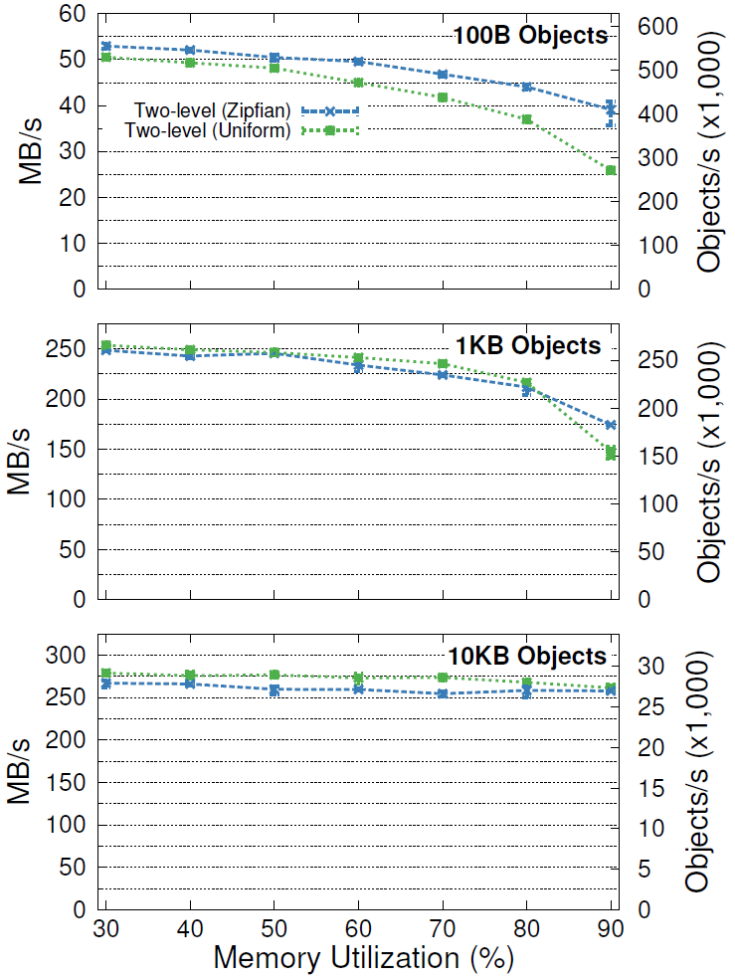
Throughput vs. Memory Utilization
Memory Performance
Utilization Degradation
80% 17-27%
90% 26-49%
80% 14-15%
90% 30-42%
80% 3-4%
90% 3-6%
1 master,
3 backups,
1 client,
concurrent multi-writes
Notes:
Explain experimental setup:
pathological workload

Slide 38
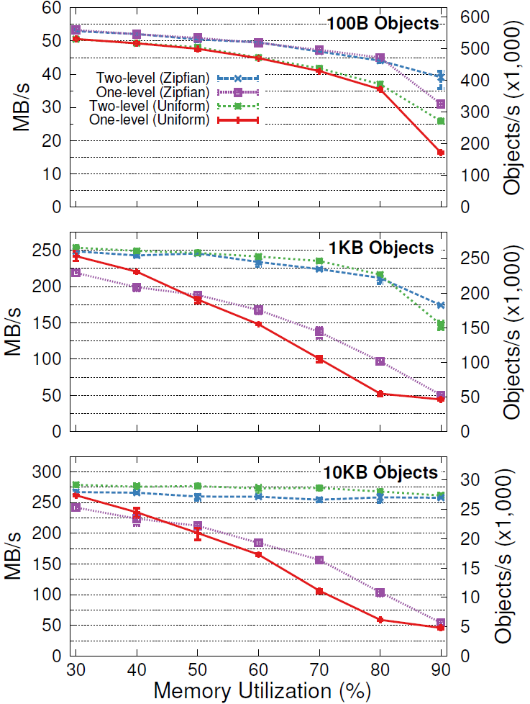
1-Level vs. 2-Level Cleaning
One-level Cleaning
Notes:
Not much difference for small objects

Slide 39
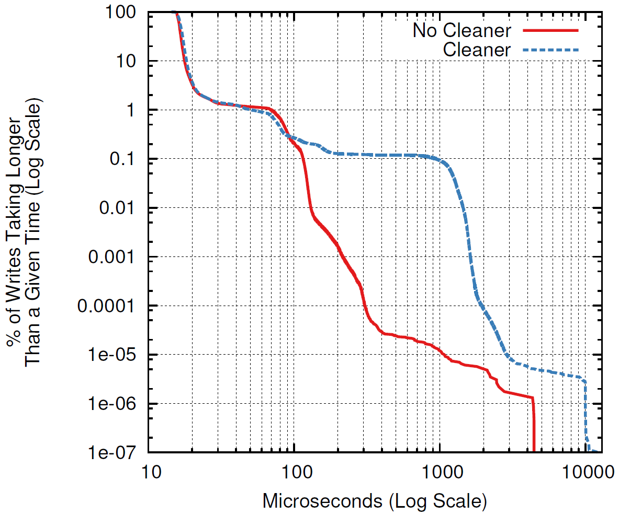
Cleaner’s Impact on Latency
1 client, sequential 100B overwrites, no locality, 90% utilization
Median:
With cleaning: 16.70 µs
No cleaner: 16.35 µs
99.9th %ile:
With cleaning: 900 µs
No cleaner: 115 µs

Slide 40
Part IV: Low-Latency RPCs

Slide 41
Datacenter Latency in 2009
Application Process
Kernel
Switch
Kernel
Server Process
NIC
NIC
Switch
Switch
Switch
Switch
Datacenter Network
Application Machine
Server Machine
Component | Delay | Round-trip
Network switch | 10-30 µs | 100-300 µs
OS protocol stack | 15 µs | 60 µs
Network interface controller (NIC) | 2.5-32 µs | 2-128 µs
Propagation delay | 0.5 µs | 1.0 µs
Typical in 2009: 200-400 µs RAMCloud goal: 5-10 µs
Notes:
This is unloaded: no buffering
What has to change? Everything

Slide 42
How to Improve Latency
Network switches (10-30 µs per switch in 2009):
10Gbit switches: 500 ns per switch
Radical redesign: 30 ns per switch
Must eliminate buffering
Software (60 µs total in 2009):
Kernel bypass: 2 µs
Direct NIC access from applications
Polling instead of interrupts
New protocols, threading architectures: 1µs
NIC (2-32 µs per transit in 2009):
Optimize current architectures: 0.75 µs per transit
Radical NIC CPU integration: 50 ns per transit

Slide 43
Round-Trip Delay, Revisited
Component | 2009 | 2015 | Limit
Switching fabric | 100-300 µs | 5 µs | 0.2 µs
Operating system | 60 µs | 0 µs | 0 µs
Application/server | 2 µs | 2 µs | 1 µs
NIC | 8-128 µs | 3 µs | 0.2 µs
Propagation delay | 1 µs | 1 µs | 1 µs
Total | 200-400 µs | 11 µs | 2.4 µs
Biggest remaining hurdles:
Software
Speed of light

Slide 44
RAMCloud Goal: 1 µs Service Time
Can’t afford many L3 cache misses (< 10?)
Can’t afford much synchronization
Acquire-release spin lock (no cache misses): 16 ns
Can’t afford kernel calls
Can’t afford batching
Trade-off between bandwidth and latency
Notes:
Most of the improvement (compared to current systems) must come outside RAMCloud.
But, low latency places some tough demands on RAMCloud itself.

Slide 45
Low Latency in RAMCloud
Kernel bypass:
Map virtual NIC into application address space
Originally developed for Infiniband (Mellanox)
Now becoming available for 10 GigE (Intel, SolarFlare, etc.)
Driven by network virtualization for faster virtual machines
Newer Mellanox NICs also support 10 GigE
Latency unimpressive for many NICs (RPC round-trip 2x Mellanox)
Polling:
Client spins while waiting for RPC response
Response time < context switch time
Condition variable wakeup takes 2 µs
Server spins while waiting for incoming request
Burns 1 core even when idle

Slide 46
Transports
Encapsulate different approaches to networking
Service naming
Reliable delivery of request & response messages
Client APIs:
session = transport->getSession( serviceLocator);
session->sendRequest(request, response);
response->isReady();
Server API (callout):
handleRpc(request) → response
Client RPC Wrappers
Transport
Network
Transport
Server RPC Dispatcher

Slide 47
Current Transports
InfRcTransport
Uses Infiniband Verbs APIs (reliable connected queue pairs)
Supports kernel bypass
Our workhorse transport (4.7 µs for 100B reads)
TcpTransport
Uses kernel TCP sockets
Slow (50-150 µs for 100B reads)
FastTransport
Custom protocol (reliable, flow-controlled, in-order delivery)
Layered on unreliable datagram drivers
Current drivers:
Kernel UDP
Infiniband unreliable datagrams (kernel bypass)
SolarFlare (10 GigE with kernel bypass)
Not yet as fast as InfRcTransport....

Slide 48
Threading Architecture
Initial implementation: single-threaded
No synchronization overhead
Minimizes latency
Fragile:
Can’t process heartbeats during long-running requests
Callers will assume server crashed
“Crashes” cascade
Vulnerable to distributed deadlock:
Nested RPCs sometimes needed:
E.g, replication during writes
All resources can be consumed with top-level requests

Slide 49
Dispatch Thread and Workers
request
Network
response
Transports
Dispatch Thread
Worker Threads
Server
Dispatch thread:
Runs all transports
Polls network for input; never sleeps
Dispatches requests to workers
Thread limits for different request classes: prevent deadlock
Worker thread:
Processes RPC requests
Returns responses to dispatch thread
Polls to wait for next request; eventually sleeps
Notes:
Dispatch thread prefers polling workers to sleeping ones.

Slide 50
Threads are Expensive!
Latency for thread handoffs:
100ns in each direction
Shared state between dispatch and worker threads:
Request/response buffers, etc.
>20 L2 additional cache misses to migrate state
Total cost of threading: ~450 ns in latency
Dispatch thread is also throughput bottleneck
We are still looking for better alternatives...
Notes:
Discuss how other systems such as MICA use the simpler threading model, but it doesn’t work for a more complex system like RAMCloud.

Slide 51
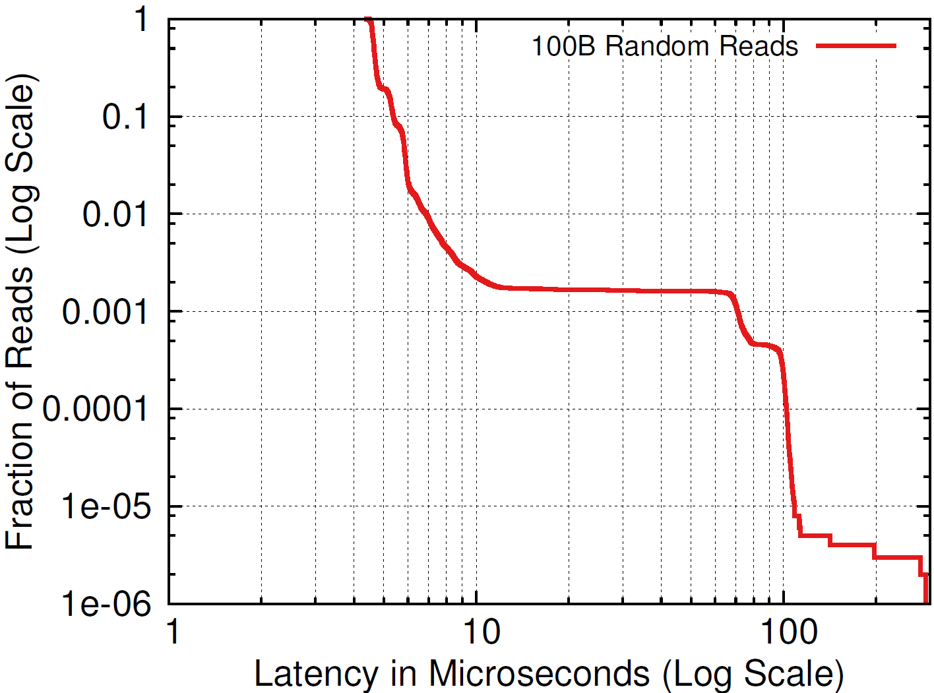
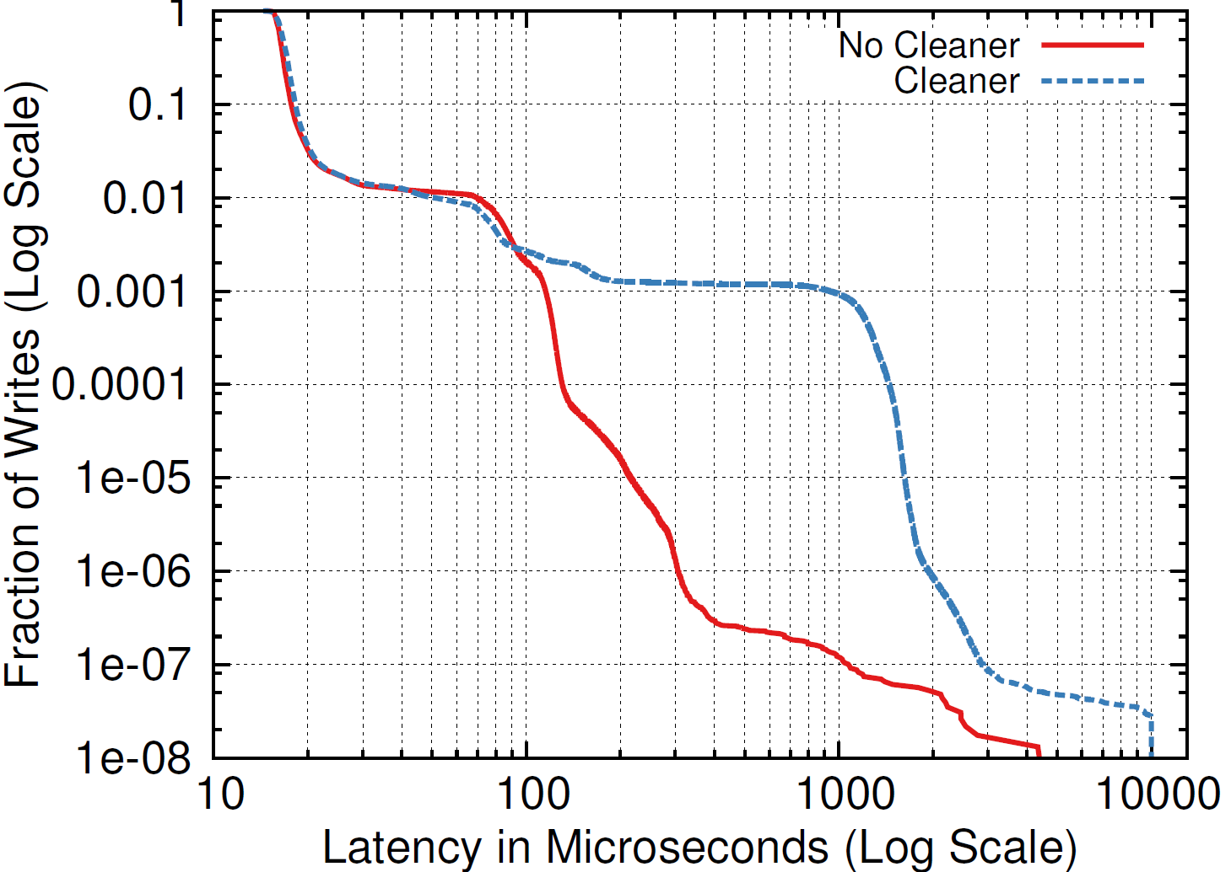
Infiniband Latency (µs)
Reads
Writes
Object Size
100
1000
10000
100000
1000000
Median | 90% | 99% | 99.9%
4.7 | 5.4 | 6.4 | 9.2
7.0 | 7.7 | 8.9 | 12.0
10.1 | 11.1 | 12.3 | 28.5
42.8 | 44.0 | 45.3 | 85.6
358 | 364 | 367 | 401
Median | 90% | 99% | 99.9%
13.4 | 14.7 | 75.6 | 148
18.5 | 20.8 | 105 | 176
35.3 | 37.7 | 209 | 287
228 | 311 | 426 | 489
2200 | 2300 | 2400 | 2700
2.8 Gbytes/sec

Slide 52
Infiniband Read Timeline (100B)
3.2 µs in network and NICs
9 L3 cache misses on server (up to 86 ns each)
Time on server:
NIC communication: 749 ns 39%
Thread handoffs: 470 ns 25%
Cache misses (est.): 300 ns 16%
Other: 382 ns 20%
Total: 1901 ns 100%
Notes:
Flow: client-server(dispatch-worker)-client
9 cache misses

Slide 53
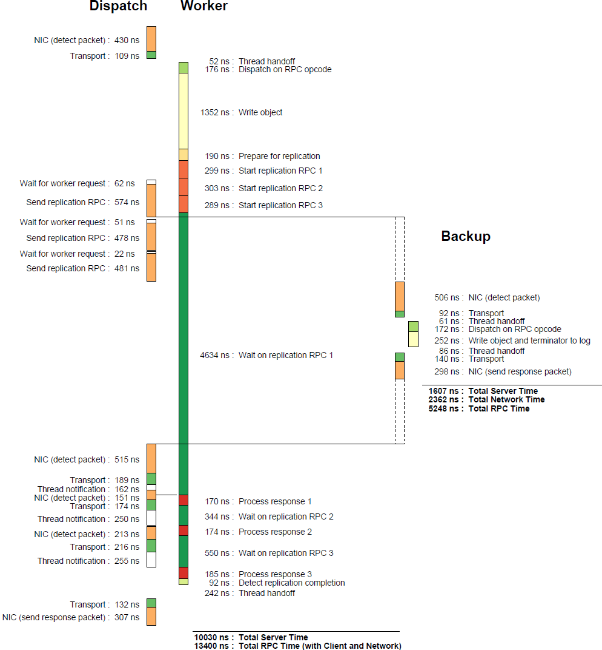
Infiniband Write Timeline (100B)
Notes:
End-to-end server time: 10 µs
Most spent in replication

Slide 54
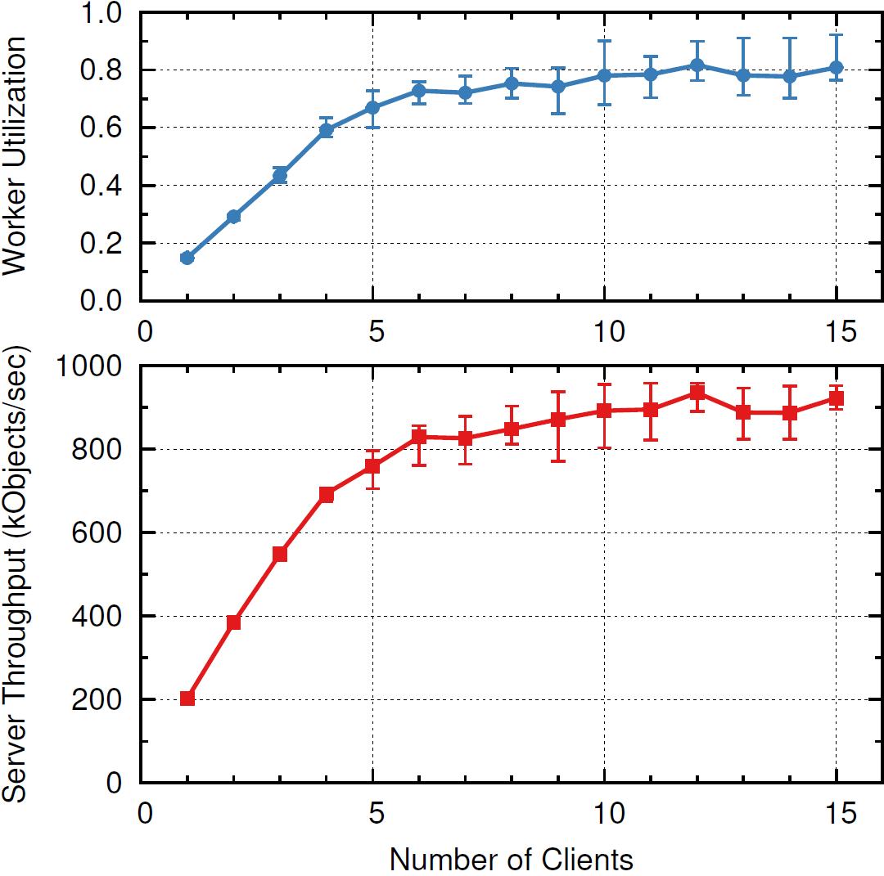
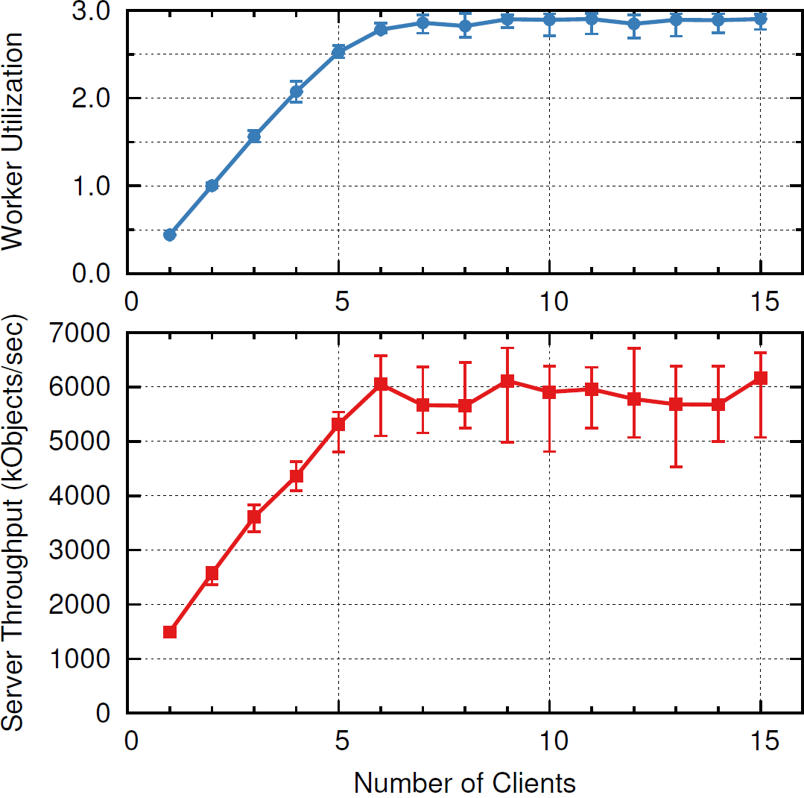
Single-Server Read Throughput
Individual Reads (100B)
Multi-reads (70 × 100B)
Notes:
Single-read perf. limited by dispatch thread
Multi-read performance limited by # cores

Slide 55
Part V: Crash Recovery

Slide 56
Failure Modes
Failures to handle:
Networking failures (e.g. packet loss, partitions)
Storage server crashes (masters/backups)
Coordinator crashes
Corruption of segments (DRAM and disk/flash)
Multiple failures
Zombies: “dead” server keeps operating
Assumptions:
Fail-stop (no Byzantine failures)
Secondary storage survives crashes
Asynchronous network
Notes:
Crash recovery: most complex and difficult part of the RAMCloud implementation
Spent more time there than low latency

Slide 57
Fault Tolerance Goals
Individual server failures? Continue normal operation:
Near-continuous availability
High performance
Correct operation
No data loss
Multiple failures also OK if:
Only a small fraction of servers fail
Failures randomly distributed
Large-scale outages:
May cause unavailability
No data loss (assuming sufficient replication)

Slide 58
Error Handling Philosophy
Error handling: huge source of complexity
Must write 3x code
Must handle secondary/simultaneous failures
Hard to test
Rarely exercised
Goal: minimize distinct cases to handle
Technique #1: masking
Deal with errors at a low level
Technique #2: failure promotion
E.g., promote internal server errors to “server failure”
May not work when needed
Notes:
Failure promotion makes handled conditions more common, so more likely to get debugged
Example of masking + promotion together: server-server RPCs:
Communication errors are masked
Only failure mode is “server not up”
Server can’t re-enter cluster once it is thought to have crashed: don’t want to implement rejoin code

Slide 59
Master Crash Recovery
Additional challenges:
Speed: must recover in 1-2 seconds
Data unavailable during recovery
Avoid creating scalability bottlenecks
Distributed operations

Slide 60
Fast Master Recovery
Goal: recover 256 GB data in 1-2 seconds:
Read from one flash drive? 1000 seconds
Transmit over one 10 GigE connection? 250 seconds
Replay log on one CPU? 500 seconds
Solution: concurrency (take advantage of cluster scale)
Crashed Master
Normal Operation
…
Backups
Crash Recovery
…
Recovery
Masters
Notes:
Remind: only one copy of data in DRAM, so unavailable until recovery complete
Speed drove the design of the mechanism
Recovery masters: just other masters

Slide 61
Scattering Segment Replicas
Requirements for replica placement:
Distribute replicas for each master uniformly
Use backup bandwidth and space evenly
Reflect failure modes (replicas in different racks)
Backups may have different device capacities/speeds
Backups enter and leave cluster
Each master must place its replicas independently
Solution: randomization with refinement
Based on Mitzenmacher’s “power of two choices”
Pick several candidate backups at random
Select best choice(s) (minimize worst-case read time for a backup)
Notes:
Pure randomization not bad, but high variance.
8000 replicas across 1000 devices? max will have 15-20
Ask: who has heard of POTC?

Slide 62
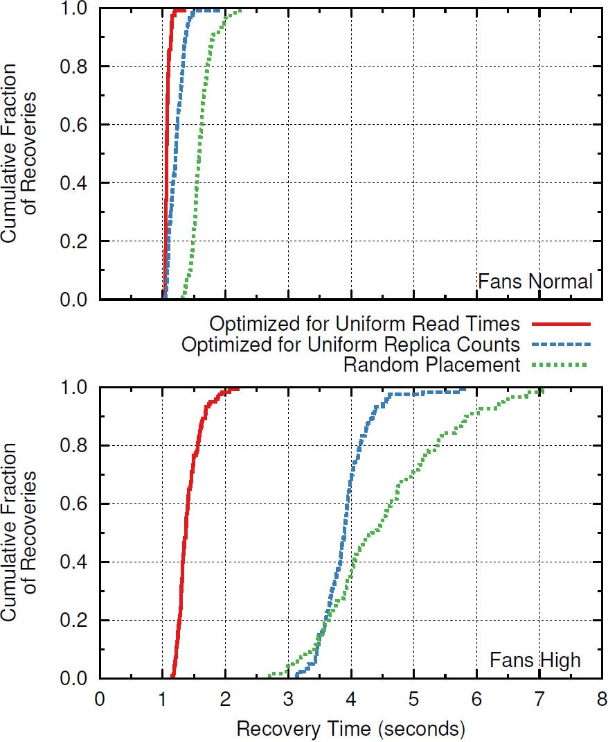
Placement Effectiveness
120 recoveries per graph
Replicas stored on disk
Notes:
120 recoveries in each graph

Slide 63
Fast Failure Detection
Must detect failures in a few hundred ms
Distributed randomized approach:
Every 100ms each server pings another at random
No response in 10-20ms? Report to coordinator
Coordinator pings again before declaring death
Probability of detecting crashed server:
63% in first round
99% after 5 rounds
Problems:
Performance glitches may be treated as failures (overloaded servers)
Protocol interactions (200 ms retry interval in TCP)
Notes:
30-sec. TCP timeout won’t fly.
Don’t want one server handling all the ping load.

Slide 64
Master Recovery Overview
Coordinator collects log metadata from all backups
Coordinator divides recovery work (tablet partitions)
Coordinator chooses recovery masters, assigns partitions
Recovery masters, backups replay log entries
Recovery masters incorporate data into their logs
Coordinator updates tablet configuration info to make tablets available on new masters
Notes:
Master leaves tablet usage stats in log, where coordinator can find them.

Slide 65
Ensuring Log Completeness
Old Head
New Head
Header
Data
Header
Data
Header
time
Header
Data
Footer
Header
Header
Data
Footer
Header
Data
Invariants:
Header names all other segments in log (log digest)
At least one open segment (header but no footer)
If multiple open segments, only oldest contains data
Defer recovery until log complete:
Open segment available
One replica available for each segment in log digest
Notes:
Remind: log allocation totally distributed (only master knew locations of segments)
What if all replicas of head segment lost?
Log completeness must be unambiguous

Slide 66
Log Replay
2. Divide log entries
3. Transfer data to masters
4. Add objects to hash table and log
1. Read disk
Hash Table
…
Backup
In-Memory Log
…
Backup
Recovery Master
6. Write replicas to disk
5. Replicate log data to backups
Concurrency in two dimensions:
Pipelining
Data parallelism

Slide 67
Segment Replay Order
Backups and masters work independently
Backups read segments, divide log entries
Masters fetch partitioned data, replay
To avoid pipeline stalls:
Backups publish read order
Masters fetch in order of expected availability
Masters issue multiple concurrent fetches
Log data replayed out of order:
Version numbers identify most up-to-date information

Slide 68
Replay Throughput
Single recovery master (Infiniband):
Object Size Throughput
(bytes) (Mobjs/sec) (MB/sec)
1 2.32 84
64 2.18 210
128 2.03 319
256 1.71 478
1024 0.81 824
2048 0.39 781
4096 0.19 754

Slide 69
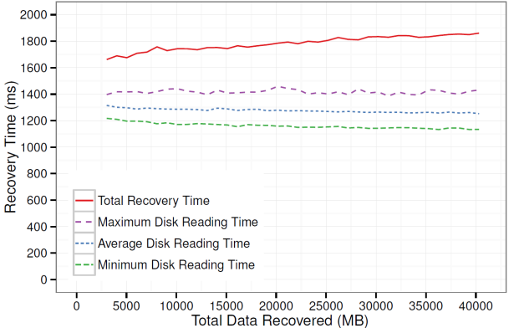
Recovery Scalability
1 master
2 backups
2 SSDs
500 MB
80 masters
160 backups
160 SSDs
40 GB
Will improve with newer machines
Need more cores (our nodes: 4 cores)
Need more memory bandwidth (our nodes: 11 GB/sec)
Notes:
Uses flash drives
What limits recovery speed?

Slide 70
Secondary Failures
Recovery complications:
Multiple master failures
Recovery masters:
Crash during recovery
Insufficient memory
Not enough recovery masters available
Backup crashes:
Before recovery
During recovery
Coordinator crashes
Replicas not available
Notes:
Secondary failures are where recovery tends to get really complicated.
Need to handle all these twists with a single mechanism.

Slide 71
Handling Multiple Failures
Recovery is organized incrementally:
Make progress in small independent pieces (one partition for one crashed master)
Retry until done
Coordinator recovery loop:
Pick a dead master
Collect replica info from backups, see if complete log available
Choose (some) partitions, assign to recovery masters
For recovery masters that complete, update tablet assignments
If dead master has no tablets assigned, remove it from cluster
This approach also handles cold start, partitions
Notes:
Don’t expect determinism.
Don’t have any preconceptions about order.
Not the most efficient way to handle cold start, but the simplest.

Slide 72
Zombies
“Dead” servers may not be dead!
Temporary network partition causes ping timeouts
RAMCloud recovers “dead” server: tablets reconstructed elsewhere
Partition resolved, “dead” server continues to serve requests
Some clients use zombie, some use new servers: inconsistency!
Preventing writes to zombies:
Coordinator must contact backups for head segment during recovery
Backups reject replication writes from zombie; zombie suicides
Preventing reads from zombies:
Zombie learns of its status during pings for failure detection
Only probabilistically safe...
Notes:
Only place in RAMCloud where safety depends on probabilities.

Slide 73
Backup Crashes
Basic mechanism:
Coordinator notifies masters of crashes
Each master independently re-replicates lost segments
Mechanism not time-critical (no loss of availability)
Complications:
Backup restart: replica garbage collection
Write-all-read-any approach requires replica consistency
Replica consistency problems:
When backup for head segment crashes
When master crashes during re-replication

Slide 74
Replica Garbage Collection
Backup restart:
Normal case: can discard existing replicas (all masters have re-replicated)
But, sometimes need replicas (e.g. cold start, master crash)
For each replica, check state of master
Not in cluster: free replica (master crashed, was recovered)
Crashed: retain replica
Master up: check with master (“do you still need this replica?”)
Repeat until all replicas freed

Slide 75
Head Segment Consistency
Master
Backup 1
Backup 2
Backup 3
Backup 4
Backup 2 crashes, master re-replicates
time
Master writes new data
Master, Backups 1, 3, 4 crash; Backup 2’s replica used for recovery
Must prevent use of out-of-date replicas
Master sends info to coordinator after crash recovery (new log epoch number)
Coordinator ignores out-of-date replica during recovery

Slide 76
Crash During Rereplication
Master
Backup 1
Backup 2
Backup 3
Backup 4
Backup 2 crashes, master begins rereplication
time
Master, Backups 1, 3 crash; Backup 4’s replica used for recovery
Must prevent use of incomplete replicas
During rereplication, new replica marked “incomplete”
Once rereplication complete, new replica marked “complete”
During recovery, backup doesn’t report incomplete replicas

Slide 77
Coordinator Crash Recovery
Must protect coordinator metadata:
Server list (active/crashed storage servers)
Information for each table:
Name
Identifier
Mapping of tablets to storage servers
Store metadata in RAMCloud?
Need server list before recovery
Instead, use separate external storage:
Key-value data model
Must be highly reliable
Doesn’t need to be very large or very fast
Pluggable: currently using ZooKeeper

Slide 78
Active/Standby Model
One active coordinator:
Record state on external storage
Multiple standbys:
Watch activity of active coordinator
If active coordinator crashes, compete to become new leader
New leader:
Read state from external storage
Cleanup incomplete operations
Standby Coordinator
Active Coordinator
Standby Coordinator
ZooKeeper

Slide 79
Leader Election & Lease
Identifies active coordinator
Version must change within lease time
Leader Object
Service Locator
Version
Update leader object to maintain leadership (conditional write based on version)
If update fails, stop acting as coordinator
Standby Coordinator
Active Coordinator
Standby Coordinator
ZooKeeper
Check leader object occasionally
If lease time elapses with no version change, conditional write to become leader
Notes:
Requires rough alignment of clock speeds (bounded drift rate)

Slide 80
Distributed Updates
Must maintain consistency between coordinator, other servers, external storage
2. Create external storage object for table: “intend to place on server X”
1. Client request: “create new table”
Standby Coordinator
Active Coordinator
Standby Coordinator
3. Tell master to take ownership
ZooKeeper
4. Update external storage: “finished table creation”
Must be idempotent!
Master
Backup
5. After crash recovery: reissue RPC to take ownership
Notes:
Go over various timings of coordinator crashes

Slide 81
Part VI: Status and Limitations

Slide 82
RAMCloud History
First design discussions: Spring 2009
Began serious coding: Spring 2010
Goal: research prototype production-quality system
Version 1.0 in January 2014
Includes all features described here
Usable for applications
108,000 lines C++ (plus 49,000 lines unit tests)
Open-source on GitHub

Slide 83
Limitations
No geo-replication
Key-value data model
Linearizability support incomplete
No protection
Incomplete configuration management (mechanisms but no policies)

Slide 84
Current Work
Higher-level data model:
Secondary indexes
Multi-object transactions
Full linearizability
Research question: achievable at low latency and large scale??
New transport layer:
New protocol for low-latency datacenter RPC (replace TCP)
New threading architecture
Better scalability

Slide 85
Part VII: Application Experience

Slide 86
Applications?
No applications in production, but several experiments:
Stanford: natural language processing, graph algorithms
Open Networking Laboratory: ONOS (operating system for software defined networks)
CERN: high energy physics (visiting scientist, summer 2014)
Huawei: real-time device management
Challenges
Low-latency networking not yet commonplace
RAMCloud not cost-effective at small scale
RAMCloud is too slow (!!)

Slide 87
Scale and Recovery
Fast crash recovery: partition lost data
Crashed Master
Recovery Masters ~500 MB/sec/server
Cluster Size | Server Capacity | Cluster Capacity | Recovery Time
101 servers | 50 GB | 5 TB | 1 sec
201 servers | 100 GB | 20 TB | 1 sec
6 servers | 100 GB | 600 GB | 40 sec
6 servers | 2.5 GB | 15 GB | 1 sec
11 servers | 5 GB | 55 GB | 1 sec
Small clusters can’t have both fast recovery and large capacity/server
Notes:
2.5 GB/server isn’t cost-effective.
For small clusters, replication in DRAM makes sense.
It’s natural to start small, but RAMCloud isn’t cost-effective when small.

Slide 88
Fast But Not Fastest
Choice #1: 5-10 µs remote access
Choice #2: 50-100ns local access
Clients
…
…
RAMCloud Servers
Choice #2 is 100x faster than RAMCloud
And, can store data in application-specific fashion
But, data must partition
What about persistence?

Slide 89
Application Philosophy
Technology transfer is a numbers game:
Must try many experiments to find the right fit
Our goals:
Learn something from every test case
Keep improving RAMCloud
Application issues suggest new research opportunities
Notes:
Small odds of success with any one group.
Single-replica-in-memory may not be the right answer.

Slide 90
Part VIII: Lessons Learned
Notes:
Can learn a lot from a big system: observe recurring problems.

Slide 91
Logging
Initially chosen for performance (batch writes to disk/flash)
Many other advantages:
Crash recovery: self-identifying records that can be replayed
Convenient place for additional metadata (log digest, tablet usage stats)
Consistent replication: mark consistent points
Immutable: simplifies concurrent access
Neutralize zombies (disable head segment)
Manages memory quite efficiently
Disadvantage:
Only one insertion point per master: limits throughput

Slide 92
Randomization
Essential tool for large-scale systems:
Replace centralized decisions with distributed ones:
Choosing backups for replicas
Failure detection
Simple and efficient algorithms for managing large numbers of objects
Coordinator dividing tablets among partitions during recovery
Many “pretty good” decisions produces nearly optimal result

Slide 93
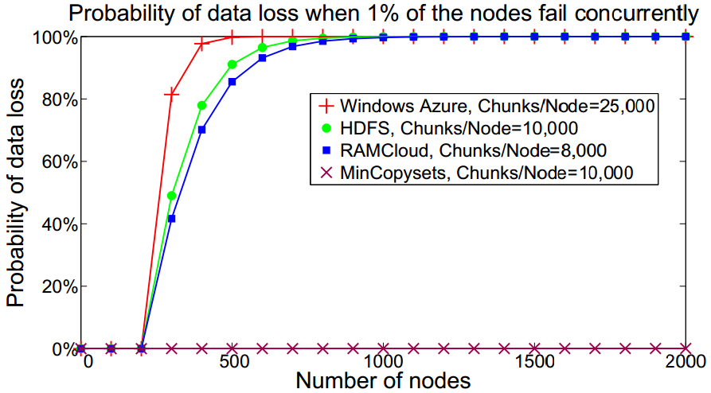
Sometimes Randomization is Bad!
Select 3 backups for segment at random?
Problem:
In large-scale system, any 3 machine failures results in data loss
After power outage, ~1% of servers don’t restart
Every power outage loses a few segments!
Solution: derandomize backup selection
Pick first backup at random (for load balancing)
Other backups deterministic (replication groups)
Result: data safe for hundreds of years
(but, lose more data in each loss)

Slide 94
Ubiquitous Retry
Assume operations may not succeed at first: provide mechanism for retries
Fault tolerance:
After crash, reconstruct data and retry
Incomplete recovery
Configuration changes (e.g., tablet moved)
Blocking:
Don’t block operations on servers (resource exhaustion, deadlock)
Return STATUS_RETRY error; client retries later
Retries now built into RPC system
All RPCs transparently retry-able
Can define reusable retry modules (e.g. for “tablet moved”)

Slide 95
Rules-Based Programming
RAMCloud contains many DCFT modules (Distributed, Concurrent, Fault-Tolerant)
Segment replica manager
Cluster membership notifier
Main loop of recovery masters
Multi-read dispatcher
...
Very hard to implement! (nondeterminism)

Slide 96
Rules-Based Programming, cont’d
Solution: decompose code into rules
Rule = condition to check against state, action to execute
Each rule makes incremental progress towards a goal
DCFT module = retry loop
Execute rules until goal reached
Event Handlers
Rules
State
Condition
Action
Condition
Action
Events
Condition
Action
…
…
…
Condition
Action
Notes:
Baby steps!
Typical action: initiate RPC
25 rules in replica mgr
2 rules for multi-read

Slide 97
Layering Conflicts With Latency
Layering:
Essential for decomposing large systems
Each crossing adds delay
Many layers → high latency
Granular interfaces especially problematic
For low latency, must rethink system architecture
Minimize layer crossings
Thick interfaces: lots of useful work for each crossing
Fast paths that bypass layers (e.g., kernel bypass for NICs)
Notes:
People with large stacks will have trouble converting to low latency

Slide 98
Conclusion
RAMCloud: general-purpose DRAM-based storage
Scale
Latency
Goals:
Harness full performance potential of DRAM-based storage
Enable new applications: intensive manipulation of large-scale data
What could you do with:
1M cores
1 petabyte data
5-10µs flat access time

Slide 99
References
[1] RAMCloud Wiki: https://ramcloud.atlassian.net/wiki/display/RAM/RAMCloud
[2] J. Ousterhout et al., “The RAMCloud Storage System,” under submission, https://ramcloud.atlassian.net/wiki/display/RAM/RAMCloud?preview=/6848571/6947168/RAMCloudPaper.pdf
[3] D. Ongaro, S. Rumble, R. Stutsman, J. Ousterhout and M. Rosenblum, “Fast Crash Recovery in RAMCloud,” Proc. 23rd ACM Symposium on Operating Systems Principles, October 2011, pp. 29-41.
[4] S. Rumble, A. Kejriwal, and J. Ousterhout, “Log-Structured Memory for DRAM-based Storage,” 12th USENIX Conference on File and Storage Technology (FAST '14), February 2014, pp. 1-16.
[5] Ryan Stutsman’s Ph.D. dissertation: Durability and Crash Recovery in Distributed In-memory Storage Systems, 2013
[6] Steve Rumble’s Ph.D. dissertation: Memory and Object Management in RAMCloud, 2014
[7] R. Stutsman, C. Lee, and J. Ousterhout, “Experience with Rules-Based Programming for Distributed, Concurrent, Fault-Tolerant Code,” Stanford technical report, https://ramcloud.atlassian.net/wiki/display/RAM/RAMCloud+Papers?preview=/6848671/12058674/dcft.pdf

Slide 100
Palette

