Slide 1
Analysis of RAMCloud Crash Probabilities
Asaf Cidon
Stanford University

Slide 2
Outline
Motivation
Segment Loss Probabilities
Simultaneous Crash Probabilities
Average Segment Loss Rate
Numerical Results
Conclusions & Takeaways

Slide 3
Motivation
Challenge the assumptions of RAMCloud’s recovery mechanism
Are 2 disk backups per segment enough?
Is it a good idea to backup every segment independently and randomly?
If we suddenly lose all our memory (i.e. power outage), is our data protected?
Estimate rate and probability of segment loss in RAMCloud

Slide 4
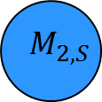
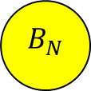
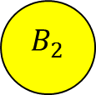
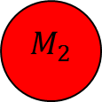
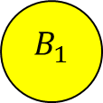
Segment Loss Probabilities
$$M_{1}$$
$$M_{2}$$
$$M_{N}$$
$$M_{2,1}$$
$$M_{2,2}$$
$$M_{2,S}$$
$$B_{1}$$
$$B_{2}$$
$$B_{N}$$
2 backups fail: $Pr\left(B_{i}{∩B}_{j}≠∅\right)$
2 backups and 1 master fail: $Pr\left(B_{i}{∩B}_{j}{∩M}_{k}≠∅\right)$

Slide 5
Assumptions
Each master randomly uniformly and independently distributes one copy of each of its segments to two different backups
A backup cannot hold a segment that belongs to a master with the same master index

Slide 6
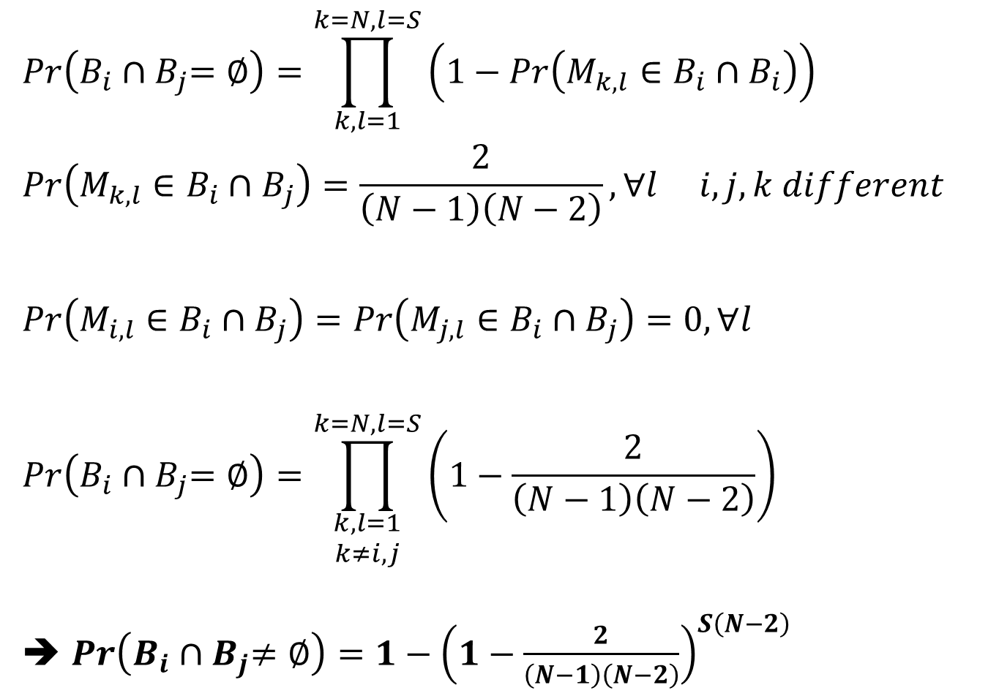
Probability of Segment Loss for 2 Backups
$$Pr\left(B_{i}{∩B}_{j}=∅\right)=\prod_{k,l=1}^{k=N,l=S}{\left(1−Pr\left({M_{k,l}∈B}_{i}{∩B}_{i}\right)\right)}$$
$$Pr\left(M_{k,l}∈B_{i}∩B_{j}\right)=\frac{2}{\left(N−1\right)\left(N−2\right)}, ∀l i,j,k different$$
$$Pr\left(M_{i,l}∈B_{i}∩B_{j}\right)=Pr\left(M_{j,l}∈B_{i}∩B_{j}\right)=0, ∀l$$
$$Pr\left(B_{i}{∩B}_{j}=∅\right)=\prod_{\begin{aligned}k,l=1 \\ k≠i,j\end{aligned}}^{k=N,l=S}{\left(1−\frac{2}{\left(N−1\right)\left(N−2\right)}\right)}$$
➔ $Pr\left(B_{i}{∩B}_{j}≠∅\right)=1−{\left(1−\frac{2}{\left(N−1\right)\left(N−2\right)}\right)}^{S\left(N−2\right)}$

Slide 7
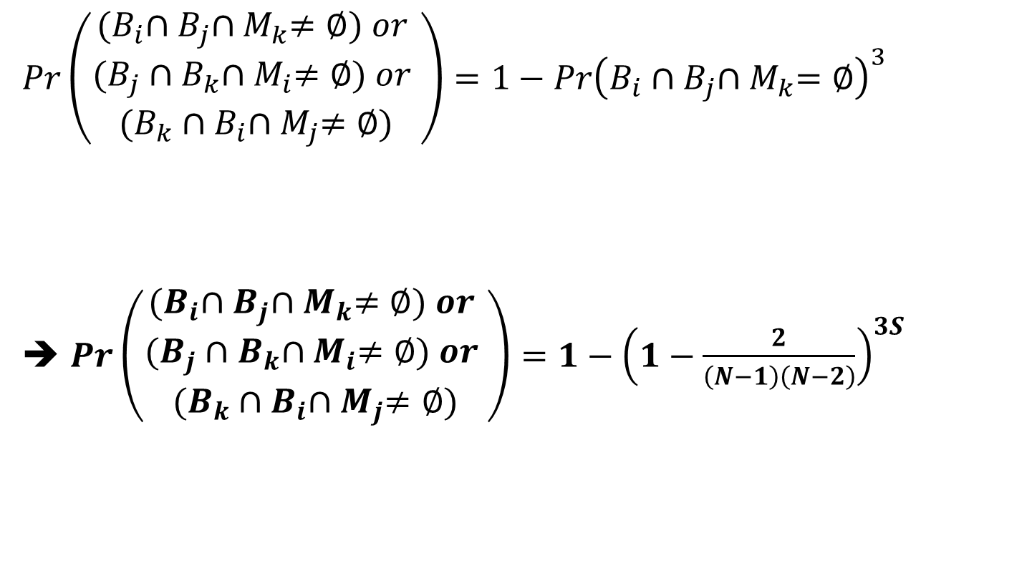
Probability of Segment Loss for 2 Backups and 1 Master
$$Pr\left(\begin{aligned}{(B}_{i}{∩B}_{j}{∩M}_{k}≠∅) or \\ (B_{j}{∩B}_{k}{∩M}_{i}≠∅) or \\ (B_{k}{∩B}_{i}{∩M}_{j}≠∅)\end{aligned}\right)=1−{Pr\left(B_{i}{∩B}_{j}{∩M}_{k}=∅\right)}^{3}$$
➔ $Pr\left(\begin{aligned}{(B}_{i}{∩B}_{j}{∩M}_{k}≠∅) or \\ (B_{j}{∩B}_{k}{∩M}_{i}≠∅) or \\ (B_{k}{∩B}_{i}{∩M}_{j}≠∅)\end{aligned}\right)=1−{\left(1−\frac{2}{\left(N−1\right)\left(N−2\right)}\right)}^{3S}$

Slide 8
More of the Same
Probability of losing segment in disk when using 3 backups per segments with k simultaneous failures:
$1−{\left(1−\frac{\left(\frac{k!}{\left(k−3\right)!}\right)}{\left(N−1\right)\left(N−2\right)\left(N−3\right)}\right)}^{S\left(N−3\right)}$
Probability of losing segment in disk and memory when using 3 backups per segments with 4 simultaneous failures:
$1−{\left(1−\frac{6}{\left(N−1\right)\left(N−2\right)\left(N−3\right)}\right)}^{4S}$

Slide 9
Intermezzo
What have we done so far?
We calculated the probability of losing at least one copy of a segment on disk given two simultaneous failures of backups
We calculated the probability of losing at least one copy of a segment on disk and on memory given the simultaneous failure of three machines
What can we do now?
Try to estimate the rate of simultaneous machine failures in a RAMCloud data center
Estimate RAMCloud’s annual segment loss rate

Slide 10
Simultaneous Crashes
General idea:
Each machine crashes as independent Poisson process with recovery time T
Try to find overlapping crashes
Very similar to Aloha network packet collisions model
Single machine failure: $X_{i}\sim Pois\left(\frac{g}{N},t\right)$
All machine failures: $\sum{X_{i}}=X\sim Pois\left(g,t\right)$
T
M1
M7
M4
0
t

Slide 11
Assumptions
All machines fail independently of each other
Each individual machine fails at a low rate
Number of machines >> 1
Constant recovery time for all machines
If a single machine fails, there is a time slot of 2T when other machine failures count as simultaneous failures

Slide 12
Average Simultaneous Crash Rate
Reminder - Poisson distribution:
$Pr\left(X=k, t=T\right)=\frac{{\left(Tg\right)}^{k}e^{−Tg}}{k!}$
Rate of crashes where only one machine fails at a time (i.e. successful packet transmission rate in Aloha):
$$(Failure Rate)∙Pr\left(X=0, t=2T\right)=gYe^{−2Tg}$$
Rate of 2 machines crashing simultaneously:
$(Failure Rate)∙Pr\left(X=1, t=T\right)=gY\left(Tg\right)e^{−Tg}$
Rate of 3 machines crashing simultaneously:
$$(Failure Rate)∙Pr\left(X=2, t=T\right)=gY\frac{{{\left(Tg\right)}^{2}e}^{−Tg}}{2}$$

Slide 13
Average Segment Loss Rate
Average disk segment loss rate for two backup failures:
$gY\left(Tg\right)e^{−Tg}$ $\left[1−{\left(1−\frac{2}{\left(N−1\right)\left(N−2\right)}\right)}^{S\left(N−2\right)}\right]$
Average disk and memory segment loss rate for three simultaneous machine failures:
$gY\frac{{{\left(Tg\right)}^{2}e}^{−Tg}}{2} \left[1−{\left(1−\frac{2}{\left(N−1\right)\left(N−2\right)}\right)}^{3S}\right]$

Slide 14
Numerical Results
Segment loss probabilities are accurate
Annual simultaneous crashes and annual segment loss rate are only lower bounds, the real numbers are probably higher
We do not take into account rare but feasible data center crash scenarios (e.g. power outages)

Slide 15
Numerical Results: Segment Disk Loss
Segment Loss on Disk Probabilities (8,000 segments per machine, 50 machines per rack)
Number of machines | 1,000 | 10,000 | 100,000 | 1,000,000
$$Pr\left(\begin{aligned}Segment Loss | \\ 2 backups, \\ 2 sim. crashes\end{aligned}\right)$$ | 0.99999995 | 0.79972 | 0.14792 | 0.01587
$$Pr\left(\begin{aligned}Segment Loss | \\ 3 backups, \\ 3 sim. crashes\end{aligned}\right)$$ | 0.054593 | 0.000487 | 4.7889E-06 | 0
$$Pr\left(\begin{aligned}Segment Loss | \\ 3 backups, \\ 4 sim. crashes\end{aligned}\right)$$ | 0.201 | 0.00195 | 1.92E-05 | 0
$$Pr\left(\begin{aligned}Segment Loss | \\ 3 backups, \\ 5 sim. crashes\end{aligned}\right)$$ | 0.4296 | 0.00486 | 4.8E-05 | 8.88E-07

Slide 16
Numerical Results: Segment Disk Loss
Segment Loss on Disk Probabilities (1,000 segments per machine, 50 machines per rack)
Number of machines | 1,000 | 10,000 | 100,000 | 1,000,000
$$Pr\left(\begin{aligned}Segment Loss | \\ 2 backups, \\ 2 sim. crashes\end{aligned}\right)$$ | 0.878 | 0.182 | 0.0198 | 0.002
$$Pr\left(\begin{aligned}Segment Loss | \\ 3 backups, \\ 3 sim. crashes\end{aligned}\right)$$ | 0.00699 | 6.09E-05 | 5.98E-07 | 0
$$Pr\left(\begin{aligned}Segment Loss | \\ 3 backups, \\ 4 sim. crashes\end{aligned}\right)$$ | 0.0276 | 0.0002 | 2.4E-06 | 0
$$Pr\left(\begin{aligned}Segment Loss | \\ 3 backups, \\ 5 sim. crashes\end{aligned}\right)$$ | 0.0677 | 0.0006 | 6E-06 | 1.11E-07

Slide 17
Numerical Results: Segment Disk & Memory Loss
Segment Loss on Disk and Memory Probabilities (8,000 segments per machine, 50 machines per rack)
Number of machines | 1,000 | 10,000 | 100,000 | 1,000,000
$$Pr\left(\begin{aligned}Segment Loss | \\ 2 backups, \\ 3 sim. crashes\end{aligned}\right)$$ | 0.05459 | 0.000487 | 4.8E-06 | 4.799E-08
$$Pr\left(\begin{aligned}Segment Loss | \\ 3 backups, \\ 4 sim. crashes\end{aligned}\right)$$ | 0.00026 | 1.978E-07 | 1.92E-10 | 0

Slide 18
Numerical Results: Rates of Simultaneous Crashes
Annual Simultaneous Crash Rate (each machine fails 2 times a year, 50 machines per rack)
Number of machines | 1,000 | 10,000 | 100,000 | 1,000,000
Annual rate of 2 machines failing simultaneously (different racks) | 1.379E-05 | 0.0158 | 15.862 | 14171.6
Annual rate of 3 machines failing simultaneously (different racks) | 4.97E-10 | 6.595E-06 | 0.0667 | 599.17

Slide 19
Numerical Results: Segment Loss Rates
Annual Segment Loss Rate (each machine fails 2 times a year, 50 machines per rack)
Number of machines | 1,000 | 10,000 | 100,000 | 1,000,000
Annual segment loss rate for 2 backups, 3 crashes | 7.53E-07 | 7.71E-06 | 7.62E-05 | 0.00068
Annual segment loss rate for 3 backups, 4 crashes | 1.313E-13 | 1.3E-12 | 1.284E-11 | ~ E-10

Slide 20
Conclusions & Takeaways
In case of big data center crash, 2 backups are not enough
For example: power outage takes out all memory, ~100% data loss if two machines do not reboot out of 1000 machine cluster
2 backups are also risky in case of 3 simultaneous failures
~5% data loss with 1000 machines
If our independent crash model is a good approximation, 2 backups are safe for ordinary crash scenarios
In most cases, using 3 backups instead of 2 significantly reduces crash probabilities

Slide 21
Suggestions for Improvement
Number of backups per segment should be a configurable system parameter
Consider using 3 backups for important data, 2 backups for ordinary data
Pros: lower data loss rate, provide majority in case of inconsistencies
Con: higher I/O bandwidth for writes
Consider backing up segments in bigger chunks
Pros: lower data loss rate, recovery time determined by slowest machine, easier to manage fewer backups (smaller tables, less coordination)
Con: bigger chunks ➔ lower recovery throughput

Slide 22
THANK YOU

