Slide 1
RAMCloud: Scalable High-Performance Storage Entirely in DRAM
John Ousterhout
Stanford University
(with Nandu Jayakumar, Diego Ongaro, Mendel Rosenblum, Stephen Rumble, and Ryan Stutsman)

Slide 2
DRAM in Storage Systems
Facebook: 200 TB total data 150 TB cache!
memcached
Web indexes entirely in DRAM
Main-memory databases
Large file caches
UNIX buffer cache
Main-memory DBs, again
1970
1980
1990
2000
2010

Slide 3
DRAM in Storage Systems
DRAM usage limited/specialized
Clumsy (consistency with backing store)
Lost performance (cache misses, backing store)
Facebook: 200 TB total data 150 TB cache!
memcached
Web indexes entirely in DRAM
Main-memory databases
Large file caches
UNIX buffer cache
Main-memory DBs, again
1970
1980
1990
2000
2010

Slide 4
RAMCloud
Harness full performance potential of large-scale DRAM storage:
General-purpose storage system
All data always in DRAM (no cache misses)
Durable and available (no backing store)
Scale: 1000+ servers, 100+ TB
Low latency: 5-10µs remote access
Potential impact: enable new class of applications

Slide 5
RAMCloud Overview
Storage for datacenters
1000-10000 commodity servers
32-64 GB DRAM/server
All data always in RAM
Durable and available
Performance goals:
High throughput: 1M ops/sec/server
Low-latency access: 5-10µs RPC
Application Servers
Storage Servers
Datacenter

Slide 6
Example Configurations
 | Today | 5-10 years
# servers | 2000 | 4000
GB/server | 24GB | 256GB
Total capacity | 48TB | 1PB
Total server cost | $3.1M | $6M
$/GB | $65 | $6
For $100-200K today:
One year of Amazon customer orders
One year of United flight reservations

Slide 7
Why Does Latency Matter?
Traditional Application
Web Application
UI
UI
App. Logic
Application Servers
App. Logic
Storage Servers
Data Structures
Single machine
Datacenter
<< 1µs latency
0.5-10ms latency
Large-scale apps struggle with high latency
Facebook: can only make 100-150 internal requests per page
Random access data rate has not scaled!

Slide 8
MapReduce
Computation
Data
Sequential data access → high data access rate
Not all applications fit this model
Offline

Slide 9
Goal: Scale and Latency
Traditional Application
Web Application
UI
UI
App. Logic
Application Servers
App. Logic
Storage Servers
Data Structures
Single machine
Datacenter
<< 1µs latency
0.5-10ms latency
5-10µs
Enable new class of applications:
Crowd-level collaboration
Large-scale graph algorithms
Real-time information-intensive applications

Slide 10
RAMCloud Architecture
1000 – 100,000 Application Servers
Appl.
Appl.
Appl.
…
Appl.
Library
Library
Library
Library
Datacenter Network
Coordinator
Master
Master
Master
…
Master
Backup
Backup
Backup
Backup
1000 – 10,000 Storage Servers

Slide 11
Data Model
Tables
create(tableId, blob) => objectId, version
read(tableId, objectId) => blob, version
write(tableId, objectId, blob) => version
cwrite(tableId, objectId, blob, version) => version
delete(tableId, objectId)
Object
Identifier (64b)
Version (64b)
(Only overwrite if version matches)
Blob (≤1MB)
Richer model in the future:
Indexes?
Transactions?
Graphs?

Slide 12
Durability and Availability
Goals:
No impact on performance
Minimum cost, energy
Keep replicas in DRAM of other servers?
3x system cost, energy
Still have to handle power failures
Replicas unnecessary for performance
RAMCloud approach:
1 copy in DRAM
Backup copies on disk/flash: durability ~ free!
Issues to resolve:
Synchronous disk I/O’s during writes??
Data unavailable after crashes??

Slide 13
Buffered Logging
Write request
Hash Table
Buffered Segment
Disk
Backup
Buffered Segment
Disk
Backup
Buffered Segment
Disk
In-Memory Log
Master
Backup
No disk I/O during write requests
Master’s memory also log-structured
Log cleaning ~ generational garbage collection

Slide 14
Crash Recovery
Power failures: backups must guarantee durability of buffered data:
DIMMs with built-in flash backup?
Per-server battery backups?
Caches on enterprise disk controllers?
Server crashes:
Must replay log to reconstruct data
Meanwhile, data is unavailable
Solution: fast crash recovery (1-2 seconds)
If fast enough, failures will not be noticed
Key to fast recovery: use system scale

Slide 15
Recovery, First Try
Master chooses backups statically
Each backup stores entire log for master
Crash recovery:
Choose recovery master
Backups read log info from disk
Transfer logs to recovery master
Recovery master replays log
First bottleneck: disk bandwidth:
64 GB / 3 backups / 100 MB/sec/disk ≈ 210 seconds
Solution: more disks (and backups)
Recovery Master
Backups

Slide 16
Recovery, Second Try
Scatter logs:
Each log divided into 8MB segments
Master chooses different backups for each segment (randomly)
Segments scattered across all servers in the cluster
Crash recovery:
All backups read from disk in parallel
Transmit data over network to recovery master
Recovery Master
~1000 Backups

Slide 17
Scattered Logs, cont’d
Disk no longer a bottleneck:
64 GB / 8 MB/segment / 1000 backups ≈ 8 segments/backup
100ms/segment to read from disk
0.8 second to read all segments in parallel
Second bottleneck: NIC on recovery master
64 GB / 10 Gbits/second ≈ 60 seconds
Recovery master CPU is also a bottleneck
Solution: more recovery masters
Spread work over 100 recovery masters
64 GB / 10 Gbits/second / 100 masters ≈ 0.6 second

Slide 18
Recovery, Third Try
Divide each master’s data into partitions
Recover each partition on a separate recovery master
Partitions based on tables & key ranges, not log segment
Each backup divides its log data among recovery masters
Dead Master
Recovery Masters
Backups

Slide 19
Other Research Issues
Fast communication (RPC)
New datacenter network protocol?
Data model
Concurrency, consistency, transactions
Data distribution, scaling
Multi-tenancy
Client-server functional distribution
Node architecture

Slide 20
Project Status
Goal: build production-quality implementation
Started coding Spring 2010
Major pieces coming together:
RPC subsystem
Supports many different transport layers
Using Mellanox Infiniband for high performance
Basic data model
Simple cluster coordinator
Fast recovery
Performance (40-node cluster):
Read small object: 5µs
Throughput: > 1M small reads/second/server

Slide 21
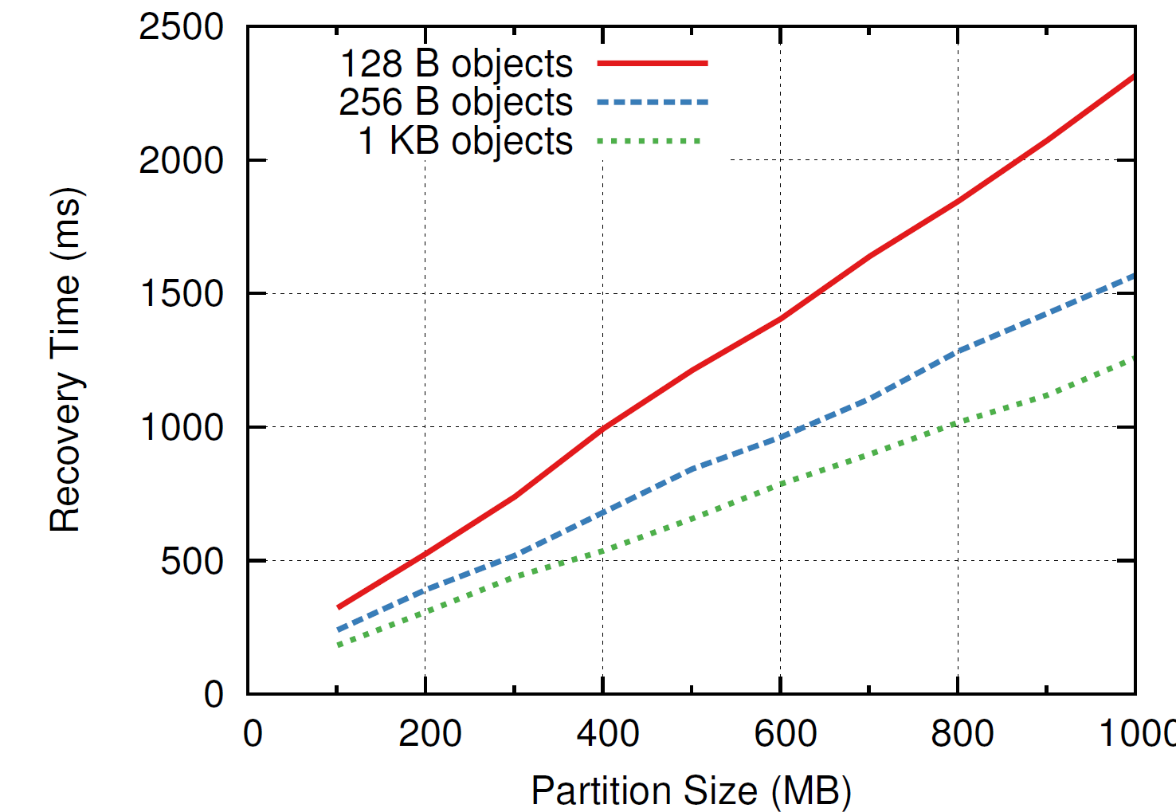
Single Recovery Master
400-800 MB/sec
1000

Slide 22
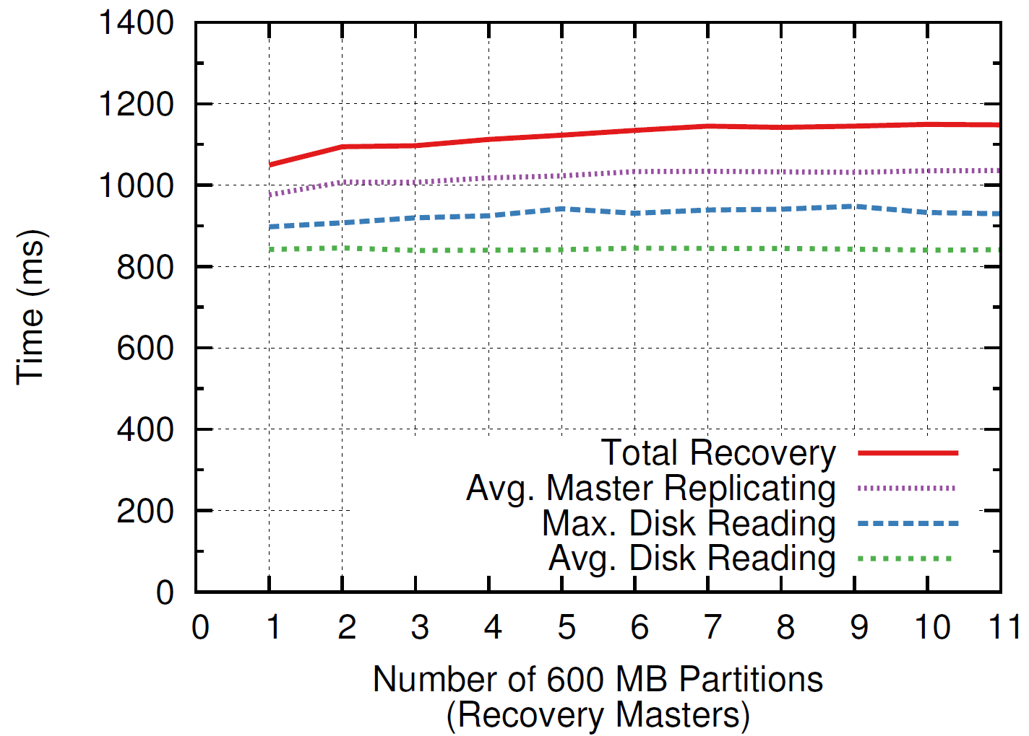
Recovery Scalability
1 master
6 backups
6 disks
600 MB
11 masters
66 backups
66 disks
6.6 GB

Slide 23
Conclusion
Achieved low latency (at small scale)
Not yet at large scale (but scalability encouraging)
Fast recovery:
1 second for memory sizes < 10GB
Scalability looks good
Durable and available DRAM storage for the cost of volatile cache
Many interesting problems left
Goals:
Harness full performance potential of DRAM-based storage
Enable new applications: intensive manipulation of large-scale data

Slide 24
Why not a Caching Approach?
Lost performance:
1% misses → 10x performance degradation
Won’t save much money:
Already have to keep information in memory
Example: Facebook caches ~75% of data size
Availability gaps after crashes:
System performance intolerable until cache refills
Facebook example: 2.5 hours to refill caches!

Slide 25
Data Model Rationale
Lower-level APIs
Less server functionality
Key-value store
Higher-level APIs
More server functionality
Distributed shared memory :
Server implementation easy
Low-level performance good
APIs not convenient for applications
Lose performance in application-level synchronization
Relational database :
Powerful facilities for apps
Best RDBMS performance
Simple cases pay RDBMS performance
More complexity in servers
How to get best application-level performance?

Slide 26
RAMCloud Motivation: Technology
Disk access rate not keeping up with capacity:
Disks must become more archival
More information must move to memory
 | Mid-1980’s | 2009 | Change
Disk capacity | 30 MB | 500 GB | 16667x
Max. transfer rate | 2 MB/s | 100 MB/s | 50x
Latency (seek & rotate) | 20 ms | 10 ms | 2x
Capacity/bandwidth (large blocks) | 15 s | 5000 s | 333x
Capacity/bandwidth (1KB blocks) | 600 s | 58 days | 8333x

