Slide 1
A Compilation of RAMCloud Slides (through Oct. 2012)
John Ousterhout
Stanford University

Slide 2
DRAM in Storage Systems
Facebook: 200 TB total data 150 TB cache!
memcached
Web indexes entirely in DRAM
Main-memory databases
Large file caches
UNIX buffer cache
Main-memory DBs, again
1970
1980
1990
2000
2010

Slide 3
DRAM in Storage Systems
DRAM usage specialized/limited
Clumsy (consistency with backing store)
Lost performance (cache misses, backing store)
Facebook: 200 TB total data 150 TB cache!
memcached
Web indexes entirely in DRAM
Main-memory databases
Large file caches
UNIX buffer cache
Main-memory DBs, again
1970
1980
1990
2000
2010

Slide 4
RAMCloud
Harness full performance potential of large-scale DRAM storage:
General-purpose storage system
All data always in DRAM (no cache misses)
Durable and available
Scale: 1000+ servers, 100+ TB
Low latency: 5-10µs remote access
Potential impact: enable new class of applications

Slide 5
RAMCloud Overview
Storage for datacenters
1000-10000 commodity servers
32-64 GB DRAM/server
All data always in RAM
Durable and available
Performance goals:
High throughput: 1M ops/sec/server
Low-latency access: 5-10µs RPC
Application Servers
Storage Servers
Datacenter

Slide 6
Example Configurations
 | 2010 | 2015-2020
# servers | 2000 | 4000
GB/server | 24GB | 256GB
Total capacity | 48TB | 1PB
Total server cost | $3.1M | $6M
$/GB | $65 | $6
For $100-200K today:
One year of Amazon customer orders
One year of United flight reservations

Slide 7
Why Does Latency Matter?
Traditional Application
Web Application
UI
UI
App. Logic
Application Servers
App. Logic
Storage Servers
Data Structures
Single machine
Datacenter
<< 1µs latency
0.5-10ms latency
Large-scale apps struggle with high latency
Random access data rate has not scaled!
Facebook: can only make 100-150 internal requests per page

Slide 8
MapReduce
Computation
...
Data
...
...
...
...
...
...
Sequential data access → high data access rate
Not all applications fit this model
Offline

Slide 9
Goal: Scale and Latency
Traditional Application
Web Application
UI
UI
App. Logic
Application Servers
App. Logic
Storage Servers
Data Structures
Single machine
Datacenter
<< 1µs latency
0.5-10ms latency
5-10µs
Enable new class of applications:
Crowd-level collaboration
Large-scale graph algorithms
Real-time information-intensive applications

Slide 10
RAMCloud Architecture
1000 – 100,000 Application Servers
Appl.
Appl.
Appl.
…
Appl.
Library
Library
Library
Library
High-speed networking:
5 µs round-trip
Full bisection bwidth
Datacenter Network
Coordinator
Commodity Servers
Master
Master
Master
…
Master
32-256 GB per server
Backup
Backup
Backup
Backup
1000 – 10,000 Storage Servers

Slide 11
Data Model
Tables
read(tableId, key) => blob, version
write(tableId, key, blob) => version
cwrite(tableId, key, blob, version) => version
delete(tableId, key)
Object
Key (≤ 64KB)
(Only overwrite if version matches)
Version (64b)
Blob (≤ 1MB)
Richer model in the future:
Indexes?
Transactions?
Graphs?

Slide 12
Research Issues
Durability and availability
Fast communication (RPC)
Data model
Concurrency, consistency, transactions
Data distribution, scaling
Multi-tenancy
Client-server functional distribution
Node architecture

Slide 13
Research Areas
Data models for low latency and large scale
Storage systems: replication, logging to make DRAM-based storage durable
Performance:
Serve requests in < 10 cache misses
Recover from crashes in 1-2 seconds
Networking: new protocols for low latency, datacenters
Large-scale systems:
Coordinate 1000’s of machines
Automatic reconfiguration

Slide 14
Durability and Availability
Goals:
No impact on performance
Minimum cost, energy
Keep replicas in DRAM of other servers?
3x system cost, energy
Still have to handle power failures
RAMCloud approach:
1 copy in DRAM
Backup copies on disk/flash: durability ~ free!
Issues to resolve:
Synchronous disk I/O’s during writes??
Data unavailable after crashes??

Slide 15
Buffered Logging
Write request
Hash Table
Buffered Segment
Disk
Backup
Buffered Segment
Disk
Backup
Buffered Segment
Disk
In-Memory Log
Master
Backup
No disk I/O during write requests
Log-structured: backup disk and master’s memory
Log cleaning ~ generational garbage collection

Slide 16
Crash Recovery
Power failures: backups must guarantee durability of buffered data:
Per-server battery backups?
DIMMs with built-in flash backup?
Caches on enterprise disk controllers?
Server crashes:
Must replay log to reconstruct data
Meanwhile, data is unavailable
Solution: fast crash recovery (1-2 seconds)
If fast enough, failures will not be noticed
Key to fast recovery: use system scale

Slide 17
Recovery, First Try
Master chooses backups statically
Each backup mirrors entire log for master
Crash recovery:
Choose recovery master
Backups read log info from disk
Transfer logs to recovery master
Recovery master replays log
First bottleneck: disk bandwidth:
64 GB / 3 backups / 100 MB/sec/disk ≈ 210 seconds
Solution: more disks (and backups)
Recovery Master
Backups

Slide 18
Recovery, Second Try
Scatter logs:
Each log divided into 8MB segments
Master chooses different backups for each segment (randomly)
Segments scattered across all servers in the cluster
Crash recovery:
All backups read from disk in parallel
Transmit data over network to recovery master
Recovery Master
~1000 Backups

Slide 19
Scattered Logs, cont’d
Disk no longer a bottleneck:
64 GB / 8 MB/segment / 1000 backups ≈ 8 segments/backup
100ms/segment to read from disk
0.8 second to read all segments in parallel
Second bottleneck: NIC on recovery master
64 GB / 10 Gbits/second ≈ 60 seconds
Recovery master CPU is also a bottleneck
Solution: more recovery masters
Spread work over 100 recovery masters
64 GB / 10 Gbits/second / 100 masters ≈ 0.6 second

Slide 20
Recovery, Third Try
Divide each master’s data into partitions
Recover each partition on a separate recovery master
Partitions based on tables & key ranges, not log segment
Each backup divides its log data among recovery masters
Dead Master
Recovery Masters
Backups

Slide 21
Project Status
Goal: build production-quality implementation
Started coding Spring 2010
Major pieces working:
RPC subsystem (supports multiple networking technologies)
Basic operations, log cleaning
Fast recovery
Prototype cluster coordinator
Nearing 1.0-level release
Performance (80-node cluster):
Read small object: 5.3µs
Throughput: 850K small reads/second/server

Slide 22
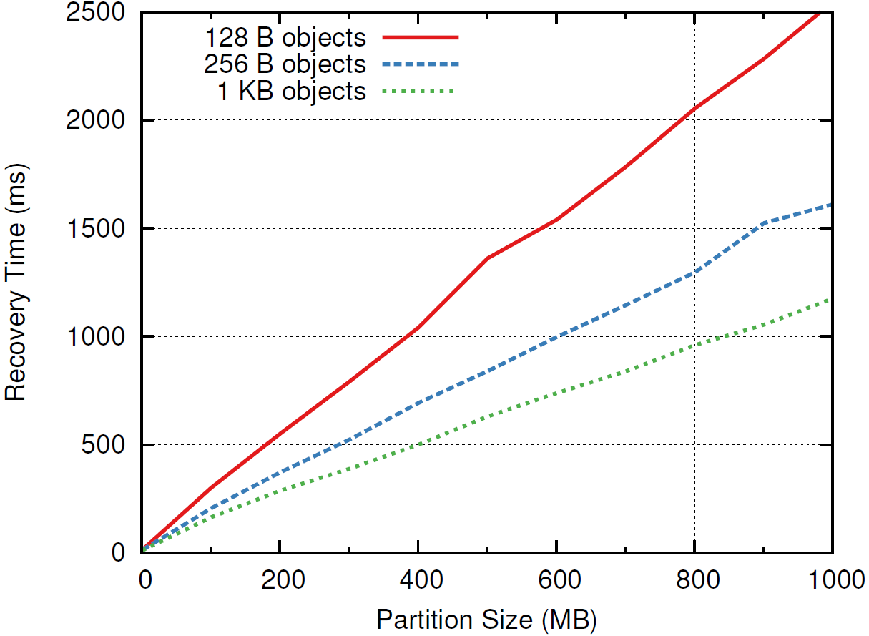
Single Recovery Master
400-800 MB/s

Slide 23
Evaluating Scalability
Recovery time should stay constant as system scales
600 MB
Recovery Masters
…
…
Backups
Memory used in crashed master

Slide 24
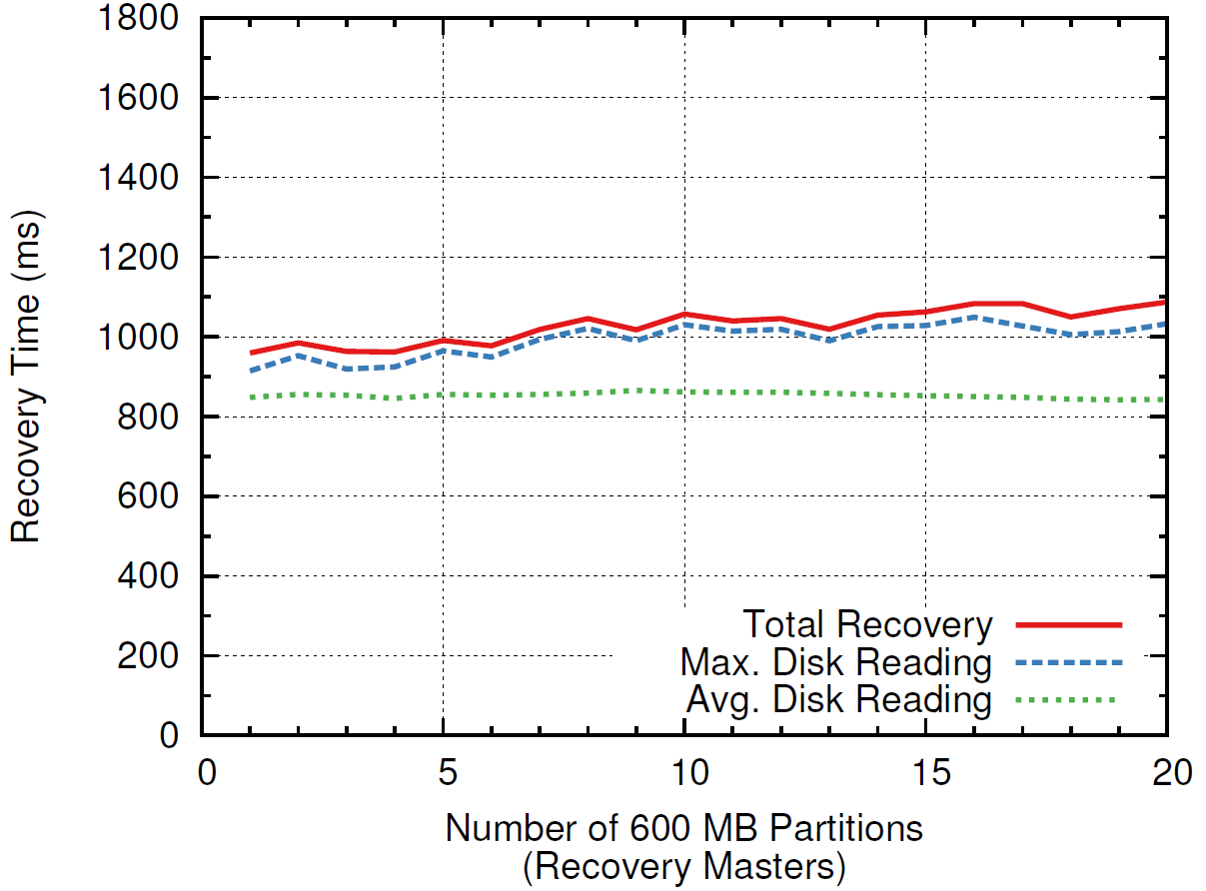
Recovery Scalability
1 master
6 backups
6 disks
600 MB
20 masters
120 backups
120 disks
11.7 GB

Slide 25
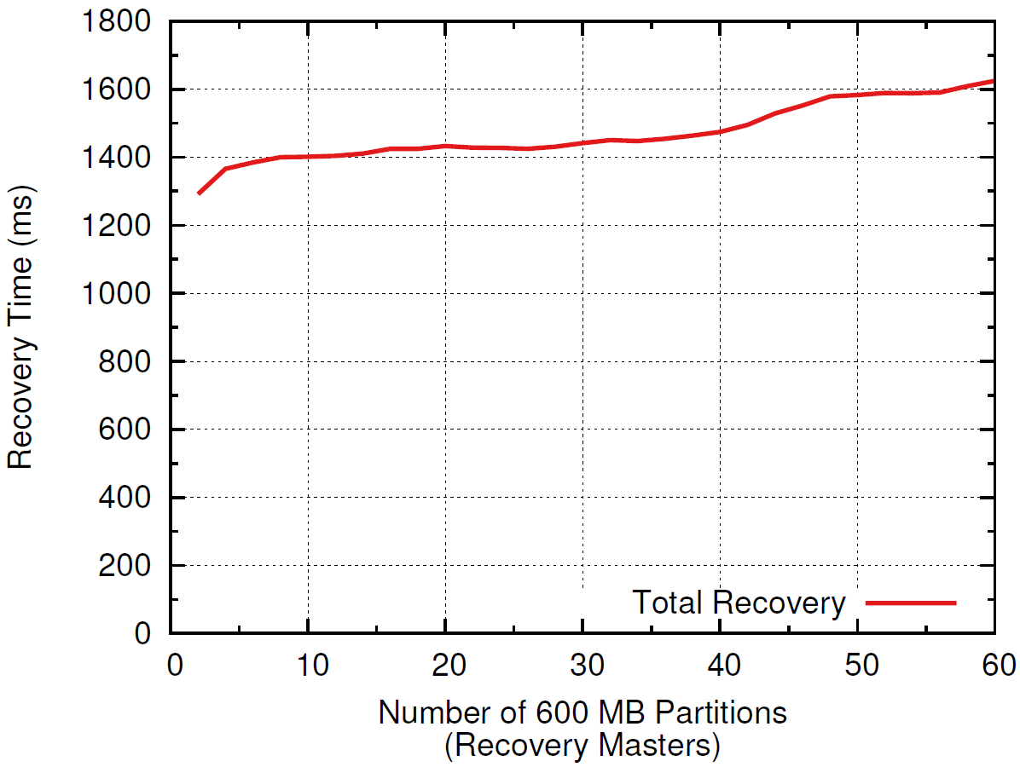
Scalability (Flash)
2 flash drives (250MB/s) per partition:
1 master
2 backups
2 SSDs
600 MB
60 masters
120 backups
120 SSDs
35 GB

Slide 26
Conclusion
Achieved low latency (at small scale)
Not yet at large scale (but scalability encouraging)
Fast recovery:
< 2 seconds for memory sizes up to 35GB
Scalability looks good
Durable and available DRAM storage for the cost of volatile cache
Many interesting problems left
Goals:
Harness full performance potential of DRAM-based storage
Enable new applications: intensive manipulation of large-scale data

Slide 27
RPC Transport Architecture
Clients
Servers
Transport API: Reliable request/response
getSession(serviceLocator) clientSend(reqBuf, respBuf)
wait()
handleRpc(reqBuf, respBuf)
InfRcTransport
TcpTransport
FastTransport
Infiniband verbs Reliable queue pairs Kernel bypass
Mellanox NICs
Kernel TCP/IP
UdpDriver
InfUdDriver
InfEthDriver
Kernel UDP
Infiniband unreliable datagrams
10GigE packets via Mellanox NIC
Driver API: Unreliable datagrams

Slide 28
RAMCloud RPC
Applications/Servers
RPC Stubs
TCP
Infiniband
Queue Pairs
Custom Datagram
Transports
UDP
InfUD
InfEth
Networks
Transport layer enables experimentation with different networking protocols/technologies
Basic Infiniband performance (one switch):
100-byte reads: 5.3 µs
100-byte writes (3x replication): 16.1 µs
Read throughput (100 bytes, 1 server): 800 Kops/sec

Slide 29
Datacenter Latency Today
Application Process
Kernel
Switch
Kernel
Server Process
NIC
NIC
Switch
Switch
Switch
Switch
Datacenter Network
Application Machine
Server Machine
Component | Delay | Round-trip
Network switch | 10-30µs | 100-300µs
OS protocol stack | 15µs | 60µs
Network interface controller (NIC) | 2.5-32µs | 10-128µs
Propagation delay | 0.2-0.4µs | 0.4-0.8µs
RAMCloud goal: 5-10µs Typical today: 200-400µs

Slide 30
Faster RPC: Switches
Overall: must focus on latency, not bandwidth
Step 1: faster switching fabrics
Per Switch
Round Trip
Typical 1 Gb/sec Ethernet switches
10-30 µs
100-300 µs
Newer 10 Gb/sec switches (e.g. Arista 7124)
0.5 µs
5 µs
100-200 ns
1-2 µs
Infiniband switches
Radical new switching fabrics (Dally)
30 ns
240 ns

Slide 31
Faster RPC: Software
Step 2: new software architecture:
Packets cannot pass through OS
Direct user-level access to NIC
Polling instead of interrupts
New network protocol
Application Process
Kernel
NIC
Each End
Round Trip
30 µs
60 µs
Typical today
1 µs
2 µs
With kernel bypass
0.5 µs
1 µs
With new NIC architecture

Slide 32
Faster RPC: NICs
Traditional NICs focus on throughput, not latency
E.g. defer interrupts for 32 µs to enable coalescing
CPU-NIC interactions are expensive:
Data must pass through memory
High-latency interconnects (Northbridge, PCIe, etc.)
Interrupts
Best-case today:
0.75 µs per NIC traversal
3 µs round-trip delay
Example: Mellanox Infiniband NICs (kernel bypass)

Slide 33
Total Round-Trip Delay
Component | Today | 3-5 Years | 10 Years
Switching fabric | 100-300µs | 5µs | 0.2µs
Software | 60µs | 2µs | 2µs
NIC | 8-128µs | 3µs | 3µs
Propagation delay | 1µs | 1µs | 1µs
Total | 200-400µs | 11µs | 6.2µs
In 10 years, 2/3 of round-trip delay due to NIC!!
3µs directly from NIC
1µs indirectly from software (communication, cache misses)

Slide 34
New NIC Architecture?
Must integrate NIC tightly into CPU cores:
Bits pass directly between L1 cache and the network
Direct access from user space
Will require architectural changes:
New instructions for network communication
Some packet buffering in hardware
Hardware tables to give OS control
Analogous to page tables
Take ideas from OpenFlow?
Ideally: CPU architecture designed in conjunction with switching fabric
E.g. minimize buffering

Slide 35
Round-Trip Delay, Revisited
Component | Today | 3-5 Years | 10 Years
Switching fabric | 100-300µs | 5µs | 0.2µs
Software | 60µs | 2µs | 1µs
NIC | 8-128µs | 3µs | 0.2µs
Propagation delay | 1µs | 1µs | 1µs
Total | 200-400µs | 11µs | 2.4µs
Biggest remaining hurdles:
Software
Speed of light

Slide 36
Other Arguments
Integrated functionality drives applications & markets:
As # cores increases, on-chip networks will become essential: solve the off-chip problem at the same time!
Floating-point arithmetic
Scientific computing
High-speed graphics
Gaming, visualization
Low-latency networking
Datacenter/cloud computing

Slide 37
Using Cores
Goal: service RPC request in 1µs:
< 10 L2 cache misses!
Cross-chip synchronization cost: ~1 L2 cache miss
Using multiple cores/threads:
Synchronization overhead will increase latency
Concurrency may improve throughput
Questions:
What is the best way to use multiple cores?
Does using multiple cores help performance?
Can a single core saturate the network?

Slide 38
Baseline
1 core, 1 thread:
Poll NIC, process request, send response
No synchronization overhead
No concurrency
NIC
request
T
response
NIC
Service Thread

Slide 39
Multi-Thread Choices
Synchronize to pass request/response
T
NIC
request
T
T
T
response
NIC
NIC Thread
NIC Thread
T
Service Threads
Server threads synchronize access to RAMCloud data
T
NIC
T
NIC
T
Synchronize for access to NIC
Service Threads

Slide 40
Other Thoughts
If all threads/cores in a single package:
No external memory references for synchronization
Does this make synchronization significantly faster?
Why not integrated NIC?
Transfer incoming packets directly to L2 cache (which L2 cache?....)
Eliminate cache misses to read packets
Plan:
Implement a couple of different approaches
Compare latency and bandwidth

Slide 41
Winds of Change
Disk → tape:
bandwidth/capacity → 0
RDBMS don’t
scale
Scalable, Durable Storage in DRAM
Web apps strangled: can only read
150 items/page
Cloud computing:
biggest obstacle is
lack of scalable storage
DRAM cheap enough:
1 yr. Amazon data for
$100-200K
Datacenters:
dense computing,
low latency

Slide 42
Research Areas
Data models for low latency and large scale
Storage systems: replication, logging to make DRAM-based storage durable
Performance:
Serve requests in < 10 cache misses
Recover from crashes in 1-2 seconds
Networking: new protocols for low latency, datacenters
Large-scale systems:
Coordinate 1000’s of machines
Automatic reconfiguration

Slide 43
Why not a Caching Approach?
Lost performance:
1% misses → 10x performance degradation
Won’t save much money:
Already have to keep information in memory
Example: Facebook caches ~75% of data size
Availability gaps after crashes:
System performance intolerable until cache refills
Facebook example: 2.5 hours to refill caches!

Slide 44
Why not Flash Memory?
DRAM enables lowest latency today:
5-10x faster than flash
Many candidate technologies besides DRAM
Flash (NAND, NOR)
PC RAM
…
Most RAMCloud techniques will apply to other technologies

Slide 45
RAMCloud Motivation: Technology
Disk access rate not keeping up with capacity:
Disks must become more archival
More information must move to memory
 | Mid-1980’s | 2009 | Change
Disk capacity | 30 MB | 500 GB | 16667x
Max. transfer rate | 2 MB/s | 100 MB/s | 50x
Latency (seek & rotate) | 20 ms | 10 ms | 2x
Capacity/bandwidth (large blocks) | 15 s | 5000 s | 333x
Capacity/bandwidth (1KB blocks) | 600 s | 58 days | 8333x

Slide 46
RAMCloud Motivation: Technology
Disk access rate not keeping up with capacity:
Disks must become more archival
More information must move to memory
 | Mid-1980’s | 2009 | Change
Disk capacity | 30 MB | 500 GB | 16667x
Max. transfer rate | 2 MB/s | 100 MB/s | 50x
Latency (seek & rotate) | 20 ms | 10 ms | 2x
Capacity/bandwidth (large blocks) | 15 s | 5000 s | 333x
Capacity/bandwidth (1KB blocks) | 600 s | 58 days | 8333x
Jim Gray’s rule | 5 min | 30 hours | 360x

Slide 47
Implementation Status
Threading
Architecture
RPC Transport
RPC
Retry
Key-Value Store
Log Cleaning
Coordinator
Recovery
Replica Management
Cluster Membership
Cluster Coordinator
Simultaneous Failures
Master Server
Backup Server
Failure Detection
Cold Start
Master
Recovery
Backup
Recovery
A few ideas
Throw-away version
Ready for 1.0

Slide 48
Implementation Status
Administration Tools
Recovery: Backups
Recovery: Masters
RPC Architecture
Recovery: Coordinator
Failure Detection
RPC Transports
Cold Start
Tablet Placement
Log Cleaning
Split/move Tablets
Master Server
Threading
Multi-Tenancy
Backup Server
Access Control/Security
Cluster Coordinator
Tub
Higher-level Data Model
Performance Tools
(ask Diego)
Multi-object Transactions
A few ideas
Throw-away first version
First real implementation
Mature
Dissertation- ready

Slide 49
RAMCloud Code Size
Code 36,900 lines
Unit tests 16,500 lines
Total 53,400 lines

Slide 50
Selected Performance Metrics
Latency for 100-byte reads (1 switch):
InfRc 4.9 µs
TCP (1GigE) 92 µs
TCP (Infiniband) 47 µs
Fast + UDP (1GigE) 91 µs
Fast + UDP (Infiniband) 44 µs
Fast + InfUd 4.9 µs
Server throughput (InfRc, 100-byte reads, one core):
1.05 × 10⁶ requests/sec
Recovery time (6.6GB data, 11 recovery masters, 66 backups)
1.15 sec

Slide 51
Lessons/Conclusions (so far)
Fast RPC is within reach
NIC is biggest long-term bottleneck: must integrate with CPU
Can recover fast enough that replication isn’t needed for availability
Randomized approaches are key to scalable distributed decision-making

Slide 52
The Datacenter Opportunity
Exciting combination of features for research:
Concentrated compute power (~100,000 machines)
Large amounts of storage:
1 Pbyte DRAM
100 Pbytes disk
Potential for fast communication:
Low latency (speed-of-light delay < 1µs)
High bandwidth
Homogeneous
Controlled environment enables experimentation:
E.g. new network protocols
Huge Petri dish for innovation over next decade

Slide 53
How Many Datacenters?
Suppose we capitalize IT at the same level as other infrastructure (power, water, highways, telecom):
$1-10K per person?
1-10 datacenter servers/person?
Computing in 10 years:
Devices provide user interfaces
Most general-purpose computing (i.e. Intel processors) will be in datacenters
 | U.S. | World
Servers | 0.3-3B | 7-70B
Datacenters | 3000-30,000 | 70,000-700,000
(assumes 100,000 servers/datacenter)

Slide 54
Logging/Recovery Basics
All data/changes appended to a log:
One log for each master (kept in DRAM)
Log data is replicated on disk on 2+ backups
During recovery:
Read data from disks on backups
Replay log to recreate data on master
Recovery must be fast: 1-2 seconds!
Only one copy of data in DRAM
Data unavailable until recovery completes

Slide 55
Parallelism in Recovery
Respond to requests from masters
Request data from backups
Add new info to hash table & log
Read disk
Filter log data
Hash Table
Log
Backup
Recovery Master
Write backup data to disk
Receive backup data
Log new data to backups

Slide 56
Measure Deeper
Application
Want to understand performance here?
Then measure down to here
Hardware
Performance measurements often wrong/counterintuitive
Measure components of performance
Understand why performance is what it is

Slide 57
Data Model Rationale
Lower-level APIs
Less server functionality
Key-value store
Higher-level APIs
More server functionality
Distributed shared memory :
Server implementation easy
Low-level performance good
APIs not convenient for applications
Lose performance in application-level synchronization
Relational database :
Powerful facilities for apps
Best RDBMS performance
Simple cases pay RDBMS performance
More complexity in servers
How to get best application-level performance?

Slide 58
Lowest TCO
10000
Disk
1000
100
Flash
Dataset Size (TB)
10
DRAM
1
0.1
0.1
1
10
100
1000
Query Rate (millions/sec)
from "Andersen et al., "FAWN: A Fast Array of Wimpy Nodes", Proc. 22nd Symposium on Operating System Principles, 2009, pp. 1-14.

Slide 59
Latency vs. Ops/sec
10⁻⁷
Main memory, one machine
10⁻⁶
Better
RAMCloud, 1000 servers
10⁻⁵
Latency (secs)
Flash, one machine
Flash, 1000 servers
10⁻⁴
5 disks, one machine
10⁻³
Cache, 90% hits
5000 disks, 1000 servers,
No cache
10⁻²
10²
10³
10⁴
10⁵
10⁶
10⁷
10⁸
10⁹
Ops/sec. (small reads)

Slide 60
Latency vs. Ops/sec
10⁻²
1000 servers, 5000 disks,
no cache
1000 servers, 5000 disks,
90% cache hits
1 server, 5 disks, no cache
10⁻³
One app. server
1 server, 5 disks,
90% cache hits
flash, 1000 servers
10⁻⁴
Latency (secs)
10⁻⁵
Many app. servers
RAMCloud, 1000 servers
Better
10⁻⁶
main memory, one machine
10⁻⁷
10²
10³
10⁴
10⁵
10⁶
10⁷
10⁸
10⁹
Ops/sec. (small reads)

Slide 61
What We Have Learned From RAMCloud
John Ousterhout
Stanford University
(with Asaf Cidon, Ankita Kejriwal, Diego Ongaro, Mendel Rosenblum, Stephen Rumble, Ryan Stutsman, and Stephen Yang)

Slide 62
Introduction
A collection of broad conclusions we have reached during the RAMCloud project:
Randomization plays a fundamental role in large-scale systems
Need new paradigms for distributed, concurrent, fault-tolerant software
Exciting opportunities in low-latency datacenter networking
Layering conflicts with latency
Don’t count on locality
Scale can be your friend

Slide 63
RAMCloud Overview
Harness full performance potential of large-scale DRAM storage:
General-purpose key-value storage system
All data always in DRAM (no cache misses)
Durable and available
Scale: 1000+ servers, 100+ TB
Low latency: 5-10µs remote access
Potential impact: enable new class of applications

Slide 64
RAMCloud Architecture
1000 – 100,000 Application Servers
Appl.
Appl.
Appl.
…
Appl.
Library
Library
Library
Library
High-speed networking:
5 µs round-trip
Full bisection bwidth
Datacenter Network
Coordinator
Commodity Servers
Master
Master
Master
…
Master
32-256 GB per server
Backup
Backup
Backup
Backup
1000 – 10,000 Storage Servers

Slide 65
Randomization
Randomization plays a fundamental role in large-scale systems
Enables decentralized decision-making
Example: load balancing of segment replicas. Goals:
Each master decides where to replicate its own segments: no central authority
Distribute each master’s replicas uniformly across cluster
Uniform usage of secondary storage on backups
Masters
M1, S2
M2, S1
M3, S9
M1, S3
M2, S4
M3, S11
M1, S8
M3, S12
M3, S13
Backups
M1, S8
M3, S12
M3, S12
M2, S1
M1, S3
M2, S4
M3, S13
M2, S4
M1, S3
M1, S8
M1, S2
M3, S9
M2, S1
M3, S11
M1, S2
M3, S9
M3, S11
M3, S13

Slide 66
Randomization, cont’d
Choose backup for each replica at random?
Uneven distribution: worst-case = 3-5x average
Use Mitzenmacher’s approach:
Probe several randomly selected backups
Choose most attractive
Result: almost uniform distribution

Slide 67
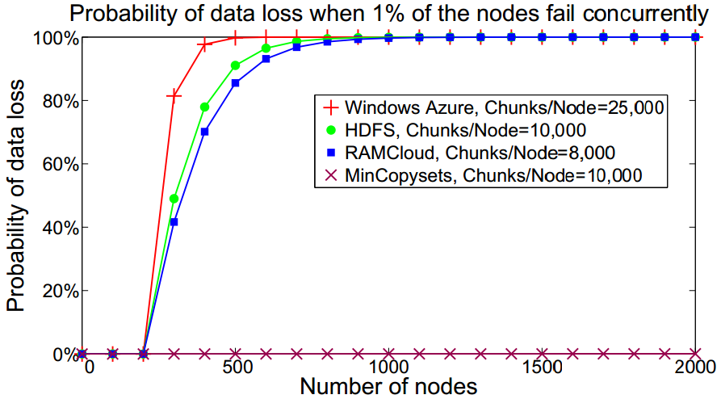
Sometimes Randomization is Bad!
Select 3 backups for segment at random?
Problem:
In large-scale system, any 3 machine failures results in data loss
After power outage, ~1% of servers don’t restart
Every power outage loses data!
Solution: derandomize backup selection
Pick first backup at random (for load balancing)
Other backups deterministic (replication groups)
Result: data safe for hundreds of years
(but, lose more data in each loss)

Slide 68
DCFT Code is Hard
RAMCloud often requires code that is distributed, concurrent, and fault tolerant:
Replicate segment to 3 backups
Coordinate 100 masters working together to recover failed server
Concurrently read segments from ~1000 backups, replay log entries, re-replicate to other backups
Traditional imperative programming doesn’t work
Result: spaghetti code, brittle, buggy
Must “go back”
after failures

Slide 69
DCFT Code: Need New Pattern
Experimenting with new approach: more like a state machine
Code divided into smaller units
Each unit handles one invariant or transition
Event driven (sort of)
Serialized access to shared state
These ideas are still evolving
Shared State

Slide 70
Low-Latency Networking
Datacenter evolution, phase #1: scale
Datacenter evolution, phase #2: latency
Typical round-trip in 2010: 300µs
Feasible today: 5-10µs
Ultimate limit: < 2µs
No fundamental technological obstacles, but need new architectures:
Must bypass OS kernel
New integration of NIC into CPU
New datacenter network architectures (no buffers!)
New network/RPC protocols: user-level, scale, latency (1M clients/server?)

Slide 71
Layering Conflicts With Latency
Most obvious way to build software: lots of layers
For low latency, must rearchitect with fewer layers
Application
Developed bottom-up
Problems:
Complex
High latency
Layers typically “thin”
Network
Application
Harder to design (top-down and bottom-up)
But, better architecturally (simpler)
Network

Slide 72
Don’t Count On Locality
Greatest drivers for software and hardware systems over last 30 years:
Moore’s Law
Locality (caching, de-dup, rack organization, etc. etc.)
Large-scale Web applications have huge datasets but less locality
Long tail
Highly interconnected (social graphs)
Traditional applications
Frequency
Web applications
Items

Slide 73
Make Scale Your Friend
Large-scale systems create many problems:
Manual management doesn’t work
Reliability is much harder to achieve
“Rare” corner cases happen frequently
However, scale can be friend as well as enemy:
RAMCloud fast crash recovery
Use 1000’s of servers to recover failed masters quickly
Since crash recovery is fast, “promote” all errors to server crashes
Windows error reporting (Microsoft)
Automated bug reporting
Statistics identify most important bugs
Correlations identify buggy device drivers

Slide 74
Conclusion
Build big => learn big
My pet peeve: too much “summer project research”
2-3 month projects
Motivated by conference paper deadlines
Superficial, not much deep learning
Trying to build a large system that really works is hard, but intellectually rewarding:
Exposes interesting side issues
Important problems identify themselves (recurrences)
Deeper evaluation (real use cases)
Shared goal creates teamwork, intellectual exchange
Overall, deep learning

