Slide 1
Designing for Understandability: the Raft Consensus Algorithm
Diego Ongaro
John Ousterhout
Stanford University

Slide 2
Algorithms Should Be Designed For ...
Correctness?
Efficiency?
Conciseness?
Understandability!
Notes:
Implementations will inevitably change or extend the base algorithm
Understandability is often neglected in academia
Particularly important for distributed/concurrent systems

Slide 3
Overview
Consensus:
Allows collection of machines to work as coherent group
Continuous service, even if some machines fail
Paxos has dominated discussion for 25 years
Hard to understand
Not complete enough for real implementations
New consensus algorithm: Raft
Primary design goal: understandability (intuition, ease of explanation)
Complete foundation for implementation
Different problem decomposition
Results:
User study shows Raft more understandable than Paxos
Widespread adoption
Notes:
Understandability is particularly important for distributed systems, where the algorithms are inherently complicated
Most important algorithm in distributed systems
Allows a collection of unreliable machines to behave like a single reliable machine

Slide 4
State Machine
Responds to external stimuli
Manages internal state
Examples: many storage systems, services
Memcached
RAMCloud
HDFS name node
...
request
Clients
result
State
Machine

Slide 5
Replicated State Machine
Clients
z←x
Consensus Module
State Machine
Consensus Module
State Machine
Consensus Module
State Machine
Servers
Log
Log
Log
x←1
y←3
x←4
z←x
x←1
y←3
x←4
z←x
x←1
y←3
x←4
z←x
Replicated log ensures state machines execute same commands in same order
Consensus module ensures proper log replication
System makes progress as long as any majority of servers are up
Failure model: delayed/lost messages, fail-stop (not Byzantine)

Slide 6
Paxos (Single Decree)
Proposers
Acceptors
Choose unique proposal #
propose(proposal #)
proposal # > any previous?
highest proposal # accepted, corresponding value
Majority? Select value for highest proposal # returned; if none, choose own value
accept(proposal #, value)
proposal # >= any previous?
accepted
Majority? Value chosen
Notes:
Allows agreement on only a single value, *ever*.
Unique proposal: larger than anything ever seen before.
Don’t discuss understandability issues on this slide.

Slide 7
Paxos Problems
Impenetrable: hard to develop intuitions
Why does it work?
What is the purpose of each phase?
Incomplete
Only agrees on single value
Doesn’t address liveness
Choosing proposal values?
Cluster membership management?
Inefficient
Two rounds of messages to choose one value
No agreement on the details
Not a good foundation for practical implementations
“The dirty little secret of the NSDI community is that at most five people really, truly understand every part of Paxos :-)”
— NSDI reviewer
“There are significant gaps between the description of the Paxos algorithm and the needs of a real-world system ... the final system will be based on an unproven protocol”
— Chubby authors
Notes:
Advantages of Paxos: concise and correct
Concise, but not simple!
Why > in the proposal phase, but >= in the accept phase?
Ask audience (a) who has tried to understand Paxos? (b) who found it difficult to understand? (c) who now feels comfortable with Paxos?
Even after I believed the proof, I still couldn’t understand it
Very few implementations, each took enormous effort

Slide 8
Raft Challenge
Is there a different consensus algorithm that’s easier to understand?
Make design decisions based on understandability:
Which approach is easier to explain?
Techniques:
Problem decomposition
Minimize state space
Handle multiple problems with a single mechanism
Eliminate special cases
Maximize coherence
Minimize nondeterminism
Notes:
Is Paxos really the best we can do?
Rest of talk: mostly describe Raft, talk a bit about how we made it understandable
Warning: Raft is still not simple...

Slide 9
Raft Decomposition
Leader election:
Select one server to act as leader
Detect crashes, choose new leader
Log replication (normal operation)
Leader accepts commands from clients, appends to its log
Leader replicates its log to other servers (overwrites inconsistencies)
Safety
Keep logs consistent
Only servers with up-to-date logs can become leader
Notes:
Different decomposition from Paxos:
No single-value consensus
Go straight to replicated log
Decompose the replication process
RaftScope demo comes after this slide

Slide 10
Server States and RPCs
start
Follower
Passive (but expects
regular heartbeats)
discover
higher
term
no
heartbeat
Candidate
Issues RequestVote RPCs to get elected as leader
win
election
Issues AppendEntries RPCs:
Replicate its log
Heartbeats to maintain leadership
Leader

Slide 11
Terms
Term 1
Term 2
Term 3
Term 4
Term 5
time
Elections
Normal
Operation
Split
Vote
At most 1 leader per term
Some terms have no leader (failed election)
Each server maintains current term value (no global view)
Exchanged in every RPC
Peer has later term? Update term, revert to follower
Incoming RPC has obsolete term? Reply with error
Terms identify obsolete information
Notes:
Key idea: identify obsolete information
Example: leader has crashed and been replaced, but it doesn’t know it

Slide 12
Leader Election
Become candidate
currentTerm++, vote for self
timeout
Send RequestVote RPCs
to other servers
votes from majority
RPC from leader
Become leader,
send heartbeats
Become follower
Notes:
3 things can happen once a candidate sends out votes...

Slide 13
Election Correctness
Safety: allow at most one winner per term
Each server gives only one vote per term (persist on disk)
Majority required to win election
Liveness: some candidate must eventually win
Choose election timeouts randomly in [T, 2T] (e.g. 150-300 ms)
One server usually times out and wins election before others time out
Works well if T >> broadcast time
Randomized approach simpler than ranking
B can’t also get majority
Voted for candidate A
Servers
Notes:
Be clear about split votes
Ranking approach had many liveness problems
Same mechanism handles initial leader timeouts and split votes

Slide 14
Normal Operation
Client sends command to leader
Leader appends command to its log
Leader sends AppendEntries RPCs to all followers
Once new entry committed:
Leader executes command in its state machine, returns result to client
Leader notifies followers of committed entries in subsequent AppendEntries RPCs
Followers execute committed commands in their state machines
Crashed/slow followers?
Leader retries AppendEntries RPCs until they succeed
Optimal performance in common case:
One successful RPC to any majority of servers

Slide 15
Log Structure
term
1
2
3
4
5
6
7
8
9
10
log index
1 x←3
1 q←8
1 j←2
2 x←q
2 z←5
3 y←1
3 y←3
3 q←j
3 x←4
3 z←6
leader for term 3
command
1 x←3
1 q←8
1 j←2
2 x←q
2 z←5
3 y←1
3 y←3
1 x←3
1 q←8
1 j←2
2 x←q
2 z←5
3 y←1
3 y←3
3 q←j
3 x←4
3 z←6
followers
1 x←3
1 q←8
1 x←3
1 q←8
1 j←2
2 x←q
2 z←5
3 y←1
3 y←3
3 q←j
committed entries
Must survive crashes (store on disk)
Entry committed if safe to execute in state machines
Replicated on majority of servers by leader of its term
Notes:
Key ideas:
Each entry stores a term number
Definition of committed
Committed entries are immutable

Slide 16
Log Inconsistencies
Crashes can result in log inconsistencies:
Raft minimizes special code for repairing inconsistencies:
Leader assumes its log is correct
Normal operation will repair all inconsistencies
1
2
3
4
5
6
7
8
9
10
log index
s₁
1 x←3
1 q←8
1 j←2
2 x←q
2 z←5
3 y←1
3 y←3
3 q←j
leader for term 4
s₂
1 x←3
1 q←8
1 j←2
2 x←q
2 z←5
3 y←1
3 y←3
s₃
1 x←3
1 q←8
1 j←2
2 x←q
2 z←5
3 y←1
3 y←3
3 q←j
3 x←4
followers
s₄
1 x←3
1 q←8
s₅
1 x←3
1 q←8
1 j←2
2 x←q
2 z←5
2 y←3
2 q←j
2 x←8
2 x←4
Notes:
First talk about s4, then s5

Slide 17
Log Matching Property
Goal: high level of consistency between logs
If log entries on different servers have same index and term:
They store the same command
The logs are identical in all preceding entries
If a given entry is committed, all preceding entries are also committed
1
2
3
4
5
6
7
8
9
10
1 x←3
1 q←8
1 j←2
2 x←q
2 z←5
3 y←1
3 y←3
3 q←j
3 x←4
3 z←6
1 x←3
1 q←8
1 j←2
2 x←q
2 z←5
3 y←1
4 x←z
4 y←7
Notes:
First step: keep the logs as consistent as possible
No holes allowed
Top server cannot copy its entry 9 to the bottom server

Slide 18
AppendEntries Consistency Check
AppendEntries RPCs include <index, term> of entry preceding new one(s)
Follower must contain matching entry; otherwise it rejects request
Leader retries with lower log index
Implements an induction step, ensures Log Matching Property
1
2
3
4
1
2
3
4
5
1
2
3
4
5
leader:
1 x←3
1 q←8
2 x←q
3 y←1
1 x←3
1 q←8
2 x←q
3 y←1
1 x←3
1 q←8
2 x←q
3 y←1
follower before:
1 x←3
1 q←8
2 x←q
1 x←3
1 q←8
1 j←2
1 y←6
1 a←x
1 x←3
1 q←8
1 j←2
1 y←6
1 a←x
follower after:
1 x←3
1 q←8
2 x←q
3 y←1
1 x←3
1 q←8
1 j←2
1 y←6
1 y←6
1 x←3
1 q←8
2 x←q
3 y←1
Example #1: success
Example #2: mismatch
Example #3: success
Notes:
Single check handles all corner cases, ensures eventual log consistency
Leader will eventually make all followers’ logs match its log

Slide 19
Safety: Leader Completeness
Once log entry committed, all future leaders must store that entry
Servers with incomplete logs must not get elected:
Candidates include index and term of last log entry in RequestVote RPCs
Voting server denies vote if its log is more up-to-date
Logs ranked by <lastTerm, lastIndex>
Leader election for term 4:
1
2
3
4
5
6
7
8
9
s₁
1
1
1
2
2
3
3
3
s₂
1
1
1
2
2
3
3
s₃
1
1
1
2
2
3
3
3
3
s₄
1
1
1
2
2
3
3
3
s₅
1
1
1
2
2
2
2
2
2
Notes:
Summarize: guarantees that leader has all committed entries
(but, can’t always tell which ones are committed!)

Slide 20
Raft Evaluation
Formal proof of safety
Ongaro dissertation
UW mechanically checked proof (50 klines)
C++ implementation (2000 lines)
100’s of clusters deployed by Scale Computing
Performance analysis of leader election
Converges quickly even with 12-24 ms timeouts
User study of understandability

Slide 21
User Study: Is Raft Simpler than Paxos?
43 students in 2 graduate OS classes (Berkeley and Stanford)
Group 1: Raft video, Raft quiz, then Paxos video, Paxos quiz
Group 2: Paxos video, Paxos quiz, then Raft video, Raft quiz
Instructional videos:
Same instructor (Ousterhout)
Covered same functionality: consensus, replicated log, cluster reconfiguration
Fleshed out missing pieces for Paxos
Videos available on YouTube
Quizzes:
Questions in 3 general categories
Same weightings for both tests
Experiment favored Paxos slightly:
15 students had prior experience with Paxos

Slide 22
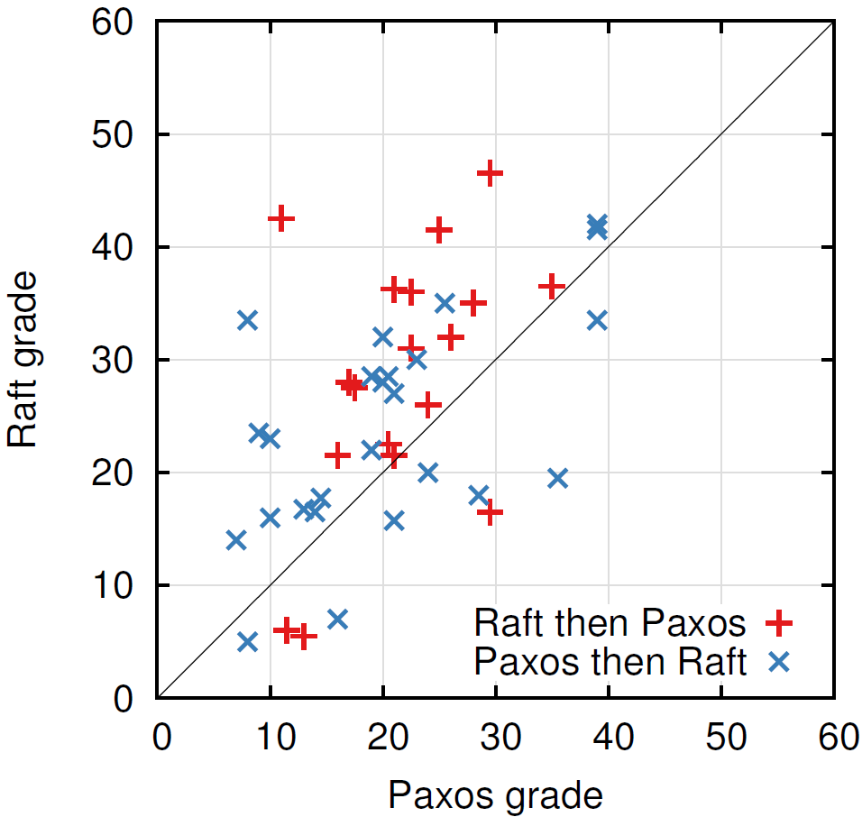
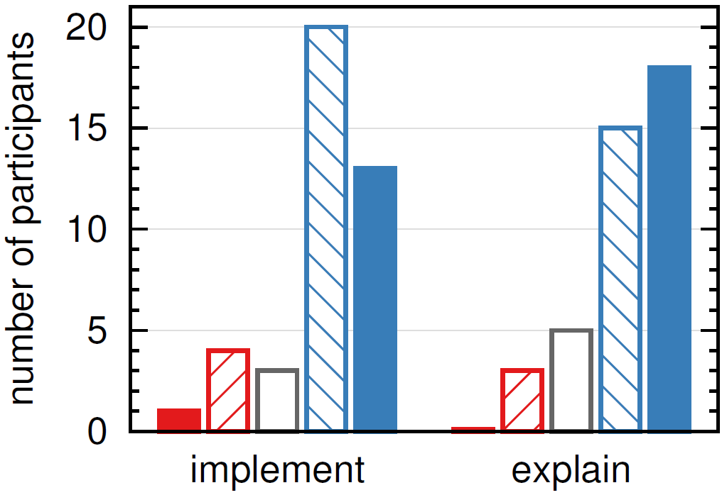
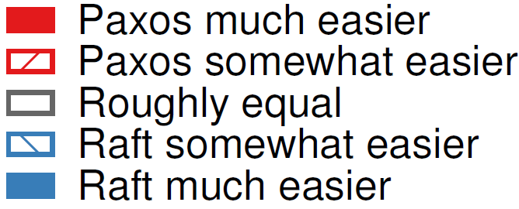
User Study Results
Notes:
Paxos median 20.8/60; Raft median 25.7/60
Paired t-test indicates 95% probably of Raft mean at least 2.5 pts higher than Paxos mean
Linear regression predicts Raft scores 2x as high as Paxos (12.5 pts out of 25 median), compensating for prior Paxos experience
Students who learned Paxos first scored worse on *both* tests!
Right graph is just opinions: they didn’t actually do these things

Slide 23
Impact
Hard to publish:
Rejected 3 times at major conferences
Finally published in USENIX ATC 2014
Challenges:
PCs uncomfortable with understandability as metric
Hard to evaluate
Complexity impresses PCs
Widely adopted:
25 implementations before paper published
83 implementations currently listed on Raft home page
>10 versions in production
Taught in graduate OS classes
MIT, Stanford, Washington, Harvard, Duke, Brown, Colorado, ...
Notes:
Many people read Diego’s dissertation!

Slide 24
Additional Information
Other aspects of Raft (see paper or Ongaro dissertation):
Communication with clients (linearizability)
Cluster liveness
Log truncation
Other consensus algorithms:
Viewstamped Replication (Oki & Liskov, MIT)
ZooKeeper (Hunt, Konar, Junqueira, Read, Yahoo!)

Slide 25
Conclusions
Understandability deserves more emphasis in algorithm design
Decompose the problem
Minimize state space
Making a system simpler can have high impact
Raft better than Paxos for teaching and implementation:
Easier to understand
More complete
Notes:
Raft was fun to design
Paxos still important: most concise implementation of consensus

Slide 26
Why “Raft”?
Replicated
And
Fault
Tolerant
Paxos

Slide 27
Extra Slides

Slide 28
Raft Properties
Election Safety: at most one leader can be elected in a given term
Leader Append-Only: a leader never modifies or deletes entries in its log
Log Matching: if two logs contain an entry with the same index and term, then the logs are identical in all entries up through the given index
Leader Completeness: if a log entry is committed, then that entry will be present in the logs of all future leaders
State Machine Safety: if a server has applied a log entry at a given index to its state machine, no other server will ever apply a different log entry for the same index

Slide 29
Leader Changes
log index
1
2
3
4
5
6
7
8
9
10
11
12
Logs may be inconsistent after leader change
No special steps by new leader:
Start normal operation
Followers’ logs will eventually match leader
Leader’s log is “the truth”
leader for
term 8
1
1
1
4
4
5
5
6
6
6
f₁
1
1
1
4
4
5
5
6
6
Missing
Entries
f₂
1
1
1
4
f₃
1
1
1
4
4
5
5
6
6
6
6
possible
followers
f₄
1
1
1
4
4
5
5
6
6
6
7
7
Extraneous
Entries
f₅
1
1
1
4
4
4
4
f₆
1
1
1
2
2
2
3
3
3
3
Notes:
Not showing commands anymore: just term numbers
Understandability: normal replication mechanism handles inconsistencies as well

