Slide 1
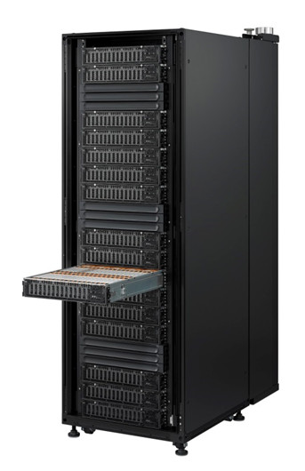
RAMCloud Market Application Analysis
SEDCL Retreat 2015
Robert Brown, CEO
Abstract
ExMatEx Application Orchestration
Identify market applications that have a definitive value proposition running on top of RAMCloud on the NEC Micro Modular Server, RAMCloud-in-a-Box. The project used RAMCloud-in-a-Box infrastructure to demonstrate that it is the ideal foundation for deploying and operating RAMCloud application workloads requiring low latency inter-process communications. Delivery of validation testing on the application(s) that require scalable, low latency storage IO will assist in developing target markets for RAMCloud. We analyzed applications that require low latency inter-process communications, and identified which market application(s) can benefit from RAMCloud’s Service Delivery optimization and application acceleration. To validate the performance characteristics that these types of application(s) require, we ported one of them to RAMCloud and measured performance at the application layer.
2 components today
Tasking
Databases
Dynamic tasking
Hierarchical multi-scale
Independent computations
Uphill dependencies
Variable granularity
Application still logically synchronous at time-step boundary
Databases (use largely driven by cloud/web influence)
Use to accelerate overall computation (sub-scale calls dominate)
Simple key/value stores
60-200 doubles down, dozen doubles up
Obviously, queries must be much faster than fine scale calls
ExMatEx Introduction
Chart 1. – RAMCloud vs. redis application Read/Write performance comparison
• Multi-scale materials
• Application driven
• Computer science focused
• ASCR Co-Design Center - $4M/yr for 5 yrs
Starting third year
• Work in many areas: molecular dynamics, proxies, programming models, DSLs, multi-scale algorithms, vendor interface, runtimes, software stacks, etc.
• More info at http://exmatex.org
• Code: https://github.com/exmatex
BioTech and Scientific Market
Customer Database Requirements
The global bioinformatics market reached the mark of around US$ 3.8 Billion in 2013 and it is anticipated to grow at a CAGR of around 19.3% during 2015-2019 ¹
Both service providers, KIO Networks and BroadCloud, in the project expressed a need in this market based on their current customer bases
Crosses into the High Performance Computing market with Molecular Modeling applications
Flexibility in protocol choices such as Infiniband and TCP/IP make RAMCloud-in-a-Box attractive in this market as NoSQL competition does not support Infiniband
An end user customer was evaluating NoSQL key value stores for genetic sequencing application
Expressed ease of deployment and an appliance approach key for them
Scalability and ease of expansion are crucial
Require 1-2 second recovery, within RAMCloud-in-a-Box parameters
Extremely fast data access with low latency
C API interface required
Open source with support must be in place
Really a “caching” service
Cache previous sub-scale calls
Typically in-memory
May want persistence too (subsequent runs of similar problem)
Key/value API to start (additional functionality/APIs possible)
Queries are tasks like any other task (same requirements)
Transactional not required (i.e. eventual consistency OK)
Transactional writes may be required in the future
Beyond caching sub-scale calls
Fault tolerance
EOS
Material properties
Many others
ExMatEx on RAMCloud-in-a-Box
Conclusions
Implemented Proxy service for Redis API calls used in ExMatEx
Proxy service translates Redis API function calls into RAMCloud API calls
redisConnect
redisCommand
HMSET = RAMCloud::RAMCloud::Write
HMGET = RAMCloud::RAMCloud::Read
HDEL
SADD
SMEMBERS
DEL
FLUSHALL
FLUSHDB
ECHO
redisFree
redisAsyncConnect
freeReplyObject
RAMCloud-in-a-Box is a simple, fast NoSQL storage appliance that eases setup and integration
100 Byte Reads in 12.453µs, 6x faster than redis
100 Byte Writes in 39.735µs, 2x faster than redis
1K Byte Reads in 19.2µs, and Writes in 60.450µs
Tightly integrated and optimized system saves time and money in setup and deployment
Extremely fast data access performance with low latency
Fast resilient data writes are 2x faster than redis that is non-resilient
Perpetual data availability for systems as a result
RAMCloud-in-a-Box is a massively scalable solution vs. redis as the current NoSQL key value market leader
RAMCloud-in-a-Box uses 75% less rack space, and 25% of the energy requirements of other systems
The scale of 680 RAMCloud-in-a-Box systems would be required to meet the customer need for faster key value storage
Figure 1. ExMatEx Application Architecture
Contact
References
Robert Brown
Software CPA, LLC
Email: bob@software-cpa.com
Website: www.software-cpa.com
Phone: 760-207-3762
RNCOS - Global Bioinformatics Market Outlook 2019.

