Slide 1
Implementing Linearizability at Large Scale and Low Latency
Collin Lee, Seo Jin Park, Ankita Kejriwal, †Satoshi Matsushita, John Ousterhout
Platform Lab
Stanford University †NEC

Slide 2
Overview
Goal: take back consistency in large-scale systems
Approach: distinct layer for linearizability
Reusable Infrastructure for Linearizability (RIFL)
At-least-once RPC ➔ exactly-once RPC
Records RPC results durably
To handle reconfiguration, associates metadata with object
Implemented on distributed KV store, RAMCloud
Low latency: < 5% (500ns) latency overhead
Scalable: supports states for 1M clients
RIFL simplified implementing transactions
Simple distributed transaction commits in ~22 μs
Outperforms H-Store

Slide 3
What is Linearizability?
Client sends
request for operation
Client receives response
time
Behaves as if executing exactly once and instantaneously
Strongest form of consistency for concurrent systems

Slide 4
What is Missing from Existing Systems?
Most systems: at-least-once semantics, not exactly-once
Retry (possibly) failed operations after crashes
Idempotent semantics: repeated executions O.K.?
At-least-once + idempotency ≠ linearizability
Need exactly-once semantics!
write(2)
client A
retry
shared object in server
1
2
2
3
2
client B
read: 2
write(3)
read: 2

Slide 5
Architecture of RIFL
RIFL saves results of RPCs
If client retries,
Don’t re-execute
Return saved result
Key problems
Unique identification for each RPC
Durable completion record
Retry rendezvous
Garbage collection

Slide 6
1) RPC Identification
Each RPC must have a unique ID
Retries use the same ID
Client assigns RPC IDs
Client ID
64-bit integer
Sequence Number
64-bit integer
System-wide unique
Monotonically increases
Assigned by client

Slide 7
2) Durable Completion Record
Written when an operation completes
Same durability as object(s) being mutated
Atomically created with object mutation
Completion Record
Client ID
Sequence Number
RPC result for client

Slide 8
3) Retry Rendezvous
Data migration is popular in large systems (eg. crash recovery)
Retries must find completion record
client
server1
server2
Time
Write
Object
CR
retry
Object
CR

Slide 9
3) Retry Rendezvous (cont.)
Associate each RPC with a specific object
Completion record follows the object during migration
Completion Record
Client ID
Sequence Number
RPC result for client
Object Identifier

Slide 10
4) Garbage Collection
Lifetime of completion record ≠ lifetime of object value
Can’t GC if client may retry later
Server knows a client will never retry if
Client acknowledges receipt of RPC result
Detect client crashes with lease.
Completion Records of client A
Seq# 1: Finished
Seq# 2: Finished
Seq# 3: Finished
…
Seq# 9: Finished
Seq# 10: Finished
ACK #2
client A

Slide 11
Linearizable RPC in Action
Client 5
Server
Write (2)
ClientID: 5
Seq#: 9
Durable Storage
ResultTracker
Write(2)
Pointer
Client 5, Seq# 9
Started
Client 5, Seq# 9
Finished
Client 5, Seq# 9
Started
Object
Value: 2
Com. Record
CID: 5, Seq: 9
Success
Object
Value: 2
Com. Record
CID: 5, Seq: 9
Success
Object
Value: 1
Success

Slide 12
Handling Retries
Client 5
Server
ResultTracker
Durable Storage
Client 5, Seq# 9
Started
Retry
Object
Value: 1
In_Progress
Write(2)
Time
Client 5, Seq# 9
Started
Object
Value: 2
Com. Record
CID: 5, Seq: 9
Success
Pointer
Retry
Client 5, Seq# 9
Finished
Success
Object
Value: 2
Com. Record
CID: 5, Seq: 9
Success

Slide 13
Performance of RIFL in RAMCloud
Achieved linearizability without hurting performance of RAMCloud
Minimal overhead on latency(< 5%) and throughput (~0%)
Supports state for 1M clients

Slide 14
Why RAMCloud?
General-purpose distributed in-memory key-value storage system
Durability: 3-way replication
Fast recovery: 1~2 sec for server crash
Large scale: 1000+ servers, 100+ TB
Low latency: 4.7 μs read, 13.5 μs write (100B object)
RIFL is implemented on top of RAMCloud
Core: 1200 lines of C++ for infrastructure
Per operation: 17 lines of C++ to make an operation linearizable

Slide 15
Experimental Setup
Server: Xeon 4 cores at 3 GHz
Fast Network
Infiniband (24 Gbps)
Kernel-bypassing transport (RAMCloud default)

Slide 16
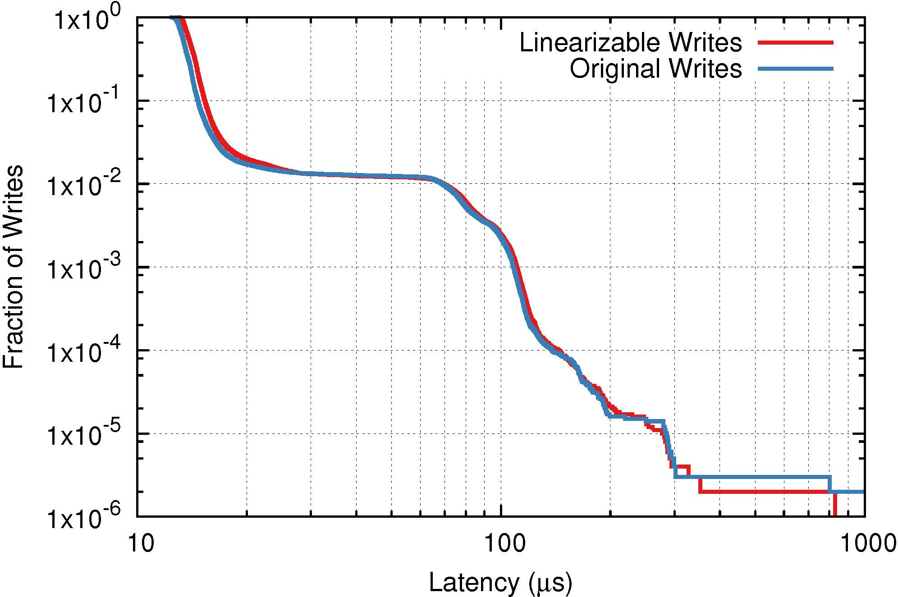
Impact on Latency
Median Latency
13.5 μs vs. 14.0 μs
99% Latency
69.0 μs vs. 69.4 μs

Slide 17
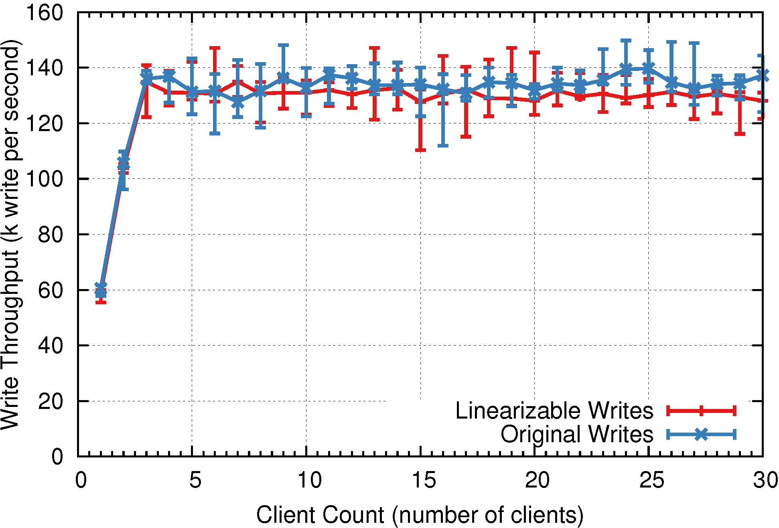
Impact on Throughput

Slide 18
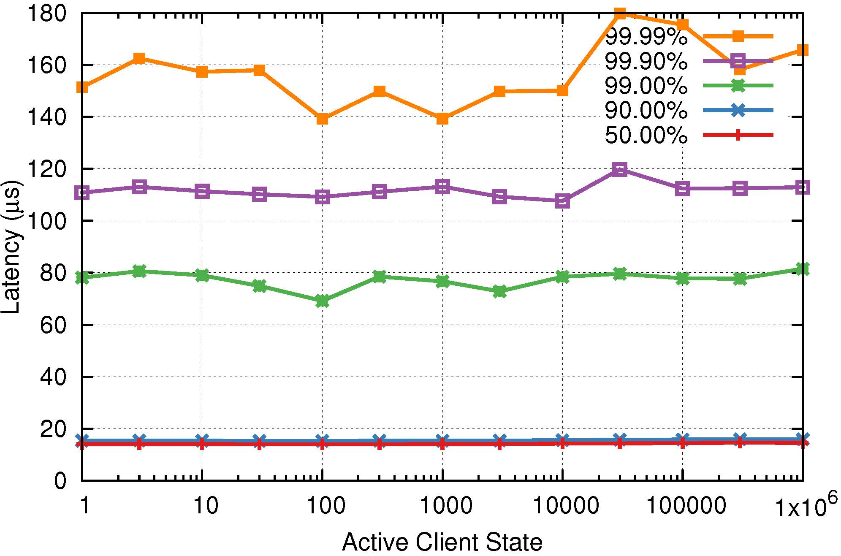
Impact of Many Client States
Storage impact: 116B per client ➔ 116MB for 1M clients
Latency impact (linearizable write, unloaded):
Median
1 client
14.0 μs
Median
1M client
14.5 μs

Slide 19
Case study: Distributed Transactions with RIFL
Extended use of RIFL for more complex operations
Two-phase commit protocol based on Sinfonia
RIFL reduced mechanisms of Sinfonia significantly
Lowest possible round-trip for distributed transactions

Slide 20
Transaction Client API
class Transaction {
read(tableId, key) => blob
write(tableId, key, blob)
delete(tableId, key)
commit() => COMMIT or ABORT
}
Optimistic concurrency control
Mutations are “cached” in client until commit

Slide 21
Transaction Commit Semantics
commit(): atomic multi-object operation
Operations in client’s cache are transmitted to servers
Conditioned on a version (same version ≡ object didn’t change)
User
Transaction API
Server
read
cache
[version, new value]
read
Storage
Transaction
write
commit
Transaction Commit Protocol
check version &
apply changes

Slide 22
Transaction Commit Protocol
Participant
Server
Client-driven 2PC
RPCs:
PREPARE() => VOTE
DECISION()
Fate of TX is determined after 1st phase
Client blocked for 1 RTT + 1 log write
Decisions processed in background
Client
Backups
PREPARE
Durable Log Write
VOTE
Objects Locked
DECISION
Durable Log Write
Done in Background

Slide 23
Transaction Recovery on Client-crash
Recovery
Coordinator
Participant
Server
Server-driven 2PC
Initiated by "worried" server
RPCs:
START-RECOVERY()
REQUEST-ABORT() => VOTE
DECISION()
Backups
START-RECOVERY
REQUEST-ABORT
Durable Log Write
VOTE
DECISION
Durable Log Write

Slide 24
RIFL Simplifies TX Recovery
PREPARE() => VOTE is linearizable RPC
Server crash: client retries PREPARE
Client crash: recovery coordinator sends fake PREPARE (REQUEST-ABORT)
Query ResultTracker with same RPC ID from client
Writes completion record of PREPARE / REQUEST-ABORT
Race between client’s 2PC and recovery coordinator’s 2PC is safe

Slide 25
Performance of Transactions in RAMCloud
Simple distributed transactions commits in 22 μs
TPC-C benchmark shows RIFL-based transactions outperform H-Store

Slide 26
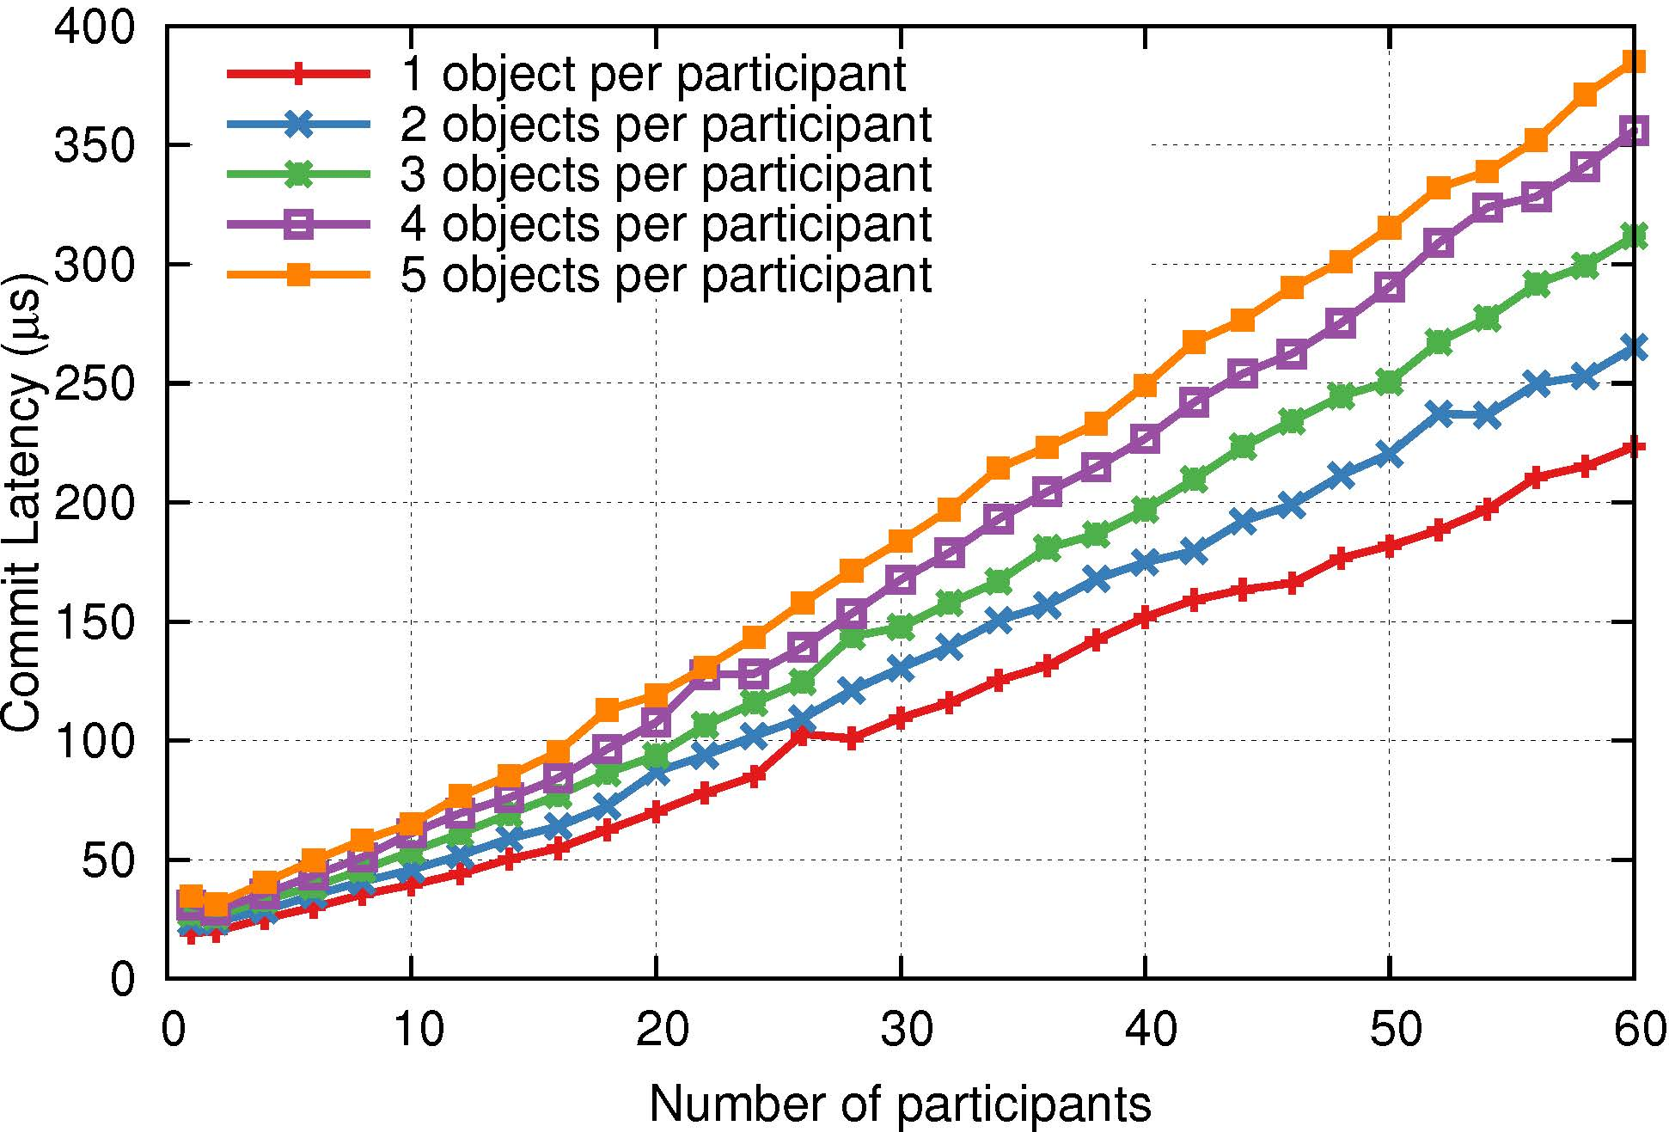
Latency of Transactions
60 servers;
5 objs / server
385 μs
3 servers; 1 obj / server
22 μs

Slide 27
TPC-C Benchmark
TPC-C simulates order fulfillment systems
New-Order transaction: 23 reads, 23 writes
Used full-mix of TPC-C (~10% distributed)
Latency is measured from end to end
Modified TPC-C for benchmark to increase server load
Compared with H-Store
Main-memory DBMS for OLTP
Two RAMCloud configurations
Kernel-bypass for maximum performance
Kernel TCP for fair comparison

Slide 28
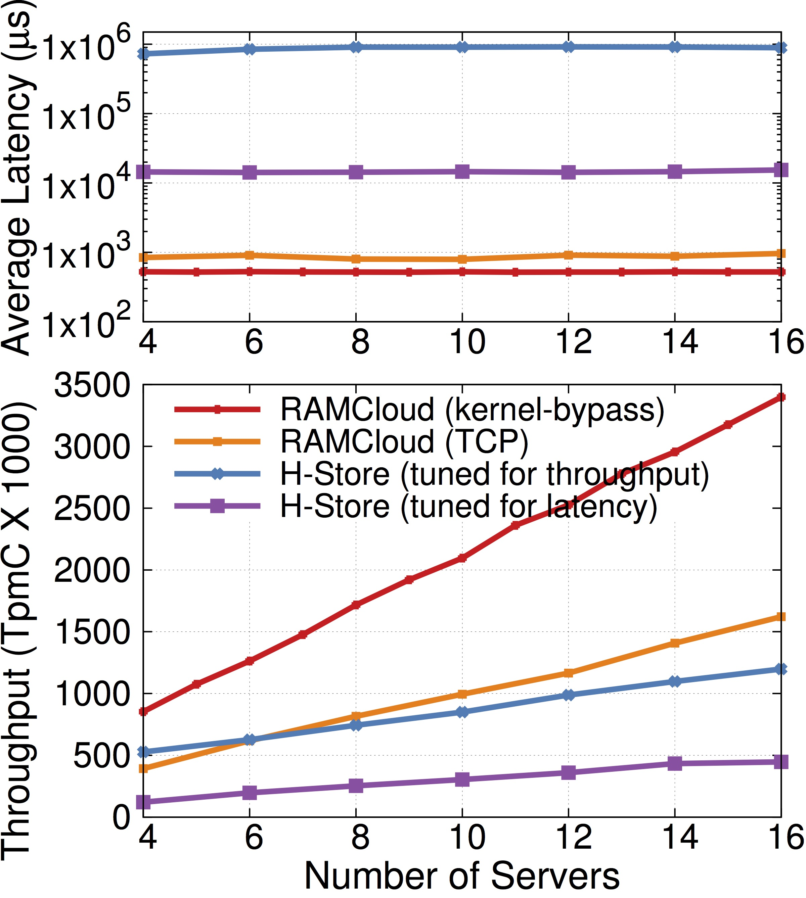
TPC-C Performance
TpmC: NewOrder committed per minute
210,000 TpmC / server
Latency: ~500µs
RAMCloud faster than H-Store (even over TCP)
Limited by serial log-replication (need batching)
1000x
10x

Slide 29
Should linearizability be a foundation?
Traditional DB
RIFL
Linearizability
Transaction
Transaction
vs.
Linearizability
Faster simple operations (eg. atomic increment)
lower latency
higher throughput
Can be added on top of existing systems
Better modular decomposition
easier to implement transaction

Slide 30
Conclusion
Distinct layer for linearizability → take back consistency in large-scale systems
RIFL saves results of RPCs; If client retries, returns saved result without re-executing
0.5us (< 5%) latency overhead, almost no throughput overhead.
RIFL makes transactions easier
RIFL-based RAMCloud transaction: ~20 μs for commit
Outperform H-Store for TPC-C benchmark

Slide 31
Questions

