Slide 1
RAMCloud: Low-latency DRAM-based storage
Jonathan Ellithorpe, Arjun Gopalan, Ashish Gupta, Ankita Kejriwal,
Collin Lee, Behnam Montazeri, Diego Ongaro, John Ousterhout, Seo Jin Park,
Henry Qin, Mendel Rosenblum, Stephen Rumble, Ryan Stutsman
Stanford University
http://ramcloud.stanford.edu

Slide 2
DRAM in Storage Systems
DRAM usage specialized/limited
Clumsy (consistency with backing store)
Lost performance (cache misses, backing store)
Facebook: 200 TB total data 150 TB cache!
memcached
Web indexes entirely in DRAM
Main-memory databases
Large file caches
UNIX buffer cache
Main-memory DBs, again
1970
1980
1990
2000
2010

Slide 3
RAMCloud Overview
Harness full performance potential of large-scale DRAM storage:
General-purpose storage system
All data always in DRAM (no cache misses)
Durable and available
Scale: 1000+ servers, 100+ TB
Low latency: 5-10µs remote access
Potential impact: enable new class of applications

Slide 4
Why Does Latency Matter?
Traditional Application
Web Application
UI
UI
App. Logic
Application Servers
App. Logic
Storage Servers
Data Structures
Single machine
Datacenter
<< 1µs latency
0.5-10ms latency
Large-scale apps struggle with high latency
Random access data rate has not scaled!
Facebook: can only make 100-150 internal requests per page

Slide 5
Goal: Scale and Latency
Traditional Application
Web Application
UI
UI
App. Logic
Application Servers
App. Logic
Storage Servers
Data Structures
Single machine
Datacenter
<< 1µs latency
0.5-10ms latency
5-10µs
Enable new class of applications:
Crowd-level collaboration
Large-scale graph algorithms
Real-time information-intensive applications

Slide 6
Project Status
Started in 2009
Building production-quality code
About 125,000 lines of C++, permissive license
RAMCloud 1.0 released
Looking for more users!

Slide 7
RAMCloud Architecture
1000 – 100,000 Application Servers
Appl.
Appl.
Appl.
…
Appl.
Library
Library
Library
Library
High-speed networking:
5 µs round-trip
Full bisection bandwidth
Datacenter Network
Coordinator
Commodity Servers
Master
Master
Master
…
Master
32-256 GB per server
Backup
Backup
Backup
Backup
1000 – 10,000 Storage Servers

Slide 8
Data Model: Key-Value Store
Basic operations:
read(tableId, key) => blob, version
write(tableId, key, blob) => version
delete(tableId, key)
Other operations:
cwrite(tableId, key, blob, version) => version
Enumerate objects in table
Efficient multi-read, multi-write
Atomic increment
Planned / in development:
Atomic updates of multiple objects
Secondary indexes
Tables
(Only overwrite if version matches)
Object
Key (≤ 64KB)
Version (64b)
Blob (≤ 1MB)

Slide 9
Durability and Availability
Challenge: making volatile memory durable
Keep replicas in DRAM of other servers?
3x system cost, energy
Still have to handle power failures
RAMCloud approach:
1 copy in DRAM
Backup copies on disk/flash: durability ~ free!

Slide 10
Buffered Logging
Write request
Hash Table
Buffered Segment
Disk
Backup
Buffered Segment
Disk
Backup
Buffered Segment
Disk
In-Memory Log
Master
Backup
Log-structured: backup disk and master’s memory
Log cleaning ~ generational garbage collection
No disk I/O during write requests
Backups need ~64 MB NVRAM (or battery) for power failures

Slide 11
Crash Recovery
Applications depend on 5µs latency: must recover crashed servers quickly!
Traditional approaches don’t work
Can’t afford latency of paging in from disk
Replication in DRAM too expensive, doesn’t solve power loss
Crash recovery:
Need data loaded from backup disks back into DRAM
Must replay log to reconstruct hash table
Meanwhile, data is unavailable
Solution: fast crash recovery (1-2 seconds)
If fast enough, failures will not be noticed
Key to fast recovery: use system scale

Slide 12
Recovery, First Try
Master chooses backups statically
Each backup mirrors entire log for master
Crash recovery:
Choose recovery master
Backups read log segments from disk
Transfer segments to recovery master
Recovery master replays log
First bottleneck: disk bandwidth:
64 GB / 3 backups / 100 MB/sec/disk ≈ 210 seconds
Solution: more disks (and backups)
Recovery Master
Dead Master
Backups

Slide 13
Recovery, Second Try
Scatter logs:
Each log divided into 8MB segments
Master chooses different backups for each segment (randomly)
Segments scattered across all servers in the cluster
Crash recovery:
All backups read from disk in parallel (100-500 MB each)
Transmit data over network to recovery master
Dead Master
Recovery Master
~1000 Backups

Slide 14
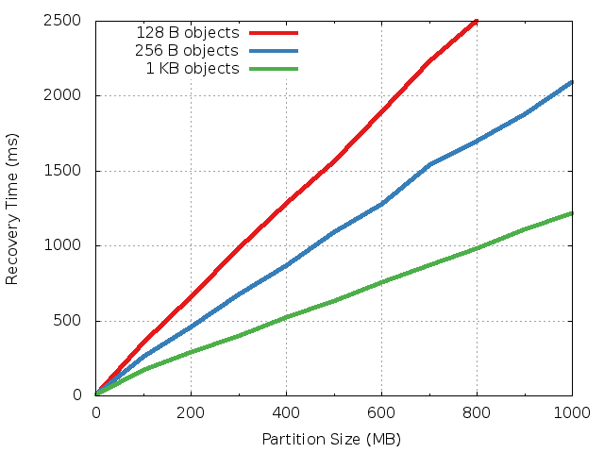
Single Recovery Master
Recovers
300-800 MB
in one second
New bottlenecks: recovery master’s NIC and CPU

Slide 15
Recovery, Third Try
Divide dead master’s data into partitions
Recover each partition on a separate recovery master
Partitions based on key ranges, not log segment
Each backup divides its log data among recovery masters
Highly parallel and pipelined
Dead Master
Recovery Masters
Backups

Slide 16
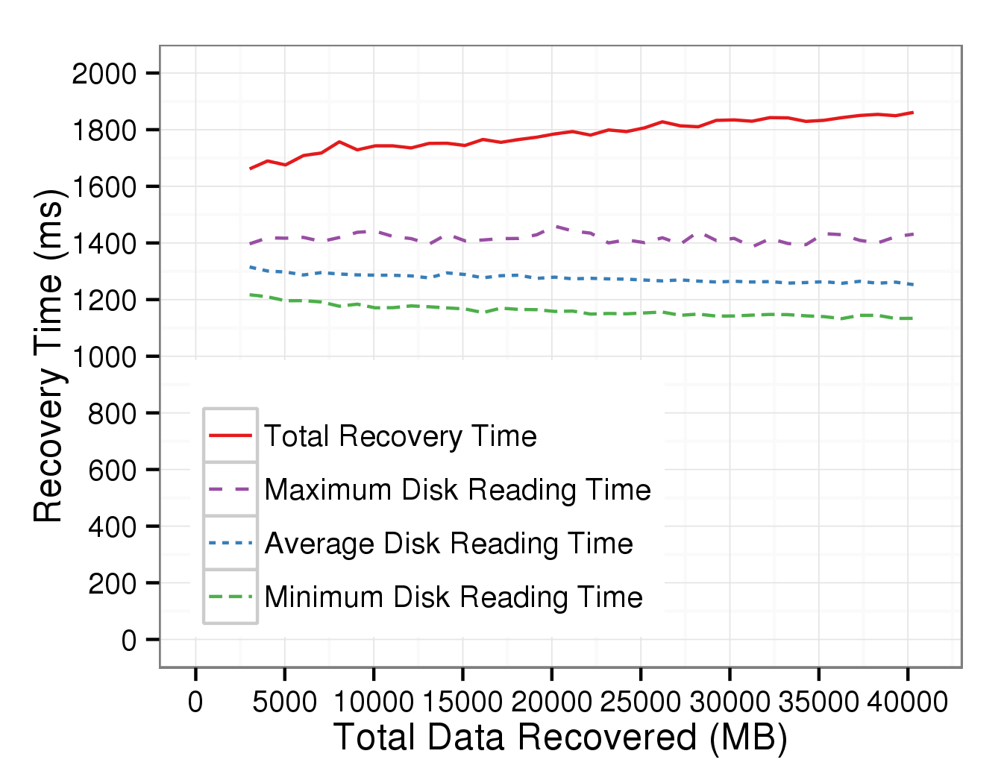
Scalability
6 masters
12 SSDs
3 GB
80 masters
160 SSDs
40 GB
Nearly flat (needs to reach 120-200 masters)
Expect faster: out of memory bandwidth (old servers)

Slide 17
RAMCloud Summary
RAMCloud goals:
Harness full performance potential of DRAM-based storage
Enable new applications: intensive manipulation of big data
Achieved low latency (at small scale)
Not yet at large scale (but scalability encouraging)
Fast crash recovery:
Recovered 40GB in < 2 seconds; more with larger clusters
Durable + available DRAM storage for the cost of volatile cache
Looking for users!
http://ramcloud.stanford.edu for code, papers
Diego Ongaro, @ongardie

