Slide 1
Consensus: Bridging Theory and Practice
Diego Ongaro
PhD Defense

Slide 2
Introduction
Consensus: agreement on shared state
Store state consistently on several servers
Must be available even if some servers fail
Needed for consistent, fault-tolerant storage systems
Top-level system configuration
Sometimes used to replicate entire database state
Consensus is widely regarded as difficult
Raft: consensus algorithm designed for understandability

Slide 3
Replicated State Machines
Clients
z←6
Consensus Module
State Machine
Consensus Module
State Machine
Consensus Module
State Machine
x | 1
y | 2
z | 6
x | 1
y | 2
z | 6
x | 1
y | 2
z | 6
Servers
Log
Log
Log
x←3
y←2
x←1
z←6
x←3
y←2
x←1
z←6
x←3
y←2
x←1
z←6
Replicated log ⇒ replicated state machine
All servers execute same commands in same order
Consensus module ensures proper log replication
System makes progress as long as any majority of servers are up
Failure model: fail-stop (not Byzantine), delayed/lost messages

Slide 4
Motivation: Paxos
“The dirty little secret of the NSDI community is that at most five people really, truly understand every part of Paxos ;-).” – NSDI reviewer
“There are significant gaps between the description of the Paxos algorithm and the needs of a real-world system…. the final system will be based on an unproven protocol.” – Chubby authors

Slide 5
Motivation: Paxos (2)
Leslie Lamport, 1989
Theoretical foundations
Hard to understand:
Can’t separate phase 1 and 2, no intuitive meanings
Bad problem decomposition for building systems
Too low-level
Implementations must extend published algorithm

Slide 6
Contributions
Understandability
Raft algorithm, designed for understandability
Strong form of leadership
Leader election algorithm using randomized timeouts
User study to evaluate understandability
Completeness
Proof of safety and formal spec for core algorithm
Cluster membership change algorithm
Other components needed for complete and practical system

Slide 7
Design for Understandability
Key considerations
How hard is it to explain each alternative?
How easy will it be for someone to completely understand the approach and its implications?
General techniques
Decomposing the problem
Reducing state space complexity

Slide 8
Raft Components
Leader election
Select one of the servers to act as cluster leader
Log replication (normal operation)
Leader takes commands from clients, appends them to its log
Leader replicates its log to other servers
Safety
Tie above components together to maintain consistency

Slide 9
RaftScope Visualization

Slide 10
Core Raft Review
Leader election
Heartbeats and timeouts to detect crashes
Randomized timeouts to avoid split votes
Majority voting to guarantee at most one leader per term
Log replication (normal operation)
Leader takes commands from clients, appends them to its log
Leader replicates its log to other servers (overwriting inconsistencies)
Built-in consistency check simplifies how logs may differ
Safety
Only elect leaders with all committed entries in their logs
New leader defers committing entries from prior terms

Slide 11
Topics for Practical Systems
Cluster membership changes
Log compaction
Client interaction

Slide 12
Cluster Membership Changes
Grow/shrink cluster, replace nodes
Agreement on change requires consensus
Raft’s approach
Switch to joint configuration: requires majorities from both old and new clusters
Switch to new cluster
Overlapping majorities guarantee safety
Continues processing requests during change

Slide 13
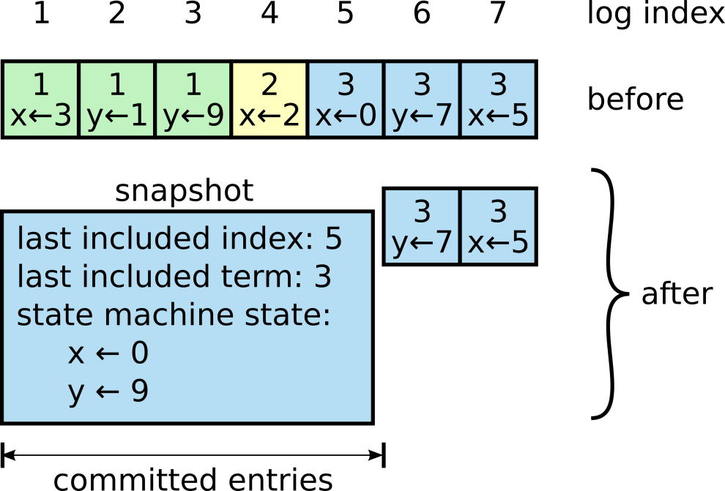
Other Topics for Complete Systems
Log compaction: snapshotting
Client interaction
How clients find the leader
Optimizing read-only operations

Slide 14
Evaluation
Understandability
Is Raft easier to understand?
Leader election performance
How quickly does the randomized timeout approach elect a leader?
Correctness
Formal specification in TLA+
Proof of core algorithm’s safety
Log replication performance
One round of RPC from leader to commit log entry (same as Multi-Paxos, ZooKeeper)

Slide 15
User Study Intro
Goal: evaluate Raft’s understandability quantitatively
Two classrooms of students
Taught them both Raft and Paxos
Quizzed them to see which one they learned better
Each student:
Considered programming assignment: less data
Raft lecture and quiz Paxos lecture and quiz Short survey | Paxos lecture and quiz Raft lecture and quiz Short survey

Slide 16
Quiz Results
43 participants
33 scored higher on Raft
15 had some prior Paxos experience
Paxos mean 20.8
Raft mean 25.7 (+23.6%)

Slide 17
Survey Results
Which would be easier to implement in a correct and efficient system?
Which would be easier to explain to a CS grad student?
For each question, 33 of 41 said Raft

Slide 18
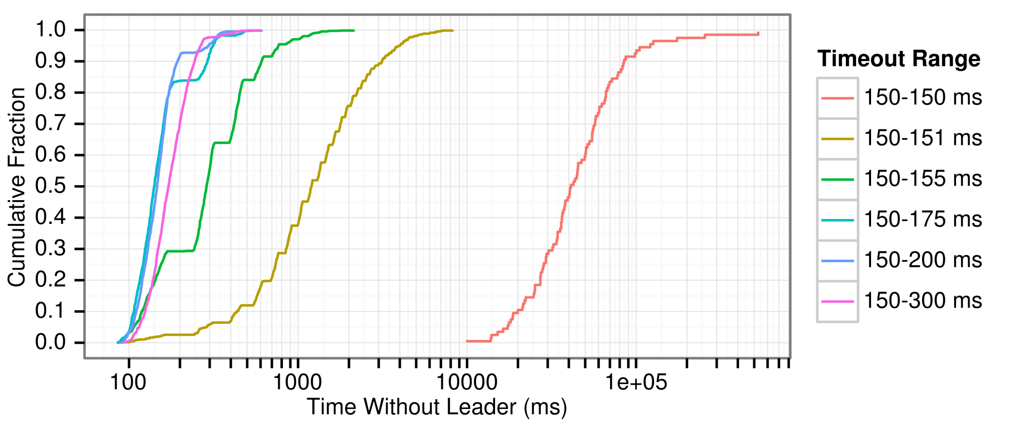
Randomized Timeouts
How much randomization is needed to avoid split votes?
Conservatively, use random range ~10x network latency

Slide 19
Raft Implementations
go-raft | Go | Ben Johnson (Sky) and Xiang Li (CoreOS)
kanaka/raft.js | JS | Joel Martin
hashicorp/raft | Go | Armon Dadgar (HashiCorp)
rafter | Erlang | Andrew Stone (Basho)
ckite | Scala | Pablo Medina
kontiki | Haskell | Nicolas Trangez
LogCabin | C++ | Diego Ongaro (Stanford)
akka-raft | Scala | Konrad Malawski
floss | Ruby | Alexander Flatten
CRaft | C | Willem-Hendrik Thiart
barge | Java | Dave Rusek
harryw/raft | Ruby | Harry Wilkinson
py-raft | Python | Toby Burress
…

Slide 20
Raft Implementations
go-raft | Go | Ben Johnson (Sky) and Xiang Li (CoreOS)
kanaka/raft.js | JS | Joel Martin
hashicorp/raft | Go | Armon Dadgar (HashiCorp)
rafter | Erlang | Andrew Stone (Basho)
ckite | Scala | Pablo Medina
kontiki | Haskell | Nicolas Trangez
LogCabin | C++ | Diego Ongaro (Stanford)
akka-raft | Scala | Konrad Malawski
floss | Ruby | Alexander Flatten
CRaft | C | Willem-Hendrik Thiart
barge | Java | Dave Rusek
harryw/raft | Ruby | Harry Wilkinson
py-raft | Python | Toby Burress
…
go-raft logo by
Brandon Philips

Slide 21
Related Work
Paxos
Theoretical, difficult to apply
“Our Paxos implementation is actually closer to the Raft algorithm than to what you read in the Paxos paper...”
– Sebastian Kanthak, Spanner
Viewstamped Replication, ZooKeeper
Both leader-based
Ad hoc in nature: did not fully explore design space
More complex state spaces: more mechanism
Each uses 10 message types, Raft has 4
ZooKeeper widely deployed but neither widely implemented

Slide 22
Summary: Contributions
Understandability
Raft algorithm, designed for understandability
Strong form of leadership
Leader election algorithm using randomized timeouts
User study to evaluate understandability
Completeness
Proof of safety and formal spec for core algorithm
Cluster membership change algorithm
Other components needed for complete and practical system

Slide 23
Conclusions
Consensus widely regarded as difficult
Hope Raft makes consensus more accessible
Easier to teach in classrooms
Better foundation for building practical systems
Burst of Raft-based systems is exciting
Renewed interest in building consensus systems
More off-the-shelf options becoming available
Understandability should be a primary design goal

Slide 24
Acknowledgements

Slide 25
Acknowledgements

Slide 26
Questions
raftconsensus.github.io

