Slide 1
Cool ideas from RAMCloud
Diego Ongaro
Stanford University
Joint work with Asaf Cidon, Ankita Kejriwal, John Ousterhout, Mendel Rosenblum, Stephen Rumble, Ryan Stutsman, et. al.

Slide 2
Introduction
RAMCloud: research project at Stanford University
Led by Professor John Ousterhout, started in 2009
Building a real system (open source, C++)
Looking for more users!
RAMCloud basics
Fast crash recovery
Recover failed servers in 1-2 seconds
New consensus algorithm called Raft
Used to store RAMCloud’s cluster configuration
Designed for understandability

Slide 3
DRAM in Storage Systems
DRAM usage specialized/limited
Clumsy (consistency with backing store)
Lost performance (cache misses, backing store)
Facebook: 200 TB total data 150 TB cache!
memcached
Web indexes entirely in DRAM
Main-memory databases
Large file caches
UNIX buffer cache
Main-memory DBs, again
1970
1980
1990
2000
2010

Slide 4
RAMCloud Overview
Harness full performance potential of large-scale DRAM storage:
General-purpose storage system
All data always in DRAM (no cache misses)
Durable and available
Scale: 1000+ servers, 100+ TB
Low latency: 5-10µs remote access
Potential impact: enable new class of applications

Slide 5
RAMCloud Architecture
1000 – 100,000 Application Servers
Appl.
Appl.
Appl.
…
Appl.
Library
Library
Library
Library
High-speed networking:
5 µs round-trip
Full bisection bandwidth
Datacenter Network
Coordinator
Commodity Servers
Master
Master
Master
…
Master
32-256 GB per server
Backup
Backup
Backup
Backup
1000 – 10,000 Storage Servers

Slide 6
Durability and Availability
Challenge: making volatile memory durable
Keep replicas in DRAM of other servers?
3x system cost, energy
Still have to handle power failures
RAMCloud approach:
1 copy in DRAM
Backup copies on disk/flash: durability ~ free!

Slide 7
Buffered Logging
Write request
Hash Table
Buffered Segment
Disk
Backup
Buffered Segment
Disk
Backup
Buffered Segment
Disk
In-Memory Log
Master
Backup
All data/changes appended to the log
No disk I/O during write requests
Backups need ~64 MB NVRAM (or battery) for power failures

Slide 8
Log-Structured Memory
Log-structured: backup disk and master’s memory
Similar to Log-Structured File Systems (Rosenblum 1992)
Cleaning mechanism reclaims free space (next slide)
Use memory efficiently (80-90% utilization)
Good performance independent of workload + changes
Use disk bandwidth efficiently (8 MB writes)
Manage both disk and DRAM with same mechanism

Slide 9
Log Cleaning
Find log segments with lots of free space
Copy live objects into new segment(s)
Free cleaned segments (reuse for new objects)
Cleaning is incremental and concurrent – no pauses!

Slide 10
Outline
RAMCloud basics
Fast crash recovery
New consensus algorithm called Raft

Slide 11
Crash Recovery Introduction
Applications depend on 5µs latency: must recover crashed servers quickly!
Traditional approaches don’t work
Can’t afford latency of paging in from disk
Replication in DRAM too expensive, doesn’t solve power loss
Crash recovery:
Need data loaded from backup disks back into DRAM
Must replay log to reconstruct hash table
Meanwhile, data is unavailable
Solution: fast crash recovery (1-2 seconds)
If fast enough, failures will not be noticed
Key to fast recovery: use system scale

Slide 12
Recovery, First Try
Master chooses backups statically
Each backup mirrors entire log for master
Crash recovery:
Choose recovery master
Backups read log segments from disk
Transfer segments to recovery master
Recovery master replays log
First bottleneck: disk bandwidth:
64 GB / 3 backups / 100 MB/sec/disk ≈ 210 seconds
Solution: more disks (and backups)
Recovery Master
Dead Master
Backups

Slide 13
Recovery, Second Try
Scatter logs:
Each log divided into 8MB segments
Master chooses different backups for each segment (randomly)
Segments scattered across all servers in the cluster
Crash recovery:
All backups read from disk in parallel (100-500 MB each)
Transmit data over network to recovery master
Dead Master
Recovery Master
~1000 Backups

Slide 14
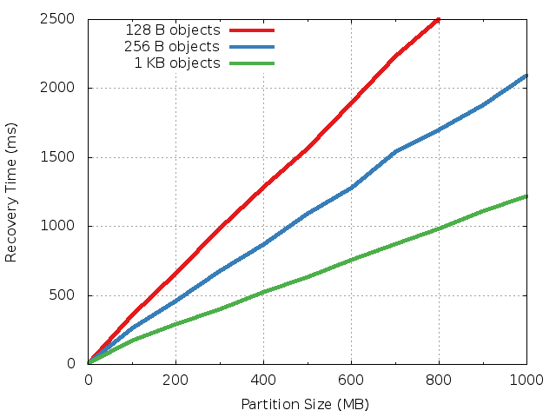
Single Recovery Master
Recovers
300-800 MB
in one second
New bottlenecks: recovery master’s NIC and CPU

Slide 15
Recovery, Third Try
Divide dead master’s data into partitions
Recover each partition on a separate recovery master
Partitions based on key ranges, not log segment
Each backup divides its log data among recovery masters
Highly parallel and pipelined
Dead Master
Recovery Masters
Backups

Slide 16
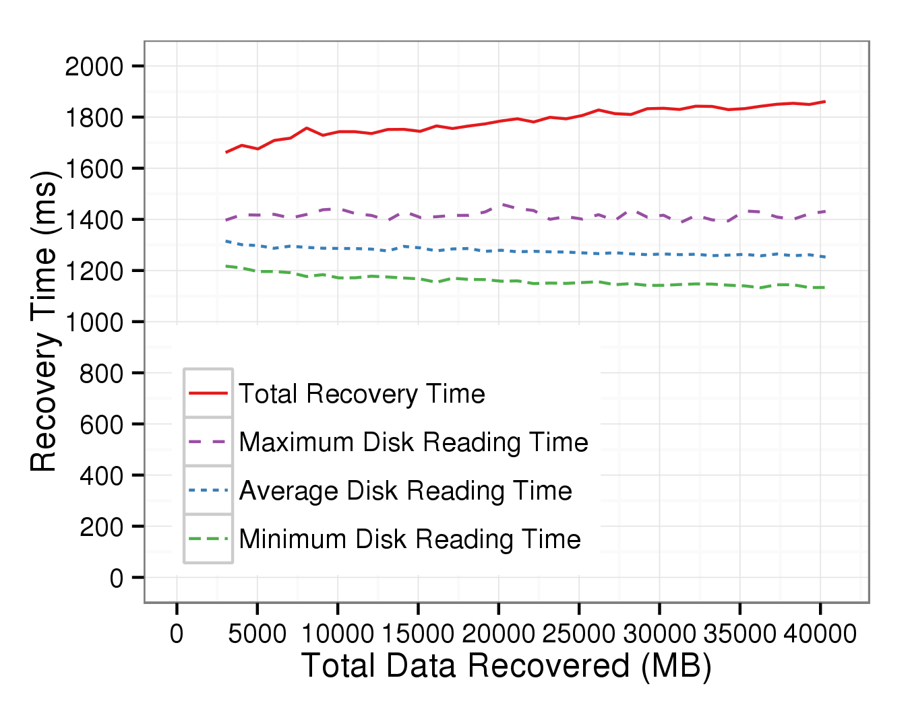
Scalability
6 masters
12 SSDs
3 GB
80 masters
160 SSDs
40 GB
Nearly flat (needs to reach 120-200 masters)
Expect faster: out of memory bandwidth (old servers)

Slide 17
Crash Recovery Conclusion
Fast: under 2 seconds for memory sizes up to 40GB
Nearly “high availability”
Much cheaper than DRAM replication (and it handles power outages)
Leverages scale:
Uses every disk, every NIC, every CPU, …
Recover larger memory sizes with larger clusters
Leverages low latency:
Fast failure detection and coordination

Slide 18
Outline
RAMCloud basics
Fast crash recovery
New consensus algorithm called Raft

Slide 19
RAMCloud Architecture
1000 – 100,000 Application Servers
Appl.
Appl.
Appl.
…
Appl.
Need to avoid single point of failure!
Library
Library
Library
Library
Datacenter Network
Commodity Servers
Coordinator
Master
Master
Master
…
Master
Backup
Backup
Backup
Backup
1000 – 10,000 Storage Servers

Slide 20
Configuration Management
Keep single coordinator server
Rely on external system to store top-level configuration:
Cluster membership
Data placement
Typically consensus-based
Examples:
Chubby (Google)
ZooKeeper (Yahoo/Apache)
Unhappy with ZooKeeper, so decided to build our own
Backup Coordinator
Coordinator
Configuration Management Servers

Slide 21
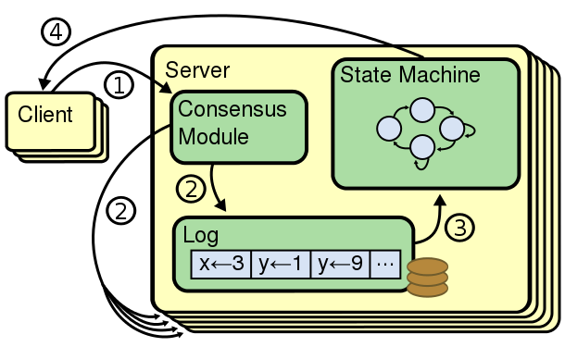
Replicated State Machines
Approach to make any (det.) service fault-tolerant
Each server’s state machine processes the same sequence of requests from its log
Consensus algo.: order requests into replicated log
Small number of servers (typically 5)
Service available with any majority of servers (3)

Slide 22
New Consensus Algorithm: Raft
Initial plan: use Paxos
Paxos is “industry standard” consensus algorithm, but:
Very hard to understand
Not a good starting point for real implementations
Our new algorithm: Raft
Primary design goal: understandability
Also must be practical and complete

Slide 23
Raft Overview
Designed from the start to manage a replicated log:
Elect a leader:
A single server at a time creates new entries in the replicated log
Elect a new leader when the leader fails
Replication:
The leader makes other servers’ logs match its own, and
Notifies other servers when it’s safe to apply operations
Safety:
Defines when operations are safe to apply
Ensures that only servers with up-to-date logs can be elected leader

Slide 24
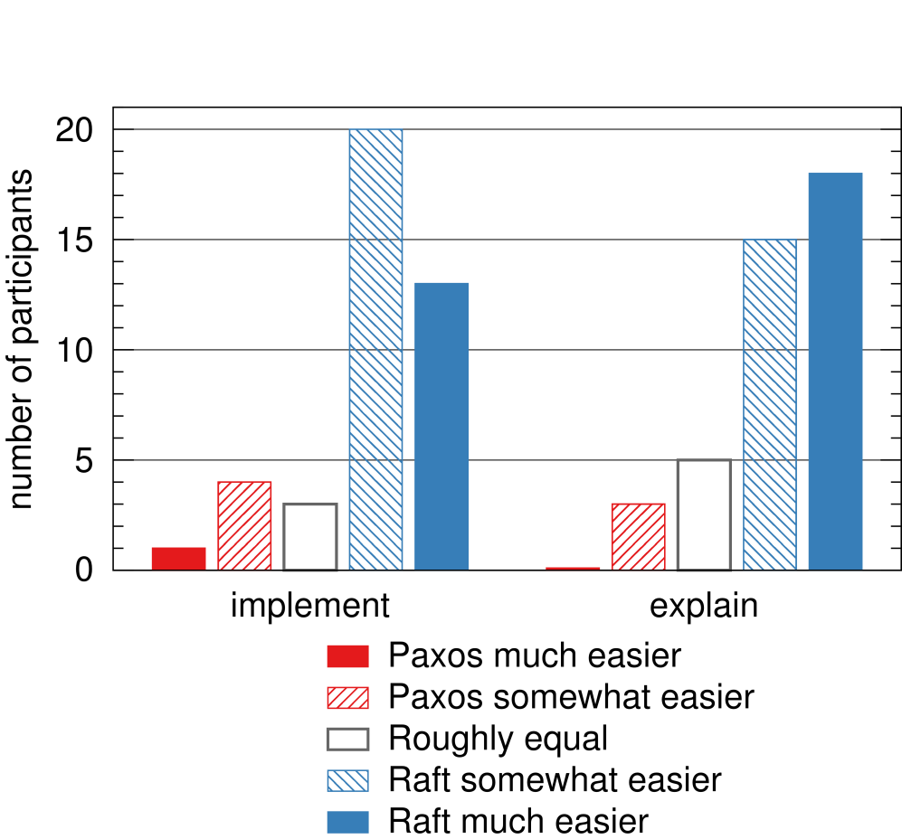
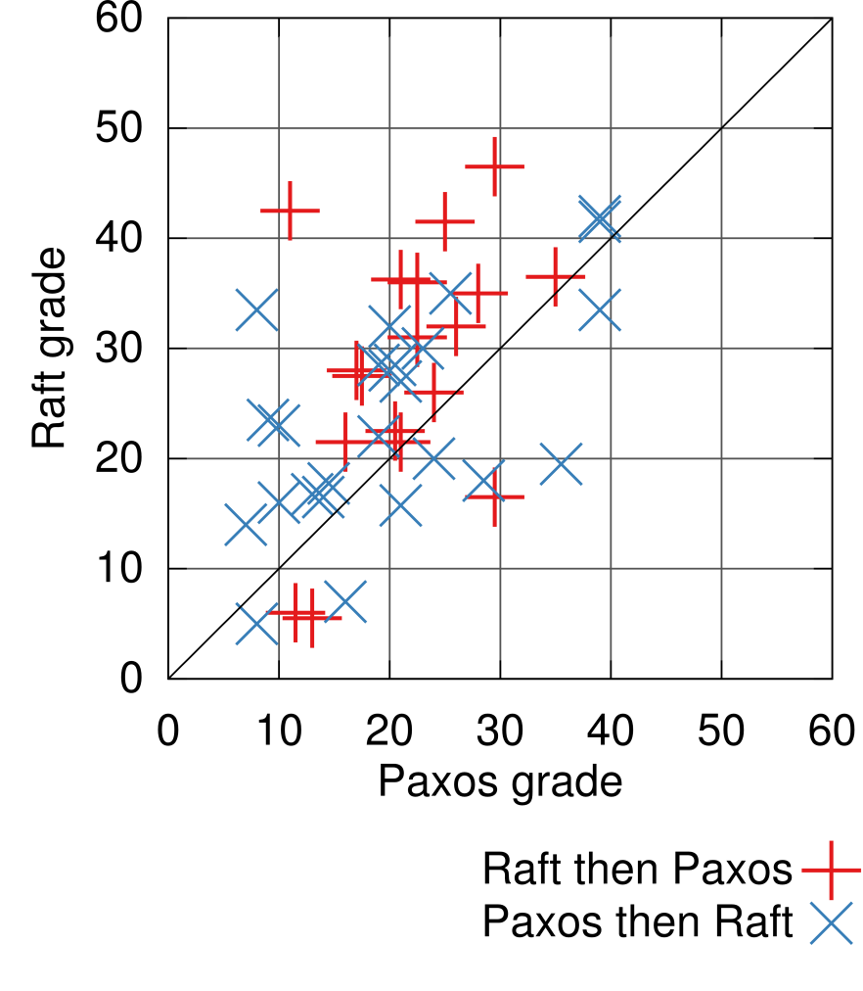
User Study
Taught students both Paxos and Raft
One-hour videos, one-hour quizzes, short survey
Raft significantly easier for students to understand

Slide 25
Raft Conclusion
Raft consensus algorithm
Equivalent to Paxos, but designed to be easy to understand
Decomposes the problem well
Built to manage a replicated log, uses strong leader
Watch our videos!
LogCabin: configuration service built on Raft
Open source, C++
Similar to ZooKeeper, not as many features yet
At least 25 other implementations on GitHub
go-raft (Go) quite popular, used by etcd in CoreOS

Slide 26
Overall Conclusion
RAMCloud goals:
Harness full performance potential of DRAM-based storage
Enable new applications: intensive manipulation of big data
Achieved low latency (at small scale)
Not yet at large scale (but scalability encouraging)
Fast crash recovery:
Recovered 40GB in < 2 seconds; more with larger clusters
Durable + available DRAM storage for the cost of volatile cache
Raft consensus algorithm:
Making consensus easier to learn and implement

Slide 27
Questions?
Speaker: Diego Ongaro
@ongardie on Twitter
ongaro@cs.stanford.edu
Much more at http://ramcloud.stanford.edu
Papers: Case for RAMCloud, Fast Crash Recovery, Log Structured Memory, Raft, etc.
Check out the RAMCloud and LogCabin code
Ask questions on ramcloud-dev, raft-dev mailing lists
Watch Raft and Paxos videos to learn consensus!
Joint work with Asaf Cidon, Ankita Kejriwal, John Ousterhout, Mendel Rosenblum, Stephen Rumble, Ryan Stutsman, et. al.

