Slide 1
Fast Crash Recovery in RAMCloud
Diego Ongaro, Stephen M. Rumble,
Ryan Stutsman, John Ousterhout,
and Mendel Rosenblum
Stanford University

Slide 2
Overview
RAMCloud: General purpose storage in RAM
Low latency: 5-10 µs remote access
Large scale: 10,000 nodes, 100 TB to 1 PB
Key Problem: RAM’s lack of durability
Durability: Pervasive log structure, even in RAM
Uses inexpensive disk-based replication
RAM performance by eliminating synchronous disk writes
Availability: Fast crash recovery in 1 to 2 s
Recovers 35 GB to RAM in 1.6 s using 60 nodes
Leverages the scale of the cluster
Balances work evenly across hosts
Avoids centralized control
Notes:
Volatility sucks.
RAMCloud provides durable storage for the cost of cache.
Our goal is to make RAM-based storage as easy-to-use as disk-based storage.
====
Tell the story: (John says do a 4 sentence take on this slide, double it, practice it on labmates)
Structured data is moving to RAM
Driven by large scale web apps by companies like Google and Facebook
RAMCloud delivers RAM performance at scale
Three orders of magnitude faster
New class of apps
Great performance, but one fundamental problem (What the issue is)
RAM is volatile
Makes it complicated to incorporate
First task in RAMCloud was solving this
But must be fast
Must be cheap
Already high cost of RAM means no replication
Instead, use cheap disks
Recover from crashes so fast apps don’t notice
Recover 35 GB of RAM in 1.6s
Deliver full performance
Can do full hosts in 1 to 2 seconds at scale
To do this need to leverage scale
Need to divide work up and balance it evenly throughout the cluster
Have to avoid centralized points
====
RAMCloud is a general-purpose datacenter storage system where all objects live in RAM all the time. There are no cache misses. All read and write requests for objects are always serviced from RAM.
Because of this it’s latency is orders of magnitude faster than today’s systems: our implementation already provides 5 us RTT for small reads of about 100 bytes and it provides 10 us RTT writes.
RAMCloud is designed aggregate the RAM of 10,000 servers or more into storage of 1 PB or more. A single RAMCloud cluster should service 100,000 application servers.
We believe RAMCloud will enable fine-grained and high-performance access to data which will lead to a new class of data-intensive, data-rich applications.
Today I’ll be talking about durability and availability in RAMCloud.
Durability & availability are what make RAMCloud easy-to-use:
When an object is written to RAMCloud it is persists even across node failures which are transparently masked from applications.
But, durability & availability are also an exceptional challenges for a RAM-based storage system. In particular, any solution must be cost-effective and yet not interfere with the performance benefits of RAM.
RAM is too expensive to use for wide-spread replication, so RAMCloud must employ disks for backups while retaining the full performance of in-memory storage.
RAMCloud’s fast crash recovery restores availability after a server crash providing full performance access to the recovered contents in 1 to 2 seconds. Applications simply see crashes as rare performance bubbles. To recover a crashed server in 1 to 2 seconds RAMCloud must employ hundreds of servers and thousands of disks in parallel.
RAMCloud allows fast writes by using a log-structured approach to durability which uses inexpensive disks without requiring a disk access per update.
Currently, in 1.6 seconds RAMCloud can recover 35 GB of data from a crashed node back into RAM and begin servicing requests at full performance. This is all using our small 60-node test cluster at Stanford.
As I’ll show later, RAMCloud’s scalability looks promising making the recovery of entire nodes in a second within reach.

Slide 3
RAMCloud Architecture
Up to 100,000 Application Servers
App
App
App
…
App
Library
Library
Library
Library
Coordinator
Datacenter Network
Masters expose RAM as Key-Value Store
Master
Master
Master
…
Master
Backup
Backup
Backup
Backup
Backups store data from other Masters
Up to 10,000 Storage Servers
Notes:
RAMCloud from a high-level view
Apps use client library
Key value store
Direct access over low latency dc network
3 to 5 years low latency networking will be commonplace
Master/Backup per host
Masters store app data in RAM
Backups backup data from OTHER Masters to disk
Coordinator manages membership, failure, starts recovery
====
This is RAMCloud from a 10,000 ft. view.
Application servers use a small RAMCloud client library to access objects directly from RAMCloud servers using a key-value style interface to access objects. We don’t see this data-model is not fundamental to the system. We believe in the future RAMCloud will support a richer data-model, but that is left to future work.
Applications access RAMCloud hosts over a low-latency datacenter network.
RAMCloud is designed with the anticipation that in 3 to 5 years as 10 gigabit Ethernet becomes commonplace, low latency, full bisection bandwidth will be cost-effective in datacenter networks.
Each node in RAMCloud node runs two distinct services:
First, each node acts as a Master, which is exclusively responsible for some subset of the objects stored in RAMCloud. At any one time, all read and write operations for a particular object always go to the same Master.
Second, each node also acts as a Backup. Each Backup in in the cluster accepts data from Masters which it stores durably in the case that it is needed later in case the Master crashes.
RAMCloud also includes a Coordinator which manages cluster membership, verifies host failures, and initiates recoveries.

Slide 4
Durability & Availability
Requirements
Retain high performance
Minimum cost, energy
Replicate in RAM of other masters?
3x system cost, energy
Still have to handle power failures
Notes:
Now we have to address the question: how do we provide durability and availability in RAMCloud?

Slide 5
The RAMCloud Approach
1 copy in RAM
Backup copies on disk/flash: durability ~ free!
Problem: Synchronous disk writes too slow
Pervasive log structure, even in RAM
Problem: Data is unavailable on crash
Fast Crash Recovery in 1 to 2 s
Fast enough that applications won’t notice
Notes:
TODO: Revisit this is more going to push back up here from the later “Recovery” slide

Slide 6
Durability with RAM performance
write
Master
Backups
Notes:
First we’ll tackle how RAMCloud provides durability. We’ll walk through how a Master responds to a write request from an application.
There are two interesting data structures on each Master: an in-memory log and a hashtable.
The in-memory log contains all of the Master’s object data, organizing the RAM of the Master as a log has some interesting advantages I’ll say more about later; the hashtable provides a mapping from an object’s identifier to its location in the log.
When a Master receives a write request

Slide 7
Durability with RAM performance
write
Master
Backups
Notes:
First we’ll tackle how RAMCloud provides durability. We’ll walk through how a Master responds to a write request from an application.
There are two interesting data structures on each Master: an in-memory log and a hashtable.
The in-memory log contains all of the Master’s object data, organizing the RAM of the Master as a log has some interesting advantages I’ll say more about later; the hashtable provides a mapping from an object’s identifier to its location in the log.
When a Master receives a write request

Slide 8
Durability with RAM performance
Backups buffer update
No synchronous disk write
write
Master
Backups
Notes:
First we’ll tackle how RAMCloud provides durability. We’ll walk through how a Master responds to a write request from an application.
There are two interesting data structures on each Master: an in-memory log and a hashtable.
The in-memory log contains all of the Master’s object data, organizing the RAM of the Master as a log has some interesting advantages I’ll say more about later; the hashtable provides a mapping from an object’s identifier to its location in the log.
When a Master receives a write request

Slide 9
Durability with RAM performance
Backups buffer update
No synchronous disk write
Master
Backups
Notes:
First we’ll tackle how RAMCloud provides durability. We’ll walk through how a Master responds to a write request from an application.
There are two interesting data structures on each Master: an in-memory log and a hashtable.
The in-memory log contains all of the Master’s object data, organizing the RAM of the Master as a log has some interesting advantages I’ll say more about later; the hashtable provides a mapping from an object’s identifier to its location in the log.
When a Master receives a write request

Slide 10
Durability with RAM performance
Backups buffer update
No synchronous disk write
Bulk writes in background
Must flush on power loss
Master
Backups
Notes:
First we’ll tackle how RAMCloud provides durability. We’ll walk through how a Master responds to a write request from an application.
There are two interesting data structures on each Master: an in-memory log and a hashtable.
The in-memory log contains all of the Master’s object data, organizing the RAM of the Master as a log has some interesting advantages I’ll say more about later; the hashtable provides a mapping from an object’s identifier to its location in the log.
When a Master receives a write request

Slide 11
Durability with RAM performance
Backups buffer update
No synchronous disk write
Bulk writes in background
Must flush on power loss
Pervasive log structure
Even RAM is a log
Log cleaner
Master
In-memory Log
Backups
Notes:
First we’ll tackle how RAMCloud provides durability. We’ll walk through how a Master responds to a write request from an application.
There are two interesting data structures on each Master: an in-memory log and a hashtable.
The in-memory log contains all of the Master’s object data, organizing the RAM of the Master as a log has some interesting advantages I’ll say more about later; the hashtable provides a mapping from an object’s identifier to its location in the log.
When a Master receives a write request

Slide 12
Durability with RAM performance
Backups buffer update
No synchronous disk write
Bulk writes in background
Must flush on power loss
Pervasive log structure
Even RAM is a log
Log cleaner
Hashtable, key → location
Master
Hashtable
In-memory Log
Backups
Notes:
First we’ll tackle how RAMCloud provides durability. We’ll walk through how a Master responds to a write request from an application.
There are two interesting data structures on each Master: an in-memory log and a hashtable.
The in-memory log contains all of the Master’s object data, organizing the RAM of the Master as a log has some interesting advantages I’ll say more about later; the hashtable provides a mapping from an object’s identifier to its location in the log.
When a Master receives a write request

Slide 13
Fast Crash Recovery
What is left when a Master crashes?
Log data stored on disk on backups
What must be done to restart servicing requests?
Replay log data into RAM
Reconstruct the hashtable
Recover fast: 64 GB in 1-2 seconds
Key to fast recovery: use system scale
Notes:
TODO: John wants a transition sentence here: we’ve seen log structured approach to durability, now its time to consider RAMCloud’s Fast Crash Recovery?
Now that data is durably stored on disk its time to think about what needs to happen when a host crashes.
When a Master crashes all that is left behind is it log segments stored on the Backups. But before objects from the crashed Master can be serviced they need to be brought back into RAM and the hashtable must be reconstructed.
We want to recover in 1 to 2 seconds, before applications notice, but to recover 64 GB of data that quickly we’ll need the cooperation of hundreds or thousands of machines from the cluster.

Slide 14
Recovery without Scale
Recovery Master
Masters backed up to 3 Backups
Each backup stores entire log
Problem: Disk bandwidth
64 GB / 300 MB/sec ≈ 210 seconds
Solution: more disks (more backups)
Backups
Crashed
Master

Slide 15
Solution: Scatter Log Data
Each log divided into 8MB segments
Master chooses different backups for each segment (randomly)
Segments scattered across all servers in the cluster
Crash recovery:
All backups read from disk in parallel
64 GB / (1000 backups * 100 MB/s/backup) = 0.6 seconds
Recovery Master
Crashed
Master
~1000 Backups
Notes:
How hard will it be to intro segs here?

Slide 16
Problem: Network bandwidth
Second bottleneck: NIC on recovery master
64 GB / 10 Gbits/second ≈ 60 seconds
CPU and memory bandwidth a limitation
Solution: more recovery masters
Spread work over 100 recovery masters
60 seconds / 100 masters ≈ 0.6 seconds

Slide 17
Solution: Partitioned Recovery
Divide each master’s data into partitions
Recover each partition on separate Recovery Master
Partitions based on key ranges, not log segment
Eliminates need for idle, empty Recovery Masters
Recovery Masters
Crashed Master
Backups
Notes:
Parts divide up recovery
Part is a subrange of object ids from crashed
RMs independent, recover one part
Still have full disk bw
NICs and core help
Handle fraction of log data
Benefit: elim need for idle machines, recover to loaded machines
====
RAMCloud uses partitions to divide work up during recovery. A partition is a sub-range of object ids which originally belonged to the crashed master. During recovery many recovery masters work independently, each recovering one partition. The recovery masters still have the aggregate disk bandwidth of the cluster at their disposal, but now the recovery benefits from the additional NICs and cores since each recovery master only handles a fraction of the log data.
Another benefit is that this drops the requirement for recovering to an entirely idle and empty machine. Instead, normal masters with existing data simply absorb ownership of the partition they are recovering into their workload.

Slide 18
Partitioning During Recovery
Backups receive a partition list at the start of recovery
Backups load segments from disk and partition log entries
Each recovery master replays only relevant log entries
To Master
Recovering
‘a’ to ‘m’
To Master
Recovering
‘n’ to ‘z’
Partition | Key Range
 | ‘a’ to ‘m’
 | ‘n’ to ‘z’
a
d
c
j
z
r
q
p
z
a
r
q
d
p
c
j
Segment
Segment

Slide 19
Issues Harnessing Scale
Balancing work evenly
Parallel work is only as fast as the slowest unit
Avoiding centralized control
Centralized control eventually becomes a bottleneck
Nodes often work without perfect/global knowledge
Notes:
Had to solve many issues
Problems/solutions fell into one/both of two categories
====
First, to parallelize effectively the length of each task must be split evenly, otherwise work only proceeds at the speed of the slowest task. Often, having more information can help, but this leads to the second issue.
In a system that’s intended to scale one must avoid centralized control.
In RAMCloud, this meant that often nodes needed to work independently, even if that meant giving up on perfect or global knowledge of what was happening in the rest of the cluster.

Slide 20
Balancing Partitions
Problem: Balancing work of each recovery master
Recovery will be slow if a single Master is given
Too much data
Too many objects
Solution: Profiler tracks density of key ranges
Done locally on each master
Balance size and number of objects per partition

Slide 21
Segment Scattering
Backups
Problem: Balancing time reading data across disks
Recovery is slow if just one Backup is slow
Solution: Use similar approach to [Mitzenmacher 1996]
Choose candidate Backups randomly
Select the “best”
Minimize worst-case disk read time
Master

Slide 22
Detecting Incomplete Logs
Problem: Ensure entire log is found during recovery
Centrally cataloging segments for each log expensive
Solution: Self-describing log
Masters record catalog of log segments in segments
Coordinator talks to each Backup at start of recovery
Finds most recent catalog
Can detect if all copies of most recent catalog are lost

Slide 23
Experimental Setup
Cluster Configuration
60 Machines
2 Disks per Machine (100 MB/s/disk)
Mellanox Infiniband HCAs (25 Gbps, PCI Express limited)
5 Mellanox Infiniband Switches Two layer topology Nearly full bisection bandwidth
Approx. for datacenter networks in 3-5 years
5.2 µs round trip from 100 B read operations
Notes:
*Describe cluster*
RC is designed for scale, but can’t afford to eval it at scale
Tried to choose experiments that highlight scalability
Only talking about a few
====
Since RAMCloud is intended to operate scale the best way to evaluate its recovery would be at scale. Unfortunately, at Stanford we only have a meager 60-node cluster on which to run experiments. Despite our small cluster we tried to choose experiments which would give us some indication as to whether our design would scale. I’m just going to talk about a couple of experiments today, but there are many more interesting experiments in the paper.

Slide 24
How much can a Master recover in 1s?
400 MB
800 MB
Notes:
The first question we need to answer in dividing up recovery is how much can each recovery master recover in 1 second?
Gave one recovery master access to plenty of disk bandwidth
Mentioned earlier: depends on object size
400 MB/s with small objects, 800 MB/s with larger objects
We use 600 MB for the rest of our experiments

Slide 25
How well does recovery scale?
X
Crashed
Master
Recovery
Master
600 MB
600 MB
6 Backups
Notes:
So the first, and most important question to us: how well does recovery scale?
Add hosts to recovery, still fast?
Scale amount of data on a master with disk bandwidth
Does time stay constant?
600 MB on original master, crash, recover to one RM
6 backups provide 600 MB/s, hope to do it in 1s
It does work.
===
That is, when more and more hosts become involved is it still fast?
In particular, if we add disk bandwidth to the cluster as we add more data to a master does recovery time stay constant when the master crashes?
For this experiment we started with a single partition of 600 MB stored on a Master being backed up by 6 Backups. 6 Backups should be just enough to recover 600 MB in one second since our disks can read about 100 MB/s.
The Master scatters its data
We then crashed the 600 MB server. And recovered it to one Recovery Master.

Slide 26
How well does recovery scale?
X
Crashed
Master
2 Recovery
Masters
1200 MB
600 MB
600 MB
12 Backups
Notes:
Next, double data
Recover 600 MB to one and 600 to another
Still work in 1 s? Yes.
====
Next, we doubled the amount of data stored in the original Master and doubled the number of backups it used. The question was: if we recover 600 MB to one Recovery Master and 600 MB to another does it still all work in one second?
We crashed the original Master and recovered to two Recovery Masters.
So then we have to ask, if we keep adding backups and recovery masters does the time stay the same?

Slide 27
How well does recovery scale?
X
20 Recovery
Masters
Crashed
Master
11.7 GB
600 MB
600 MB
600 MB
600 MB
600 MB
600 MB
600 MB
600 MB
600 MB
600 MB
600 MB
600 MB
600 MB
600 MB
600 MB
600 MB
600 MB
600 MB
600 MB
600 MB
120 Backups
Notes:
Taken to the limit for our cluster
All disks are maxed at 20 rec masters
That’s 11.7 GB.
And…
====
John votes to say less about why we are limited here. If it takes pressure off the next slide I’d prefer it here.
====
Taking this to the limit for our cluster means we can scale up until all our disks are fully utilized. If we were to try to scale beyond that recovery times would increase and in a real deployment we would expect to have thousands of disks.
So this limits us to recovering 20 recovery masters with 600 MB each or a total of 12,000 MB on the master we crash.

Slide 28
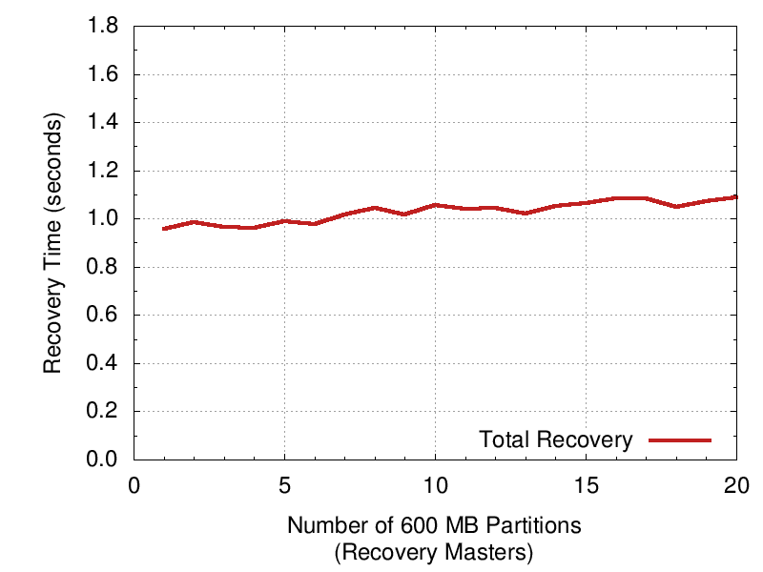
How well does recovery scale?
1 Recovery Master
6 disks: 600 MB/s
Recovered: 600 MB
20 Recovery Masters
120 backups: 11.7 GB/s
Recovered: 11.7 GB
Notes:
Still works in 1.1s.
Lost 200 ms.
Slope due to stragglers, blue line.
Add disks increases prob one is slow
Even with slope we’ll make 2 s with 100 RM and a full 64 GB host.
Wanted larger – needed disk bandwidth: flash.
===
Don’t say needed more hosts – just needed more disk bandwidth to try more recovery masters.
===
And the answer is we are able to recover that 11.7 GB in about 1.1 seconds
Going from 1 recovery master to 20 you can see we lost about 200 ms. The slope here is due to straggling disks. The blue line shows how long it took for the last disk to finish reading its segments. You can see that total recovery time tracks it tightly.
As we add more disks the probability that one of them is slow increases. Even though RAMCloud tries to compensate for them we can see they still effect recovery time.
Even with this slope it looks like with 100 recovery masters we’ll still be within our 2 second goal.
At this point we started to get greedy. In order to try larger recoveries we either needed more hosts or disk bandwidth per host. More hosts were too expensive, so we turned to flash.

Slide 29
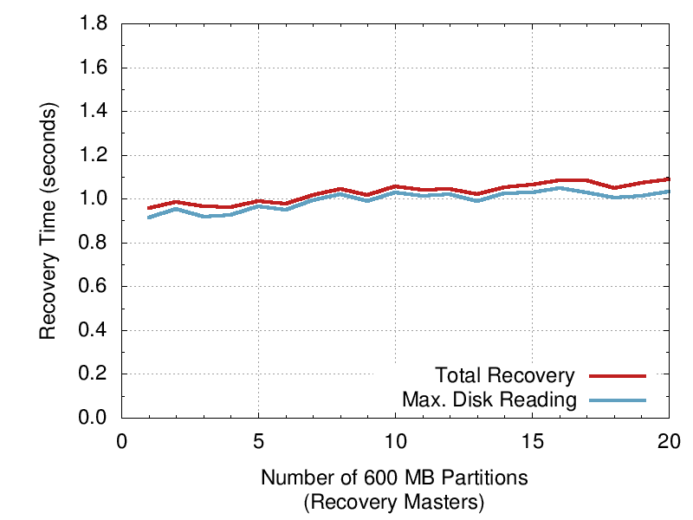
How well does recovery scale?
1 Recovery Master
6 disks: 600 MB/s
Recovered: 600 MB
20 Recovery Masters
120 backups: 11.7 GB/s
Recovered: 11.7 GB
Total recovery time tightly tracks straggling disks
Notes:
Still works in 1.1s.
Lost 200 ms.
Slope due to stragglers, blue line.
Add disks increases prob one is slow
Even with slope we’ll make 2 s with 100 RM and a full 64 GB host.
Wanted larger – needed disk bandwidth: flash.
===
Don’t say needed more hosts – just needed more disk bandwidth to try more recovery masters.
===
And the answer is we are able to recover that 11.7 GB in about 1.1 seconds
Going from 1 recovery master to 20 you can see we lost about 200 ms. The slope here is due to straggling disks. The blue line shows how long it took for the last disk to finish reading its segments. You can see that total recovery time tracks it tightly.
As we add more disks the probability that one of them is slow increases. Even though RAMCloud tries to compensate for them we can see they still effect recovery time.
Even with this slope it looks like with 100 recovery masters we’ll still be within our 2 second goal.
At this point we started to get greedy. In order to try larger recoveries we either needed more hosts or disk bandwidth per host. More hosts were too expensive, so we turned to flash.

Slide 30
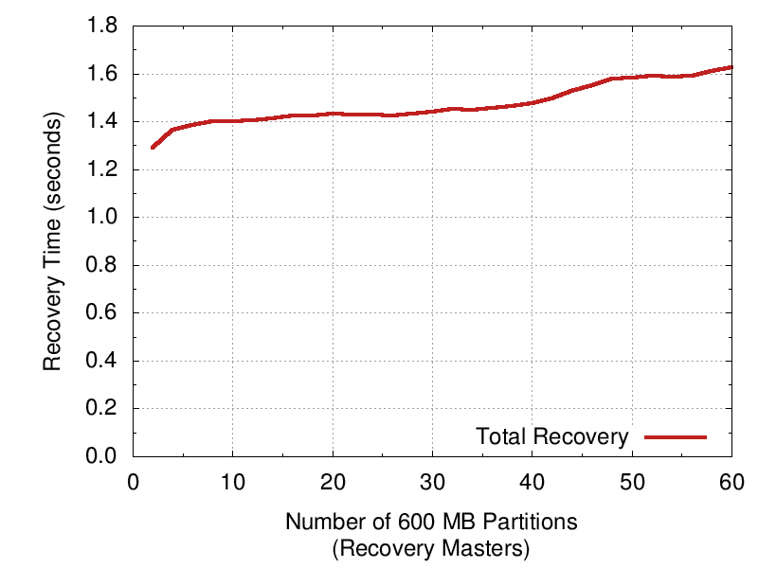
Flash Allows Higher Scalability
60 Recovery Masters
120 SSDs: 31 GB/s
Recovered: 35 GB
2x270 MB/s SSDs per recovery master
(vs. 6x100 MB/s disks per recovery master)
Notes:
Really stressing cluster.
Wanted to see what we could do.
Recover 35 GB in 1.6s.
Slope is complicated, several bottlenecks creeping in.
In a cluster with scale servers wouldn’t be this overloaded.
But we got a big number.
Even with our small cluster.
====
Say less, don’t say 22 GB/s. – it doesn’t appear anywhere. Very short explanation for why line is higher – might suffice to say y-intercept and slope are higher here just because we’re pushing things out of balance. This is just a greedy grab and these machines are running much more loaded than they would during a normal recovery.
===
With flash we can perform the same experiment, but only 2 SSDs are needed to read 600 MB of data in less than 2 seconds. Here 2 SSDs only deliver 540 MB/s compared to the 600 MB/s we were getting from 6 disk-based backups, so times appear just a bit higher.
But this allows us to keep 60 recovery masters busy during recovery even with our small cluster size.
The result is we are able to crash a master containing 35 GB of data and recover in about 1.6s.
So we’re able to recover at a rate of about 22 GB/s with just 60 hosts. At this point we’re more than halfway to recovering a crashed 64 GB master in less than 2 seconds. So things look promising, and we were very pleased that it scaled down to even our small 60 node test cluster well.

Slide 31
Fast Recovery Improves Durability
GFS (SOSP ‘03)
3-Copies on Disk
RAMCloud with
1-Copy in RAM
2-Copies on Disk
Assumptions:
2 failures/server/year
Failures are independent
Failures lose all contents of both RAM and disk
Replication factor 3
Notes:
Believed that fast recovery improved durability.
Window for simult failures low.
After calc, turns our impact is large.
Read assumptions.
Turns out just having 2 disk copies things look good.
Can see going from rec time 1 to 10 increase prob of data loss by more than 100x.
And again to 100s.
Green line is interesting – it represents GFS as described in SOSP ‘04.
Scattering across 100,000 with just 3 copies on disk has more than 10% chance of data loss in a year.
Similar systems might have to go to 4 copies to scale that much.
====
Say GFS as – if wants to scale to 100,000 nodes would have to use 4 copies on disk.
===
We had an idea that since RAMCloud’s recovery system is so fast that the opportunity for multiple simultaneous failures is reduced, which should have a positive impact on durability.
This is a plot of the probability of data loss in a one year period if RAMCloud would have taken the less conservative route: that is, if RAMCloud kept one copy in RAM, and just two on disk. Across the x-axis is the number of servers in the cluster. This affects durability because the more servers data is spread across the more likely it is that enough of them will fail simultaneously to cause data loss. I should note two simplifying assumptions in this graph as well: first, this graph assumes host failures are independent, and second, it assumes that the entire contents of both RAM and disk are lost on host crash.
With RAMCloud’s current recovery times we are down here at the bottom with the red line, so even using one less copy on disk the probability that RAMCloud would lose data is very low.
Interestingly, if we increased recovery time by a factor of 10 to 10 s we see that the probability of data loss in a year goes up by more than a factor of 100. And we see it again as recovery times go from 10 s to 100 s. This means our fast recovery significantly improves our durability.
The green line with the 100 s recovery time is interesting because it corresponds to the way GFS scatters its data and its recovery time: it keeps copies of chunks in triplicate and recovers in about 100 s. At the scale of 100,000 machines probability of data loss is over 10%. This could indicate other systems which scatter data with longer recovery times like BigTable and GFS might have trouble scaling up to 100,000 machines or more.
(Citation GFS, 6.2.5 Recovery Time, second paragraph, last sentence, 2 mins to go from 1 replica on some segs to 2; so it must be strictly worse, because it doesn’t get aggressive about rereplication until after replica count goes down to 1) (lazy rereplication for a crashed host takes 23 mins).

Slide 32
Related Work
Log-structured Filesystem (LFS)
RAMCloud keeps log in-memory and on disk
More efficient cleaner; cleans from RAM instead of disk
memcached
Apps must deal with backing store and consistency
Reduced performance from misses, cold caches
Bigtable + GFS
Primarily disk based
Scatters across disks for durability
Bigtable uses a logging approach on GFS
Stores indexes, eliminates need for replay on recovery

Slide 33
Conclusions
Pervasive log structure
Fast writes, inexpensive
Fast crash recovery in 1 to 2 s
Recovers 35 GB to RAM in 1.6 s using 60 nodes
Leverages the scale of the cluster
Potential Impact
Easy to harness performance of RAM at scale
5-10 µs access time
100 TB to 1 PB
As durable and available as disk
Enable a new class data-intensive applications

Slide 34
Questions?
ramcloud.stanford.edu

Slide 36
Recovery Flow

