Slide 1
RAMCloud: System Performance Measurements (Jun ‘11)
Nandu Jayakumar
(nandu@cs.stanford.edu)

Slide 2
Goals
Evaluate the performance and scalability of RAMCloud as a data-store.
What are we measuring ?
Round-trip latency per operation
Overall system throughput
Performance under load
Notes:
For an online data store, latency under load primary consideration.
Number of RAMCloud servers required will be chosen based on projected load as well as desired throughput/latency characteristics.
Role of co-ordinator.

Slide 3
RAMCloud Cluster
1000 – 100,000 Application Servers
Appl.
Appl.
Appl.
…
Appl.
Library
Library
Library
Library
Datacenter Network
Coordinator
Master
Master
Master
…
Master
Backup
Backup
Backup
Backup
1000 – 10,000 Storage Servers

Slide 4
Test Setup
Cluster
40 nodes, Mellanox NICs/switch
Single master/coordinator node
When used, 3 backups running on nodes different from master.
Multiple clients

Slide 5
Latency
End-to-end round trip latency in microseconds at client.
Single client/single master.
Read operation on single object/single table – 100 Bytes
All transports are over 32 Gbps Infiniband network.
Notes:
Goes over network – client and master are on separate hosts
Start-off by characterizing a very small and simplified part of the system.

Slide 6
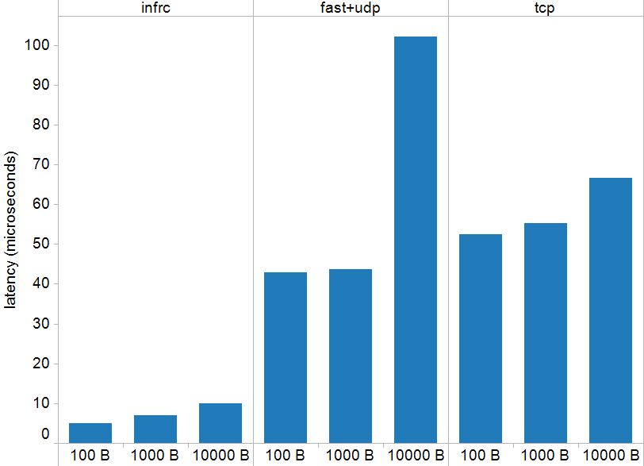
Latency versus Object Size/Transport
Notes:
Size of an object stored.
Fast+udp – At 10K going through the kernel becomes costly – number of syscalls is different based on number of packets.

Slide 7
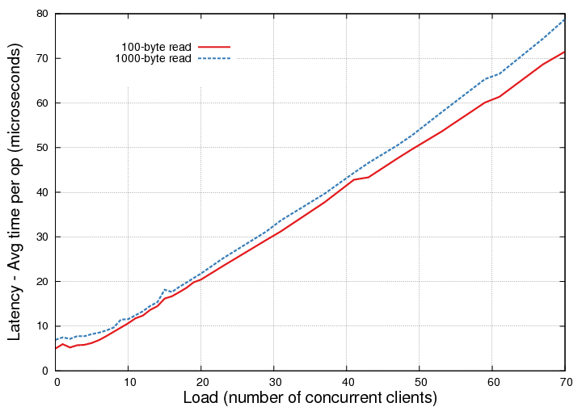
Latency – Under Load – InfRc
Notes:
What is the typical load on a single RAMCloud server in a cluster ?
Is the latency acceptable at higher loads ?

Slide 8
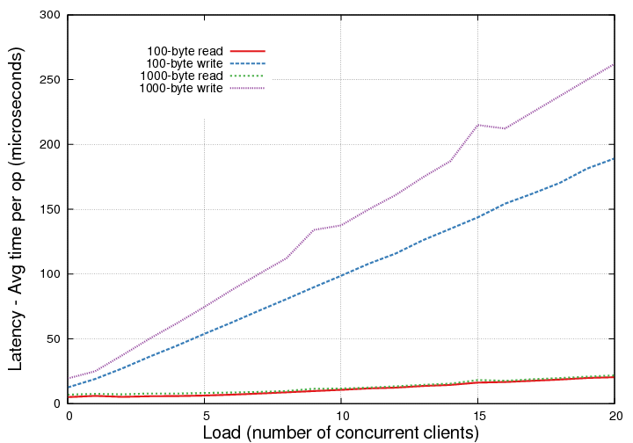
Write Latency – Zoomed in
Notes:
3 backups are being used here. Each write operation is significantly costlier. Why ?
Could look at all of CRUD – but only showing read vs write.

Slide 9
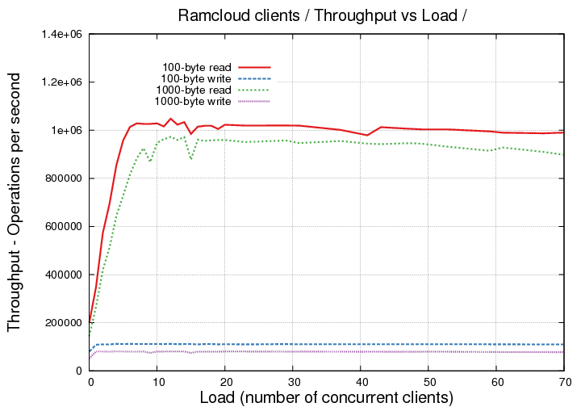
Throughput – Under Load – InfRC
Notes:
Shifting perspective to server.
This is a single-threaded server running on a single core.

Slide 10
Future Work
Multiple masters – measure scalability
Compare against other key-value stores – Open-source Yahoo! Cloud Serving Benchmark
More interesting workloads
elasticity

Slide 11
Summary
At a small scale
5us RTT RPCs goal possible
1 million reads/sec per server goal possible
Goals ambitious enough ?
How will this scale to datacenters ?
Notes:
Number of nodes in a RAMCloud cluster.
How big will clusters be ? Are current memcached caches an indication ?

Slide 12
More detail
http://fiz.stanford.edu:8081/display/ramcloud/RPC+Measurements+May+2011
http://fiz.stanford.edu:8081/display/ramcloud/Inf+Under+Load
http://fiz.stanford.edu:8081/display/ramcloud/Workload+Generator
RAMCLOUD_SOURCE/src/Bench.cc
RAMCLOUD_SOURCE/scripts/*pl

