Slide 1
Fast Crash Recovery in RAMCloud
Ryan Stutsman
SEDCL Retreat
June 3, 2011

Slide 2
Durability and Availability
Goals:
No impact on performance
Minimum cost, energy
Replicate in DRAM of other masters?
3x system cost, energy
Still have to handle power failures
Replicas unnecessary for performance

Slide 3
Durability and Availability
RAMCloud approach:
1 copy in DRAM
Backup copies on disk/flash: durability ~ free!

Slide 4
Problems
Synchronous disk I/O’s during writes?
Buffered logging
Data unavailable after crashes?
Fast recovery

Slide 5
RAMCloud Architecture
1,000 – 100,000 Application Servers
Appl.
Appl.
Appl.
…
Appl.
Library
Library
Library
Library
Datacenter Network
Coordinator
Master
Master
Master
…
Master
Storage Servers act as both a Master and a Backup
Backup
Backup
Backup
Backup
1,000 – 10,000 Storage Servers

Slide 6
Buffered Logging
Notes:
Incoming data is appended to an in-memory log which is replicated among backups.
The in-memory log is broken into 8 MB pieces called “segments”.
Once a master fills a segment it is never modified again.
Backups buffer just the most recent segment, whenever the master fills a segment it notifies the backups that it is done with that segment.
The backups begin to flush that segment out to disk.
Masters then notify the backups that they would like to write another segment, the backups reserve buffer space for that segment and the process repeats.
After 3 backups have buffered the data for an update the master updates its hash table and returns “success” to the client.
At that point the client can expect, come hell or high water, that the object will be reflected on all future read requests.
This means that the backups need to guarantee updates to their buffered replica’s of the masters segment durable.
Do provide this we expect backups to have a small amount of non-volatility they use to make this guarantee.
This allows us to have updates on the order of 2xRPC RTT (10 us) rather than 4-8 ms.

Slide 7
Buffered Logging
No disk I/O during write requests
But must guarantee buffered data durability:
DIMMs with built-in flash backup?
Caches on enterprise disk controllers?
Per-server battery backups?
8 MB I/Os minimize disk latency overhead
Achieves 90% disk bandwidth
Helpful for reading during fast recovery as well
Master’s memory also log-structured
Log cleaning ~ generational garbage collection

Slide 8
Master Crash Recovery
Problem: Data unavailable after a master crash
Goal: 1 – 2 second recovery
Applications just see “hiccups”
Good enough for “continuous availability?”
Solution: Harness system scale

Slide 9
Recovery, First Try
Master chooses backups statically
Each backup stores entire log for master
Crash recovery:
Choose recovery master
Backups read log info from disk
Transfer logs to recovery master
Recovery master replays log
First bottleneck: disk bandwidth:
64 GB / 3 backups / 100 MB/sec/disk ≈ 210 seconds
Solution: more disks (more backups)
Recovery Master
Backups

Slide 10
Recovery, Second Try
Scatter logs:
Each log divided into 8MB segments
Master chooses different backups for each segment (randomly)
Segments scattered across all servers in the cluster
Crash recovery:
All backups read from disk in parallel
Transmit data over network to recovery master
Recovery Master
~1000 Backups

Slide 11
Scattered Logs
Disk no longer a bottleneck:
64 GB / 8 MB/segment / 1000 backups ≈ 8 segments/backup
100 ms/segment to read from disk
0.8 seconds to read all segments in parallel
Second bottleneck: NIC on recovery master
64 GB / 10 Gbits/second ≈ 60 seconds
Recovery master CPU is also a bottleneck
Solution: more recovery masters
Spread work over 100 recovery masters
64 GB / 10 Gbits/second / 100 masters ≈ 0.6 seconds

Slide 12
Recovery, Third Try
Divide each master’s data into partitions
Recover each partition on a separate recovery master
Partitions based on tables & key ranges, not log segment
Each backup divides its log data among recovery masters
Dead Master
Recovery Masters
Backups

Slide 13
Start of Recovery
Coordinator C gets “M is down” report
C verifies M is down
C broadcasts to cluster: “which segments do you have for M?” “begin reading and partitioning them”
C verifies no segments are missing
C notifies selected recovery masters: “recover this partition of M from these locations”

Slide 14
Recovery

Slide 15
Parallelism During Recovery
Tightly overlapped and pipelined
Each recovery master can recover 400-800 MB of log per second
All steps are all being performed by all hosts simultaneously
Segments can be replayed in any order
Possible due to version number on objects
Recovery masters can work independently and distribute load over backups
Recovery masters can replay any data when it becomes available

Slide 16
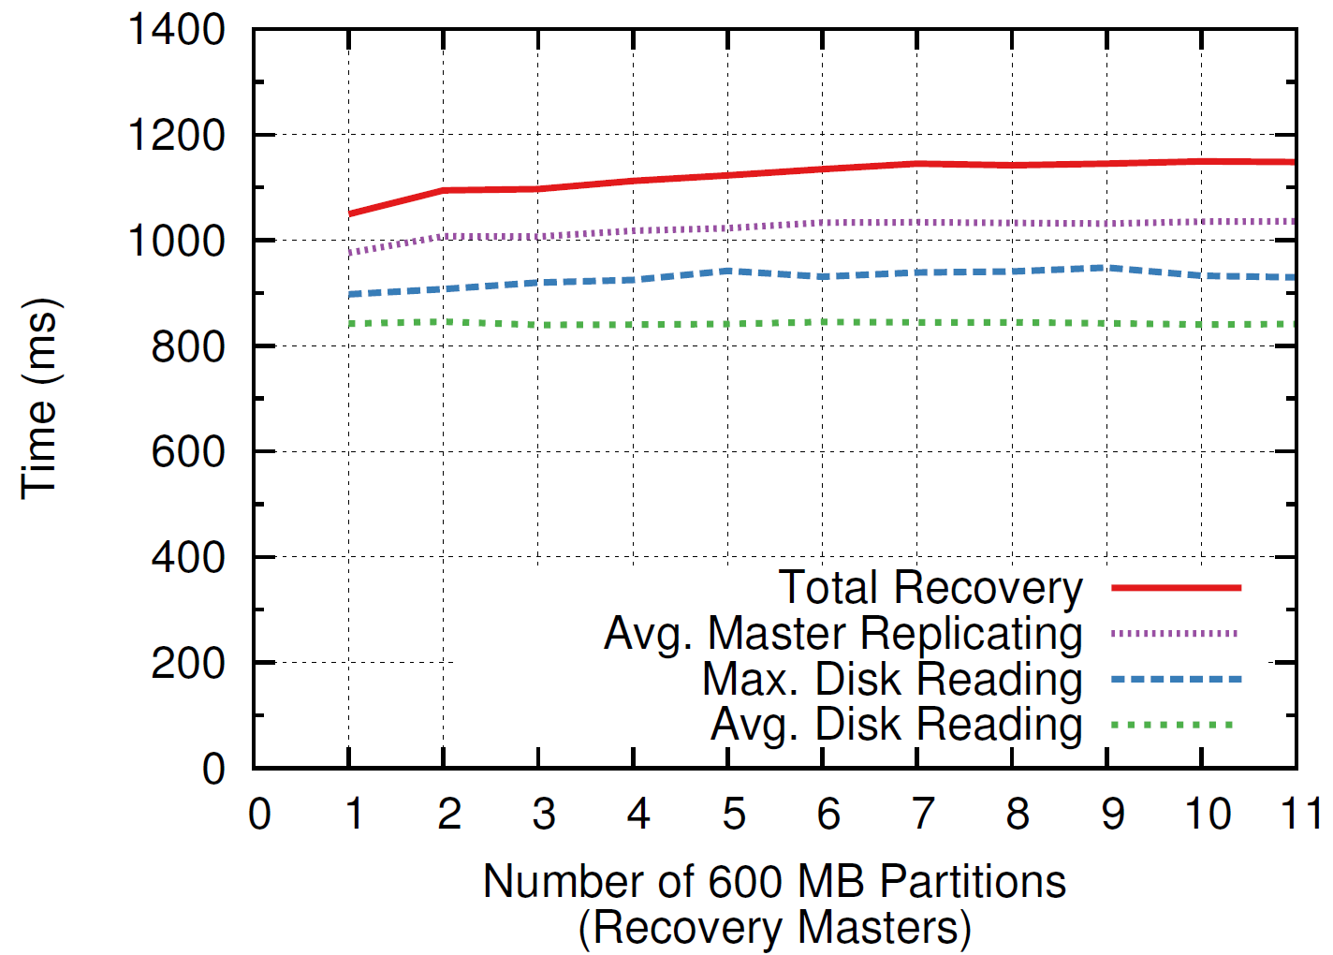
Recovery Scalability
1 master
6 backups
6 disks
600 MB
11 masters
66 backups
66 disks
6.6 GB

Slide 17
TODO
Restoring locality
Recovering Backups
Cold boot

Slide 18
Recovering Backups
In parallel with master recovery
Each master recreates any segments it has stored on that backup elsewhere
Expect to re-replicate 8 segments
1,000 machines, 64 GB per master
Just need to buffer on a new backup
Fast compared to master recovery

Slide 19
Recovery Summary
Before Crash
On Crash
Scatter log data
Balance partitions
Steve’s talk
Detect failure
Find log data
Check log integrity
Select new masters
Replay log data
Recreate backups

Slide 21
Recovery Summary
Before Crash
On Crash
Scatter log data
Balance master load
Steve’s talk
Detect failure
Find log data
Check log integrity
Select new masters
Replay log data
Recreate backups

Slide 22
Distribute Segments
To different failure domains
Each segment should be in a different rack
“Evenly” for fast recovery
Lower-bound is the time for all disks to read
Without overruning non-volatile buffers
Need to balance rate as well as total data
Without centralized coordination

Slide 23
Random Placement
Doesn’t handle failure domain constraints
Somewhat evens data for fast recovery
Place balls randomly into bins; max expected in any one bin? Not great. (log n / log log n)
Somewhat evens non-volatile buffers load
No centralized coordination

Slide 24
Random Placement
Best Case Read Time: (20 / 4) * 100 ms = 500 ms
Expected Read Time: max(7,7,2,4) * 100 ms = 700 ms
Time Over Optimal: 200 ms
Minimizing variance between backup is important.

Slide 25
Random With Refinement
On “segment open”
Choose 5 candidate backups that meet placement constraints
Select the one with
Either, the fewest segments from this master
Or, the one expected to spend the least amount of time loading recovery data if this master crashed (important when backup performance is heterogeneous)

Slide 26
Random With Refinement

Slide 27
Random With Refinement

Slide 28
Random With Refinement

Slide 29
Random With Refinement

Slide 30
Random With Refinement

Slide 31
Random With Refinement
Best Case Read Time: (20 / 4) * 100 ms = 500 ms
Expected Read Time: max(4,6,6,4) * 100 ms = 600 ms
Time Over Optimal: 100 ms

Slide 32
Adjust for Disk Speeds
Disk speed varies
When choosing between backups in the random selection choose the host with the least expected time needed to load during recovery

Slide 33
Random With Refinement
Handles failure domain constraints
Evens data for fast recovery
Place balls randomly with refinement into bins what is the maximum expected in any one bin? (log log n / log 5)
Somewhat evens non-volatile buffers load
Hard on “fresh” backups
Can do something about this if it matters
No centralized coordination

Slide 34
Scattering Results

Slide 35
Detecting Incomplete Logs
Problem: Segments may be lost
With high probability the list is complete
But, when 3 or more hosts have crashed before segments could be re-replicated
Coordinator checks when receiving segment backup locations
No centralized list of log segments
Solution: Self-describing log
Check using information in the backup segments

Slide 36
Log Digests
Each segment includes a log digest
List of the segment ids that make up the log when the segment was created
After broadcast the coordinator
Tracks the log digest from the segment with the highest segment id
Checks to make sure all listed segments have been found among backups

Slide 37
Finding the Head of the Log
Problem: What if the newest segment was lost?
Otherwise we might have a stale log digest
Segments have a “head” flag which is cleared when the master is done writing to it
Masters use an “open-before-close” policy
Prevents the a race between close of a head and open of a new one
If the segment with the highest id is not a “head” then assume data is lost

Slide 38
Fast Recovery: Strawman #1
Load 64 GB from 3 backups

Slide 39
Fast Recovery: Strawman #1
Load 64 GB from 3 backups
64 GB / 3 disks / 100 MB/s / disk = 3.5 minutes

Slide 40
Fast Recovery: Strawman #2
Scatter and load from all (1000) backups
64 GB / 1000 disks / 100 MB/s / disk = 0.6 s
…

Slide 41
Fast Recovery: Strawman #2
Scatter and load from all (1000) backups
64 GB / 10 Gbps = 1 minute
…

Slide 42
Fast Recovery
Crashed
Master
Scatter and load from all (~1000) backups
Partition data among many (~100) replacements
0.6 s by using many disks/NICs
…

Slide 43
Recovery Time Variance

Slide 44
Partitioning Recovery
Coordinator divides up <table, object id> ranges among recovery masters
Minimizing recovery time is difficult
Must “balance” work among recovery masters
Each master leaves a will behind with the Coordinator

Slide 45
Message Overheads at Scale

Slide 46
The Will & Partitions
Table ID | Start Object ID | End Object ID | Partition
1 | 0 | 999
2 | 0 | 999
3 | 0 | 999
1, 192
1, 382
3, 18
3, 993
1, 11
2, 99

Slide 47
The Will & Partitions
Table ID | Start Object ID | End Object ID | Partition
1 | 0 | 100
2 | 0 | 999
3 | 0 | 999
1 | 101 | 999
1, 192
1, 382
3, 18
3, 993
1, 11
2, 99
Repartitioning of segments can happen “after the fact”

