Slide 1
Durability and Crash Recovery for Distributed In-Memory Storage
Ryan Stutsman
Stanford University

Slide 2
Introduction
RAMCloud: large-scale datacenter storage in DRAM
Scale: up to 10,000 servers, 1+ PB capacity
Low latency: 5 µs remote access, 1M ops/s/server
1000× faster than disk-based storage systems
Impact: more data-intensive applications
Key problem: durability and availability
Frequent failures at large-scale
Cost of DRAM rules out traditional replicated approaches
My work: DRAM as reliable as replicated disk storage without performance or cost penalties

Slide 3
Contributions
DRAM as reliable as replicated disk storage without performance or cost penalties
Scalable Crash Recovery
Availability through fast recovery rather than redundancy
Leverages scale to restore an entire server’s DRAM in 1 to 2 s
Fault-tolerant Decentralized Log Structure
Provides fast writes by eliminating disk accesses
Retains consistency and restores durability after failures
Scales by avoiding centralization
Notes:
Want:
Cost of today’s volatile DRAM caches
With durability of today’s disk-based datacenter storage systems
But with performance that exceeds both by orders of magnitude

Slide 4
Outline
Introduction
Contributions
RAMCloud Overview
Fast Crash Recovery
Evaluation
Distributed Fault-Tolerant Log
Surviving Massive Failures
Conclusion

Slide 5
RAMCloud Architecture
Up to 100,000 Application Servers
App
App
App
…
App
High-speed network
~5 µs round-trip
Library
Library
Library
Library
Coordinator
Datacenter Network
Uses DRAM as
Key-Value Store
64 to 256 GB
Master
Master
Master
…
Master
Backup
Backup
Backup
Backup
Stores data from other Masters
Up to 10,000
Commodity Storage Servers

Slide 6
Outline
Introduction
Contributions
RAMCloud Overview
Fast Crash Recovery
Evaluation
Distributed Fault-Tolerant Log
Surviving Massive Failures
Conclusion

Slide 7
Availability Challenges
Server failures frequent
DRAM is volatile and expensive
Goals
As durable as disk-based storage systems
Minimize impact on performance
Minimum cost, energy

Slide 8
Strawman: Replicate in DRAM?
3× system cost, energy
Still have to handle power failures
Standard datacenter battery backups limited to 45 s
Master
write
Master
Master
Notes:
Expect question: if I put flash, can I flush all to disk?
Answer? Sure, but it still costs 3x more than our solution, and you’ll see that’s basically what we are doing without the need for high per-host bandwidth.
NVCACHE seems to be about > $300/GB and seems to top out at 1 GB per machine

Slide 9
RAMCloud’s Approach
1 copy in DRAM
Backup on disk/flash: cheap compared to DRAM
Problem: synchronous disk writes too slow
Fault-tolerant decentralized log structure
Problem: data is unavailable on crash
Fast crash recovery in 1 to 2 s
Fast enough that applications won’t notice

Slide 10
Fast Writes: Buffered Logging
write(“first-name”, “ryan”)
Hash Table
Buffered Segment
Disk
Backup
Buffered Segment
Disk
Backup
Buffered Segment
Disk
In-Memory Log Segments
Master
Backup
No disk I/O during write requests
Efficient 8 MB bulk writes
Limits buffered data; flush on power loss in < 250 ms

Slide 11
Restoring Availability: Crash Recovery
What is left when a master crashes?
Log data stored on disk on backups
What must be done to restart servicing requests?
Replay log data into DRAM
Reconstruct the hashtable

Slide 12
Recovery Bottlenecks
Goal: recover 64 GB in 1-2 seconds
Can’t do it with simple replication
Key to fast recovery:
use system scale
Crashed
Master
Disks: ~100 MB/s each
64 GB / 300 MB/s ≈ 210 seconds
Backups
NIC: ~1 GB/s
64 GB / 1 GB/s ≈ 60 seconds
Recovery Master

Slide 13
Scatter Segments
Each log divided into 8MB segments
Master chooses different backups for each segment
Segments scattered randomly across all servers
During recovery:
All backups read from disk in parallel
64 GB / (1000 backups * 100 MB/s/backup) = 0.6 seconds
Master
In-Memory Log Segments
Backups

Slide 14
Partitioned Recovery
Divide each master’s data into partitions
Each partition groups a fraction of crashed key space
64 GB / (100 masters * 1 GB/s/master) = 0.6 seconds
Recover each partition on separate Recovery Master
Recovery Masters
Crashed Master
Backups

Slide 15
Parallelism in Recovery
2. Bucket objects
by partition
3. Transfer filtered data to recovery master
4. Add objects to hash table & log
1. Read disk
Hash Table
Log
Backup
5. Send log data to backups
Recovery Master
6. Write backup data to disk
Recovery is both data parallel and tightly pipelined

Slide 16
Issues
Eliminating stragglers
Randomized segment scattering
Balancing partitions
Finding log segments
Verifying log integrity
Maximizing concurrency
Out-of-order log replay
Fast failure detection
Failures during recovery
Consistency/Zombie masters

Slide 17
Randomized Segment Scattering
Randomizing replica locations has many benefits
Avoids centralized allocation: 100k+ segments/second
Avoids hotspots; spreads request load
Balances total replicas on each disk
Spreads replicas from each master across all disks
Notes:
log n / log log n versus log log n / log d

Slide 18
Uniform Randomization Doesn’t Work
Problem: balancing time reading across disks
Recovery time determined by the slowest disk
Random distribution has large variance
Frequently 2 to 3× more replicas on one backup than avg
Master
Backups
Notes:
log n / log log n versus log log n / log d
All have 1 million total runs
Using choose 5 with 24576 balls into 1000 bins
Max - Frequency - Percent
25 721 0.0721
26 999279 99.9279
Using choose 1 with 24576 balls into 1000 bins
Max - Frequency - Percent
36 5 0.0005
37 609 0.0609
38 10980 1.098
39 60919 6.0919
40 146908 14.6908
41 204745 20.4745
42 197518 19.7518
43 149973 14.9973
44 99529 9.9529
45 59387 5.9387
46 33223 3.3223
47 17914 1.7914
48 9125 0.9125
49 4714 0.4714
50 2335 0.2335
51 1161 0.1161
52 529 0.0529
53 236 0.0236
54 106 0.0106
55 51 0.0051
56 19 0.0019
57 10 0.001
58 3 0.0003
60 1 0.0001
Choose 5, SOSP config for flash, 13500 balls into 120 bins
Max - Frequency - Percent
113 679464 67.9464
114 320536 32.0536
Choose 1, SOSP config for flash, 13500 balls into 120 bins
Max - Frequency - Percent
126 1 0.0001
127 6 0.0006
128 34 0.0034
129 248 0.0248
130 1107 0.1107
131 3635 0.3635
132 9114 0.9114
133 18994 1.8994
134 32777 3.2777
135 49500 4.95
136 66162 6.6162
137 79779 7.9779
138 88771 8.8771
139 90976 9.0976
140 89656 8.9656
141 83179 8.3179
142 74473 7.4473
143 64509 6.4509
144 53441 5.3441
145 43994 4.3994
146 35480 3.548
147 27981 2.7981
148 21647 2.1647
149 16640 1.664
150 12777 1.2777
151 9405 0.9405
152 7298 0.7298
153 5184 0.5184
154 3776 0.3776
155 2752 0.2752
156 2039 0.2039
157 1386 0.1386
158 987 0.0987
159 686 0.0686
160 522 0.0522
161 331 0.0331
162 243 0.0243
163 174 0.0174
164 128 0.0128
165 73 0.0073
166 45 0.0045
167 37 0.0037
168 16 0.0016
169 12 0.0012
170 10 0.001
171 6 0.0006
172 6 0.0006
173 1 0.0001
174 1 0.0001
175 1 0.0001

Slide 19
Balancing Disk Read Times
Solution: add small amount of choice
Analyzed in [Mitzenmacher 1996]
Choose candidate backups randomly
Select candidate that minimizes expected disk read time
Must take into account disk performance; fan vibration
Master
Backups
Notes:
log n / log log n versus log log n / log d

Slide 20
Issues
Eliminating stragglers
Randomized segment scattering
Balancing partitions
Finding log segments
Verifying log integrity
Maximizing concurrency
Out-of-order log replay
Fast failure detection
Failures during recovery
Consistency/Zombie masters

Slide 21
Finding Log Segment Replicas
Problem: centralized segment catalog prohibitive
No centralized map of replica locations
No centralized list of which segments comprise a log
Solution: ask all backups with broadcast
On master crash coordinator contacts each backup
Have to contact all backups anyway: scattered segments
Collects a list of all available replicas

Slide 22
Detecting Incomplete Logs
Problem: ensure complete log found on recovery
What if all replicas for some segment are missing?
Solution: make log self-describing
Add a “log digest” to each replica when it is allocated
Lists all segments of the log
Reduces problem to finding up-to-date log digest
S7
S19
S20
Digest
[S7, S19, S20]

Slide 23
Choosing an Up-to-date Digest
Solution: mark the most recent log digest
Whenever a new digest is created it is marked
Clear mark when last modification is made to segment
Challenge: ensure safe transition between digests
Mark new digest before clearing mark on the old one
Two may be marked; only add data after just one marked
Segment 19
Segment 20
OK
[7, 19]
Time
OK
[7, 19]
[7, 19, 20]
OK
Stale
[7, 19]
[7, 19, 20]
OK
Digest
Digest

Slide 24
Issues
Eliminating stragglers
Randomized segment scattering
Balancing partitions
Finding log segments
Verifying log integrity
Maximizing concurrency
Out-of-order log replay
Fast failure detection
Failures during recovery
Consistency/Zombie masters

Slide 25
Outline
Introduction
Contributions
RAMCloud Overview
Fast Crash Recovery
Evaluation
Distributed Fault-Tolerant Log
Surviving Massive Failures
Conclusion

Slide 26
Experimental Setup
Cluster Configuration
60 Machines
2 Disks per Machine (100 MB/s/disk)
Mellanox Infiniband HCAs (25 Gbps, PCI Express limited)
5 Mellanox Infiniband Switches Two layer topology Nearly full bisection bandwidth
Approximation for datacenter networks in 3-5 years
5.2 µs round trip from 100 B read operations

Slide 27
How well does recovery scale?
Crashed
Master
Recovery
Master
600 MB
600 MB
6 Backups

Slide 28
How well does recovery scale?
Crashed
Master
2 Recovery
Masters
1200 MB
600 MB
600 MB
12 Backups

Slide 29
How well does recovery scale?
20 Recovery
Masters
Crashed
Master
11.7 GB
600 MB
600 MB
600 MB
600 MB
600 MB
600 MB
600 MB
600 MB
600 MB
600 MB
600 MB
600 MB
600 MB
600 MB
600 MB
600 MB
600 MB
600 MB
600 MB
600 MB
120 Backups

Slide 30
How well does recovery scale?
1 Recovery Master
6 disks: 600 MB/s
Recovered: 600 MB
20 Recovery Masters
120 backups: 11.7 GB/s
Recovered: 11.7 GB
Recovery well pipelined; all disks active > 75% of the time

Slide 31
Flash Allows Higher Scalability
60 Recovery Masters
120 SSDs: 31 GB/s
Recovered: 35 GB
2x270 MB/s SSDs per recovery master
(vs. 6x100 MB/s disks per recovery master)

Slide 32
Outline
Introduction
Contributions
RAMCloud Overview
Fast Crash Recovery
Evaluation
Fault-Tolerant Decentralized Log
Surviving Massive Failures
Conclusion

Slide 33
Fault-tolerant Decentralized Log
Fast and cheap durability in normal case
Eliminates synchronous disk writes
High read bandwidth for fast crash recovery
Scalable; avoids centralization
Even on segment transitions
But, how do failures impact logs?
Low-Latency Read/Write
Operations
Multiple/Massive Recovery
Fast Crash Recovery
Fault-tolerant Decentralized Log

Slide 34
Distributed Replica Recreation
Masters
Backups
Problem: failures accumulate into loss of segments
Solution: recreate replicas to restore redundancy
Simple: master uses same approach as normal operation
Efficient: use master’s in-memory copy
Concurrent: work is divided up among all the hosts
Faster than master recovery, but lower priority

Slide 35
Restarting After Widespread Failure
Problem: widespread correlated failures may lose all replicas of some segments
Power outages, loss of core switch, coordinated segfaults
Rare events, a few times a year; usually temporary
Unavailability ok until problem subsides
Solution: wait for servers to rejoin with replicas
Perform recovery when all segments available for server

Slide 36
Inconsistent Replicas
Problem: some found replicas may be inconsistent
Master can’t wait for backup to rejoin to add data to log
Master can’t clear log digest mark on lost head replicas
Cannot solve with log alone and remain available
(Sketch of) Solution: must centralize some state
Prevent inconsistency of most replicas: atomic recreation
Minimize centralized state for inconsistent head replicas
Update log head version on coordinator on inconsistency
Rare, expect 6 updates/hr, constant 16 bytes of state/log
S20
S21
S7
S19
S20

Slide 37
Outline
Introduction
Contributions
RAMCloud Overview
Fast Crash Recovery
Evaluation
Fault-Tolerant Decentralized Log
Surviving Massive Failures
Conclusion

Slide 38
Coordinating Restart/Massive Recovery
Simplicity is goal on loss of many/all servers
Massive failures are expected to be rare
Reuse master recovery
Treat massive failure as a series of single failures
Recoveries fail until a complete log is available
Retry recoveries round-robin

Slide 39
Outline
Introduction
Contributions
RAMCloud Overview
Fast Crash Recovery
Evaluation
Fault-Tolerant Decentralized Log
Surviving Massive Failures
Conclusion

Slide 40
Key Design Principles
Make scale your friend
Failures are frequent at scale
But, scale provides resources for solving problems; crash recovery
Cannot design for the “common” case
“Rare” corner cases happen frequently
Code must always be ready to adapt to failures
Pervasive randomization
Decentralized decision-making, avoids pathologies; use carefully
Collapse error handling
Fast recovery simplifies the system
When in doubt, crash
DRAM corruption and more

Slide 41
Related Work
Large-scale DRAM storage
Large-scale memcached [NSDI 13]
Apps must deal with backing store and consistency
Reduced performance from misses, cold caches
Fast recovery for availability
Fast Crash Recovery in Distributed File Systems [Baker 94]
Reconstruct server’s view of client cache state
Restart quickly enough for continuous availability
Notes:
Other ideas:
Mary Baker [Baker 94]
HANA
FDS [OSDI 12]

Slide 42
Related Work
Fast updates by buffering in non-volatile memory
POSTGRES [VLDB 87]
Log-structured storage
Log-structured Filesystem (LFS) [SOSP 91]
Filesystem interface on a single disk
RAMCloud keeps log in-memory and on disk
GFS [SOSP 03]
Fault-tolerant log via replicated chunks throughout cluster
Buffers writes in buffer cache
Centralized metadata server to allocate chunks
Supports Bigtable [OSDI 06], primarily disk-based DB
Notes:
Key categories: fast recovery, rebuild DRAM index, fault-tolerant log structure,

Slide 43
Conclusion
RAMCloud: large-scale datacenter storage in DRAM
Scale: Up to 10,000 servers, 1+ PB capacity
Low latency: 5 µs remote access, 1M ops/s/server
1000× faster than disk-based storage systems
Impact: more data-intensive applications
My work: DRAM as reliable as replicated disk storage without performance or cost penalties

Slide 44
Contributions
DRAM as reliable as replicated disk storage without performance or cost penalties
Scalable Crash Recovery
Availability through fast recovery rather than redundancy
Leverages scale to restore an entire server’s DRAM in 1 to 2 s
Fault-tolerant Decentralized Log Structure
Provides fast writes by eliminating disk accesses
Retains consistency and restores durability after failures
Scales by avoiding centralization

Slide 45
Thanks
Christine, Mendel, Christos
Mikhail Atallah, David, John
Nickolai, Daniel, Jad, Mike Walfish
Steve, Diego, Ankita, Satoshi
Mom, Dad

Slide 46
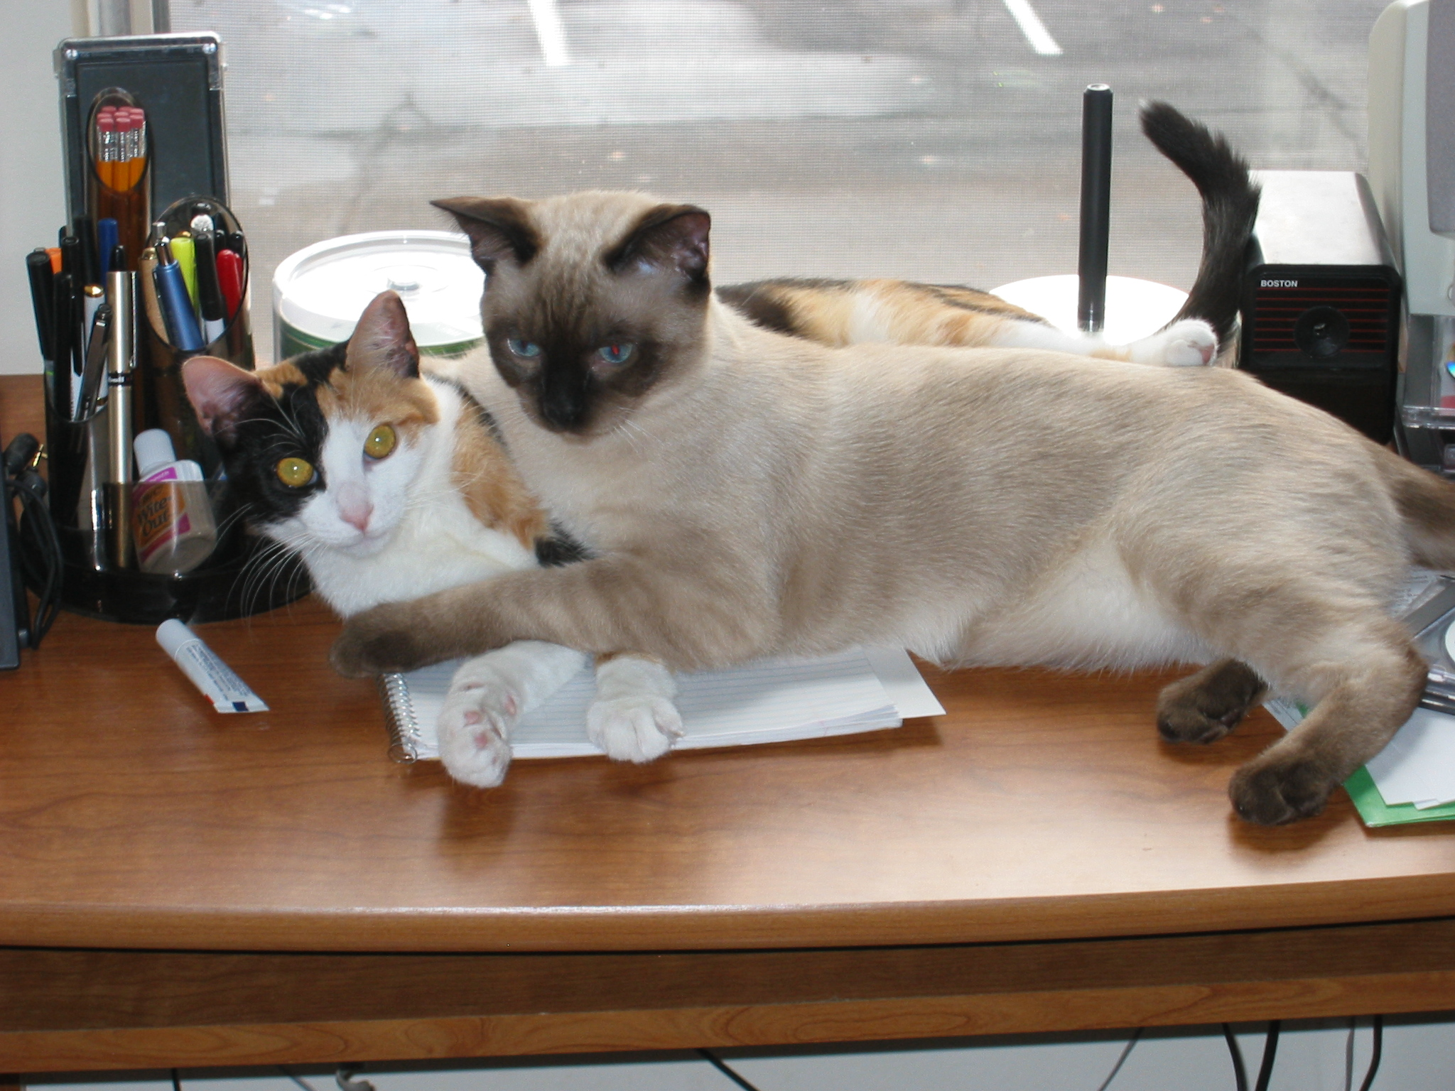

Slide 48
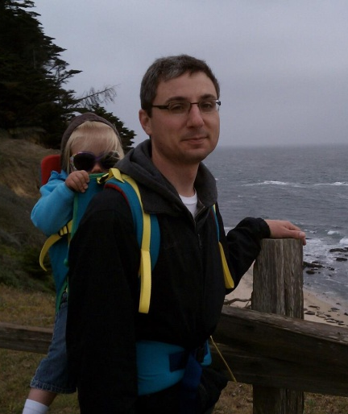
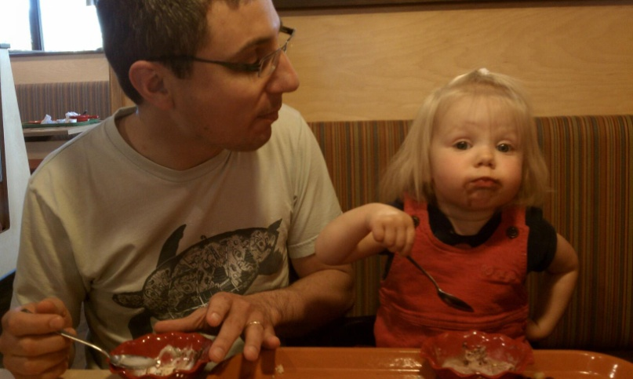
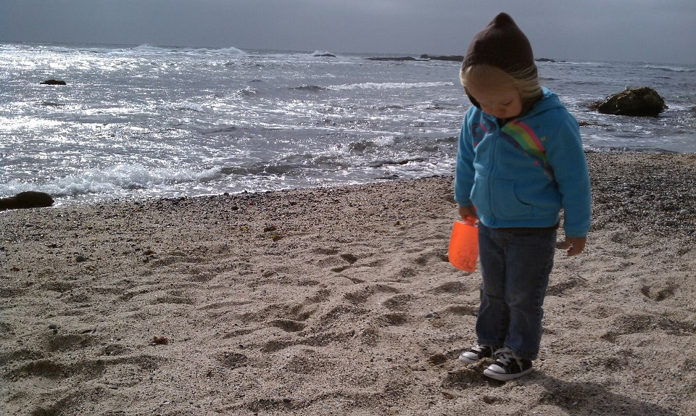
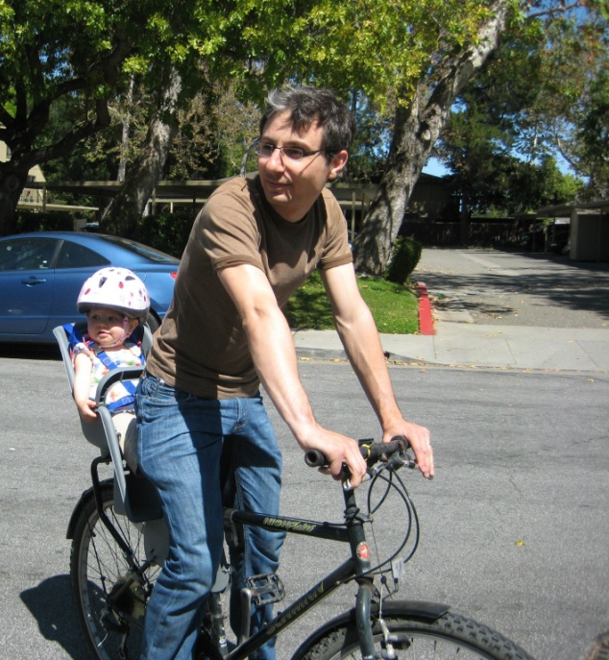
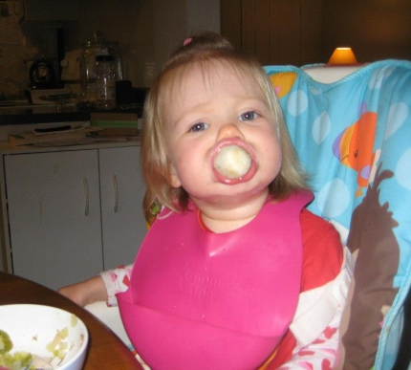

Slide 49
Contributions
DRAM as reliable as replicated disk storage without performance or cost penalties
Scalable Crash Recovery
Availability through fast recovery rather than redundancy
Leverages scale to restore an entire server’s DRAM in 1 to 2 s
Fault-tolerant Decentralized Log Structure
Provides fast writes by eliminating disk accesses
Retains consistency and restores durability after failures
Scales by avoiding centralization
Notes:
Things to say:
For the price of today’s volatile DRAM caches

Slide 51
Why not a Caching Approach?
Lost performance:
1% misses → 10x performance degradation
Won’t save much money:
Already have to keep information in memory
Example: Facebook caches ~75% of data size
Availability gaps after crashes:
System performance intolerable until cache refills
Facebook example: 2.5 hours to refill caches!

Slide 52
Why not Flash Memory?
DRAM enables lowest latency today:
5-10× faster than flash
Exposes all software bottlenecks
Many candidate technologies besides DRAM
Flash (NAND, NOR)
PCRAM
MRAM
…
Most RAMCloud techniques will apply to other technologies

Slide 53
Partitioning During Recovery
Backups receive a partition list at the start of recovery
Backups load segments from disk and partition objects
Recovery masters only fetch relevant objects
To Master
Recovering
0 to 4
To Master
Recovering
5 to 9
Partition | Table ID | Hash Range
 | 28 | 0 to 4
 | 28 | 5 to 9
0
4
3
2
9
7
5
6
9
0
7
5
4
6
3
2
Segment
Segment

Slide 54
Fault-Tolerance Summary
 | Independent | Widespread, Simultaneous
Temporary | Segfault, reboot | Power loss, segfault, faulty core switch
Permanent | Bad disk, reprovisioned | Fire, nuclear attack, Godzilla
Available & Durable
Durable
Available & Durable
Good luck
Independent failures: lose DRAM, segment redundancy
Solution: fast master recovery, recreate lost replicas
Widespread failures: lose all replicas of some segments
Solution: unavailability ok, reuse replicas after rejoin

Slide 55
Lowest TCO
10000
Disk
1000
100
Flash
Dataset Size (TB)
10
DRAM
1
0.1
0.1
1
10
100
1000
Query Rate (millions/sec)
from "Andersen et al., "FAWN: A Fast Array of Wimpy Nodes", Proc. 22nd Symposium on Operating System Principles, 2009, pp. 1-14.

Slide 56
Latency vs. Ops/sec
10⁻⁷
Main memory, one machine
10⁻⁶
Better
RAMCloud, 1000 servers
10⁻⁵
Latency (seconds)
Flash, one machine
Flash, 1000 servers
10⁻⁴
5 disks, one machine
10⁻³
Cache, 90% hits
5000 disks, 1000 servers,
No cache
10⁻²
10²
10³
10⁴
10⁵
10⁶
10⁷
10⁸
10⁹
Ops/sec. (small reads)

Slide 57
Balancing Disk Read Times

Slide 58
How much can a Master recover in 1 s?
400 MB
800 MB

Slide 59
Fast Recovery Improves Durability
GFS (SOSP ‘03)
3-Copies on Disk
RAMCloud with
1-Copy in RAM
2-Copies on Disk
Assumptions:
2 failures/server/year
Failures are independent
Failures lose all contents of both RAM and disk
Replication factor 3

Slide 60
Don’t Count On Locality
Greatest drivers for software and hardware systems over last 30 years:
Moore’s Law
Locality (caching, de-dup, rack organization, etc. etc.)
Large-scale Web applications have huge datasets but less locality
Long tail
Highly interconnected (social graphs)
Traditional applications
Frequency
Web applications
Items

Slide 61
Why Does Latency Matter?
Traditional Application
Web Application
UI
UI
App. Logic
Application Servers
App. Logic
Storage Servers
Data Structures
Single machine
Datacenter
<< 1 µs latency
10-100 ms latency
Large-scale apps struggle with high latency
Random access data rate has not scaled!
Facebook: can only make 100-150 internal requests per page

Slide 62
Goal: Scale and Latency
Traditional Application
Web Application
UI
UI
App. Logic
Application Servers
App. Logic
Storage Servers
Data Structures
Single machine
Datacenter
<< 1 µs latency
10-100 ms latency
5 µs
Enable new class of applications:
Crowd-level collaboration
Large-scale graph algorithms
Real-time information-intensive applications

Slide 63
Example Configurations
 | 2010 | 2015-2020
# servers | 2000 | 4000
GB/server | 24 GB | 256 GB
Total capacity | 48 TB | 1 PB
Total server cost | $3.1M | $6M
$/GB | $65 | $6
For $100-200K today:
One year of Amazon customer orders
One year of United flight reservations

Slide 64
RAMCloud Motivation: Technology
Disk access rate not keeping up with capacity:
Disks must become more archival
More information must move to memory
 | Mid-1980’s | 2009 | Change
Disk capacity | 30 MB | 500 GB | 16667x
Max. transfer rate | 2 MB/s | 100 MB/s | 50x
Latency (seek & rotate) | 20 ms | 10 ms | 2x
Capacity/bandwidth (large blocks) | 15 s | 5000 s | 333x
Capacity/bandwidth (1KB blocks) | 600 s | 58 days | 8333x
Jim Gray’s rule | 5 min | 30 hours | 360x

Slide 65
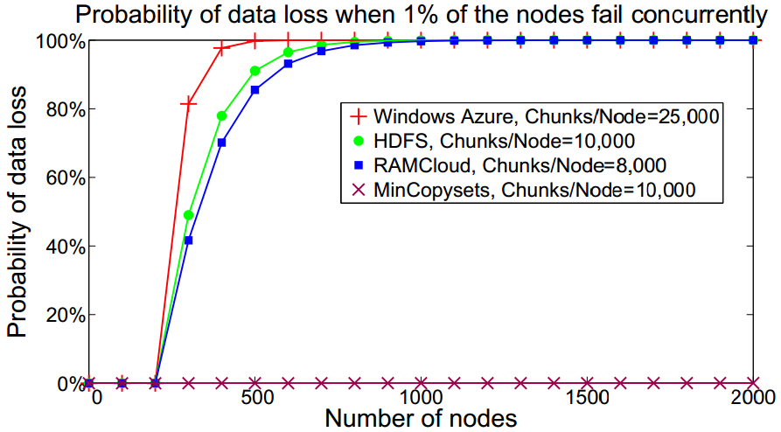
Sometimes Randomization is Bad!
Select 3 backups for segment at random?
Problem:
In large-scale system, any 3 machine failures results in data loss
After power outage, ~1% of servers don’t restart
Every power outage loses data!
Solution: derandomize backup selection
Pick first backup at random (for load balancing)
Other backups deterministic (replication groups)
Result: data safe for hundreds of years
(but, lose more data in each loss)

Slide 66
Inconsistent Replicas
Segment 19 on Master
Replicas for
Segment 19 on Backups
Write
starts
Time
Write
ends
Missing new, acknowledged object
Want to recover if one consistent replica comes online
Problem: head segment is under active change
Lost replica may be useful for recovery one moment
A moment later it must not be used during recovery
Solution: make inconsistencies rare; centralized state

Slide 67
Related Work
Decentralization (logs)
Durable DRAM storage
Notes:
Other ideas:
Mary Baker [Baker 94]
HANA
FDS [OSDI 12]

Slide 68
Distributed Replica Recreation
Segment 19 on Master
Replicas for
Segment 19 on Backups
Time
Recreate lost replicas to maintain redundancy
Simple: Master uses same procedure as normal operation
Efficient: Use master’s in-memory copy
Concurrent: Work is divided up among all the hosts
Recreation time similar to master recovery
Master recovery is prioritized

Slide 69
Replica Inconsistencies
Problem: log operations may fail on some replicas
Recover if one consistent replica is/comes online
But, replicas can be partitioned away
CAP: can’t have availability and consistency too
Must use highly-available centralized coordinator
Can’t keep centralized replica list for consistency
100,000+ log segments added/removed per second

Slide 70
Expected Replica Recreation Time
One backup disk could have 192 GB of data
Assume 1,000 64 GB masters triplicating segments
Aggregate network bandwidth: 1,000 GB/s
Aggregate disk bandwidth: 200 GB/s
~1,000 ms
~200 ms if backups can safely buffer extra 256 MB
100× faster than similar systems
Strong benefit to durability against independent failures
Master recovery is prioritized
Notes:
80 masters with 64 GB of data triplicated across 80 backups
Assume 2 x 150 MB/s SSDs
~8.2 s (192 GB / (2 x 150 MB/s))
Each master has ~24 replicas on a given backup

Slide 71
Minimal centralization
Idea 1: make inconsistent replicas rare
Atomically recreate replicas for non-head segments
Final contents is known, only ship final checksum
Idea 2: update central state only on inconsistencies
Only head segments can become inconsistent
Expect about 3 every 30 minutes in large cluster
Only record which replicas can be considered head
Can be done with 128 bits per affected log

Slide 72
Inconsistent Head Replicas
Segment 19 on Master
Replicas for
Segment 19 on Backups
Write
starts
Time
Write
ends
Missing new, acknowledged object
Problem: Head segment under active change
Lost replica may be useful for recovery one moment
A moment later it must not be used during recovery

Slide 73
Eliminating Inconsistent Head Replicas
Segment 19 on Master
Replicas for
Segment 19 on Backups
v1
v1
v1
Write
starts
v1
v1
v1
Time
v2
v2
v1
v2
Update Min Head Segment Version on Coordinator
Write
ends
v2
v2
v1
v2
Stale segment detected,
Recovery waits for other replicas
Min Head Segment Version: 19, 2
Solution: make valid head replicas distinguishable
Update replica versions when failure affects head segment
Record min head segment id/version on coordinator
Rare and constant amount of state (128-bits) per server

Slide 74
Replica Garbage Collection
Problem: backups may miss frees from masters
Masters may crash before issuing frees
Backup crashes and restarts later
Stored replicas may be needed or may be redundant
Masters may have created new replicas elsewhere

Slide 75
Fault-tolerance Requirements
Server failures:
Desired fault-tolerance:
Intermittent (permanent) loss of individual servers
Remain available
Rare but temporary loss of many or all servers
Remain durable
 | Independent | Correlated
Permanent | Bad disk, reprovisioned | Fire, nuclear attack, Godzilla
Temporary | Segfault, reboot | Power loss, segfault, faulty switch

Slide 76
Fault-tolerance Requirements
Server failures:
Desired fault-tolerance:
Intermittent (permanent) loss of individual servers
Remain available
Rare but temporary loss of many or all servers
Remain durable
 | Independent | Correlated
Permanent | Bad disk, reprovisioned | Fire, nuclear attack, Godzilla
Temporary | Segfault, reboot | Power loss, segfault, faulty switch
Available
Cross fingers
Durable

Slide 77
Compensating for Failures
Problem: replicas are lost when servers crash
Solution: rapidly recreate lost replicas
Prevents 4 successive crashes from resulting in loss
Mitigates independent loss of single servers
Problem: unavailable segments due to temporary server losses
Solution: must reuse replicas found on disks
Mitigates temporary correlated loss of (many) servers
Creates a new problem: inconsistent replicas

Slide 78
Compensating for Failures
Problem: replicas are lost when servers crash
Solution: rapidly recreate lost replicas
Prevents 4 successive crashes from resulting in loss
Mitigates independent loss of single servers
Problem: temporary server losses may make segments unavailable
Solution: must reuse replicas found on disks
Mitigates temporary correlated loss of (many) servers
Creates a new problem: inconsistent replicas
 | Independent | Correlated
Permanent | Bad disk, reprovisioned | Fire, nuclear attack, Godzilla
Temporary | Segfault, reboot | Power loss, segfault, faulty switch
Replica
Recreation
Reuse on Restart

Slide 79
Replica Garbage Collection
Problem: master’s may not always free replicas
Backup crashes and restarts later
Stored replicas may be needed or may be redundant
Masters may have created new replicas elsewhere
When the backup rejoins the master may be
Under recovery → keep
Dead and gone → discard
Still operating → ?
Ask server and discard if segment is no longer part of log

Slide 80
Contributions
Fault-tolerant DRAM-based Datacenter Storage
1000x faster than today’s systems for
the same cost as volatile DRAM caches
Scalable Crash Recovery
Leverages scale to achieve continuous availability by
restoring an entire server’s DRAM in 1 to 2 seconds
Fault-tolerant Decentralized Log Structure
Provides cheap durability on disks, low-latency writes,
and high-bandwidth for recovery while tolerating failures

Slide 81
Introduction
RAMCloud: large-scale datacenter storage in DRAM
Scale: Up to 10,000 servers, 1+ PB capacity
Low latency: 5 µs remote access, 1M ops/s/server
Key problem: durability and availability
Cost of DRAM rules out traditional replicated approaches
My work: DRAM as reliable as replicated disk storage without giving up performance
Fault-tolerant Decentralized log for fast, durable writes
Scalable fast crash recovery: 1 to 2 s
Decentralized management for large-scale

Slide 82
State-of-the-art: Caching
Facebook: 200 TB of data; 150 TB of DRAM cache
Doesn’t save much money
Results in lost performance: cache misses
Availability gaps after crashes: “Black Thursday”
Eliminate underlying database? Need durability
My work: make DRAM as reliable as replicated disk storage without giving up performance
No need for a separate database

Slide 83
RAMCloud
Harness performance of large-scale DRAM storage:
General-purpose storage system
All data always in DRAM
Scale: Up to 10,000 servers, 1+ PB capacity
Low latency: 5 µs remote access, 1 M ops/s/server
Strong consistency (linearizability)
Key problem: durability & availability

Slide 84
Fault-tolerant Decentralized Log
Lost replicas
Recreation of replicas prevents failures from accumulating
Replica consistency
Convert inconsistent replicas into replica loss
Only needed for replicas lost while under active modification
Rarely records a small amount of state on the coordinator
Detecting incomplete logs
Broadcast to find replicas
Log digest provides catalog of segments
Log digest marker ensures up-to-date digest is found
No centralization during normal operation
Even during transitions between segments

Slide 85
Contributions
Large-scale DRAM-based datacenter storage
With performance 1000x faster than today’s datacenter storage systems
As durable as any disk-based datacenter storage system
With the same cost and energy consumption as today’s volatile DRAM caches
Fast Crash Recovery
Reconstitutes an entire server’s DRAM in 1 to 2 seconds (64 to 256 GB)
Fast enough that applications never notice server failures
Scales to tens-of-thousands of machines
Improves in recovery time with scale
Provides strong consistency even across failures
Fault-tolerant Decentralized Log Structure
Creates efficient disk-based backups while retaining low-latency updates
Imposes no overhead for read operations and eliminates disk operations for updates
Aggressively maintains durability to prevent losses from permanent servers failures
Survives widespread temporary correlated server failures while retaining consistency

Slide 86
Contributions
Large-scale DRAM-based datacenter storage
With performance 1000x faster than today’s datacenter storage systems
As durable as any disk-based datacenter storage system
With the same cost and energy consumption as today’s volatile DRAM caches
Fast Crash Recovery
Reconstitutes an entire server’s DRAM in 1 to 2 seconds (64 to 256 GB)
Fast enough to constitute continuous availability , eliminating the need for redundancy in DRAM
Fast enough that applications never notice server failures
Scales to tens-of-thousands of machines
Improves in recovery time with scale
Provides strong consistency even across failures
Fault-tolerant Decentralized Log Structure
Creates efficient disk-based backups while retaining low-latency updates
Imposes no overhead for read operations and eliminates disk operations for updates
Aggressively maintains durability to prevent losses from permanent servers failures
Survives widespread temporary correlated server failures while retaining consistency

Slide 87
Issues
Eliminating stragglers
Randomized segment scattering
Balancing partitions
Finding log segments
Verifying log integrity
Maximizing concurrency
Out-of-order log replay
Fast failure detection
Failures during recovery
Consistency/Zombie masters

Slide 88
Balancing Partitions
Distribution of data/keys across tablets changes
Can’t afford centralized metrics on coordinator
Record statistics into the log scattered on backups
Coordinator collects the metrics at recovery start
Divides crashed master’s tablets at recovery time
Packs tablets across recovery masters to balance work
May combine or split tablets in the process
Need a diagram if want to keep; probably drop this.

Slide 89
Issues
Eliminating stragglers
Randomized segment scattering
Balancing partitions
Finding log segments
Verifying log integrity
Maximizing concurrency
Out-of-order log replay
Fast failure detection
Failures during recovery
Consistency/Zombie masters

Slide 90
Maximizing Concurrency
Preventing pipeline stalls critical to meet deadline
Problem: Replicas may be loaded out-of-order
Solution: Allow out-out-order replay
Objects contain a version number
Newest version can be determined regardless of order
Recovery masters work ahead when replicas are slow to load

Slide 91
Contributions
Large-scale DRAM-based datacenter storage as durable as any disk-based system
Durable and available DRAM-based storage for the same price and energy consumption as today’s volatile DRAM caches
Fast Crash Recovery
Reconstitutes an entire server’s DRAM in 1 to 2 seconds (64 to 256 GB)
Fast enough that applications never notice server failures
Scales to tens-of-thousands of machines
Improves in recovery time with scale
Provides strong consistency even across failures
Fault-tolerant Decentralized Log Structure
Creates efficient disk-based backups while retaining low-latency updates
Imposes no overhead for read operations and eliminates disk operations for updates
Aggressively maintains durability to prevent losses from permanent servers failures
Survives widespread temporary correlated server failures while retaining consistency

Slide 92
DRAM Explosion
More apps keeping all/most data in DRAM
Each app uses a custom approach
Facebook: 200 TB total data 150 TB cache!
memcached
Web indexes entirely in DRAM
Main-memory databases
Total Data in DRAM
Large file caches
UNIX buffer cache
Main-memory DBs, again
1970
1980
1990
2000
2010

Slide 93
Problems with Caching
Won’t save much money
Cache size approaching dataset size (75% at Facebook)
Lost performance
1% cache misses → 10× performance loss
Writes are expensive
Availability gaps after crashes
System performance intolerable until cache refills
Facebook: 2.5 hours of downtime in 2010
“Black Thursday”
Notes:
Facebook: looking at Bobby’s post it looks more like just one value was invalid in the DB which caused all clients to shoot it down and refetch it. This overloaded the servers, and server timeouts were also interpreted as failures and clients performed shootdowns on them. This re-evicted the items from the cache over and over and kept the backing store servers knocked over.
Cache miss times: 10 ms
Cache hit times: 500 us
Expected performance with 1% misses: .99(100) + .01(10000) = 199 us
.99(100) + .01(100000) = 1099 us = 10x slowdown
Or 10 us to 10 ms
Real numbers 0.99(300) + .01(10000) = 297 + 100 = 397 = 25%

Slide 94
Keep it all in DRAM?
Underlying database provides durability
Goal: Eliminate the need for separate database
Make DRAM as reliable as replicated disk storage without giving up performance

Slide 95
Topic list from thesis (1)
Server logs
Segments
Buffering write ops
Scattering replicas
For bw, must reflect failure modes, compensate for IO bw, distribute request load, compensate for adds/removes, don’t want to overwhelm new servers but they must catch up
Must be fully decentralized decision making
Primary replicas

Slide 96
(2)
Replica recreation
Segment certificates, atomic modification
Finding replicas
Detecting incomplete logs
Log digests, open-before-close, close-before-write
Detecting inconsistent replicas
Epoch number
Reclaiming space
Explicit, after recovery, unavailable backups need to decide what to do after restart (master gone and recovered, master available, master under recovery)

Slide 97
(3)
Failure detection
Partitioning recovery
Replay
Segment replay order
Maximum version recovery
Multiple failures
Failures during recovery
Crash – loss of {master, backup}, too few recovery masters, no storage space, coordinator crashes during recovery
Cold start
Iteratively retry until a recovery succeeds
Leases

Slide 98
(4)
Eval questions
How large should partitions be?
How many disks are needed per recovery master?
How well does recovery scale?
How well does segment scattering work?
Will scattering result in data loss?
What is the fastest possible recovery?
Risks
Scalability
Over-hasty recovery
Fragmented Partitions
Runs on coordinator

Slide 99
Thesis
Large-scale RAM-based storage must be durable and available for applications to gain its full benefits, and it can be made so cost-effectively using commodity hardware.
Solution
Fast (1 - 2s) crash recovery for availability
Restoration of durability after crashes
Survival of massive failures (with loss of availability)

Slide 100
Primary Contribution
Large-scale DRAM-based storage as durable and as available as disk-based systems allowing applications to gain DRAM’s performance benefits while minimizing cost and energy consumption
Solution
Fast (1 - 2s) crash recovery for availability
Restoration of durability after crashes
Survival of massive failures (with loss of availability)

Slide 101
Technical Contributions: Recovery
Large-scale DRAM-based storage that
efﬁciently creates disk-based backups of data stored in DRAM while retaining low-latency access times;
imposes no overhead for read operations and eliminates disk operations for writes;
performs fast crash recovery by reloading an entire server’s DRAM contents (64 to 256 GB) and restoring full performance to the cluster in 1 to 2 seconds, fast enough that applications never notice server failures;
provides durable and available DRAM-based storage for the same price and energy consumption as today’s volatile DRAM caches;
scales to tens of thousands of machines;
provides strong consistency semantics (linearizability) in spite of failures;
and improves in recovery time as cluster size scales.

Slide 102
Other changes to make
Any key principles that can be extracted from the more advanced/newer parts of recovery?
Backup recovery
Log consistency issues
Particularly the newest rework
Backup rewrite? New storage layer?
Managing recovery concurrency
Replica garbage collection
Server list management
Rules etc

Slide 103
Implementation Status
Goal: build production-quality implementation
80,000 lines of C++
Additional 40,000 lines of unit and system tests
Complete
RPC system
Basic key-value operations
Space reclamation/log cleaner
Durability & crash recovery
Real-time table migration
In-progress
Coordinator fault-tolerance
Tested at Facebook with live traffic servicing real users

Slide 104
Randomized Segment Scattering
Randomizing replica locations has many benefits
Avoids centralized allocation
Avoids hotspots; spreads request load
Balances total replicas on each disk
Spreads replicas from each master across all disks
Notes:
log n / log log n versus log log n / log d

Slide 105
Uniform Randomization Doesn’t Work
Problem: Balancing time reading across disks
Recovery time determined by the slowest disk
Random distribution has large variance
Frequently 2 to 3× more replicas on one backup than average
Master
Backups
Notes:
log n / log log n versus log log n / log d
All have 1 million total runs
Using choose 5 with 24576 balls into 1000 bins
Max - Frequency - Percent
25 721 0.0721
26 999279 99.9279
Using choose 1 with 24576 balls into 1000 bins
Max - Frequency - Percent
36 5 0.0005
37 609 0.0609
38 10980 1.098
39 60919 6.0919
40 146908 14.6908
41 204745 20.4745
42 197518 19.7518
43 149973 14.9973
44 99529 9.9529
45 59387 5.9387
46 33223 3.3223
47 17914 1.7914
48 9125 0.9125
49 4714 0.4714
50 2335 0.2335
51 1161 0.1161
52 529 0.0529
53 236 0.0236
54 106 0.0106
55 51 0.0051
56 19 0.0019
57 10 0.001
58 3 0.0003
60 1 0.0001
Choose 5, SOSP config for flash, 13500 balls into 120 bins
Max - Frequency - Percent
113 679464 67.9464
114 320536 32.0536
Choose 1, SOSP config for flash, 13500 balls into 120 bins
Max - Frequency - Percent
126 1 0.0001
127 6 0.0006
128 34 0.0034
129 248 0.0248
130 1107 0.1107
131 3635 0.3635
132 9114 0.9114
133 18994 1.8994
134 32777 3.2777
135 49500 4.95
136 66162 6.6162
137 79779 7.9779
138 88771 8.8771
139 90976 9.0976
140 89656 8.9656
141 83179 8.3179
142 74473 7.4473
143 64509 6.4509
144 53441 5.3441
145 43994 4.3994
146 35480 3.548
147 27981 2.7981
148 21647 2.1647
149 16640 1.664
150 12777 1.2777
151 9405 0.9405
152 7298 0.7298
153 5184 0.5184
154 3776 0.3776
155 2752 0.2752
156 2039 0.2039
157 1386 0.1386
158 987 0.0987
159 686 0.0686
160 522 0.0522
161 331 0.0331
162 243 0.0243
163 174 0.0174
164 128 0.0128
165 73 0.0073
166 45 0.0045
167 37 0.0037
168 16 0.0016
169 12 0.0012
170 10 0.001
171 6 0.0006
172 6 0.0006
173 1 0.0001
174 1 0.0001
175 1 0.0001

Slide 106
Balancing Disk Read Times
Solution: Add small amount of choice
Analyzed in [Mitzenmacher 1996]
Choose candidate backups randomly
Select candidate that minimizes replicas on each disk
Achieves distribution ≤ 1 off optimal for 99.9% of runs
Master
Backups
Notes:
log n / log log n versus log log n / log d

Slide 107
Compensating for Disk Speed Variance
Problem: Disk performance varies
A replica takes different time to read on each disk
Balancing replicas may not balance read time
Differing models, defective disks, vibration from fans…
Solution: Make masters aware of disk performance
Backups report disk speeds to masters
Masters use speed estimate to select among candidates
Select candidates that minimize worst-case read time
Notes:
log n / log log n versus log log n / log d

Slide 108
Issues
Eliminating stragglers
Randomized segment scattering
Balancing partitions
Finding log segments
Verifying log integrity
Out-of-order log replay
Backup failures
Replacing lost backup data
Avoiding use of inconsistent replicas
Server failures during recoveries
Power outages, network partitions

Slide 109
Future Directions
Low-latency software systems
Storage; eliminating disks for structured data
OS is the primary source of latency
Networking stack limit scalability
Rethinking applications for low-latency
Data models
Query model (indexing, transactions, consistency)
Fast analytics on changing datasets
Applications
Crowd collaboration, graph algorithms, real-time applications
Rethink software to expose capabilities of hardware

