Slide 1
Durability and Crash Recovery for Distributed In-Memory Storage
Ryan Stutsman,
Asaf Cidon, Ankita Kejriwal,
Ali Mashtizadeh, Aravind Narayanan,
Diego Ongaro, Stephen M. Rumble,
John Ousterhout, and Mendel Rosenblum

Slide 2
RAMCloud Overview
RAMCloud: General purpose storage in RAM
Low latency: 5 µs remote access
Large scale: 10,000 nodes, 100 TB to 1 PB
Enable applications which access data intensively
Access 100 to 1000x times more data
Simplify development of large scale applications
Eliminate issues that kill developer productivity
Partitioning, parallelism/pipelining, locality, consistency
Key Problem: RAM’s lack of durability

Slide 3
Thesis
Large-scale RAM-based storage must be durable and available for applications to gain its full benefits, and it can be made so cost-effectively using commodity hardware.
Solution
Fast (1 - 2s) crash recovery for availability
Restoration of durability after crashes
Survival of massive failures (with loss of availability)

Slide 4
Durability Requirements
Minimal impact on normal case performance
Remain available during typical failures
Remain durable during massive/correlated failures
No undetected data loss
Low cost, low energy
Use commodity datacenter hardware available in a few years
The performance of RAM-based storage
with durability of traditional datacenter storage

Slide 5
Outline
Master Recovery
Backup Recovery
Massive Failures/Cluster Restart
Distributed Log
Key structure underlying RAMCloud

Slide 6
RAMCloud Architecture
Up to 100,000 Application Servers
App
App
App
…
App
Library
Library
Library
Library
Coordinator
Datacenter Network
Masters expose RAM as Key-Value Store
Master
Master
Master
…
Master
Backup
Backup
Backup
Backup
Backups store data from other Masters
Up to 10,000 Storage Servers

Slide 7
Normal Operation
write
Master
In-memory Log
Buffer
Buffer
Buffer
Backups

Slide 8
Normal Operation
write
Master
In-memory Log
Buffer
Buffer
Buffer
Backups

Slide 9
Normal Operation
Backups buffer update
No synchronous disk write
Must flush on power loss
write
Master
In-memory Log
Buffer
Buffer
Buffer
Backups

Slide 10
Normal Operation
Backups buffer update
No synchronous disk write
Must flush on power loss
Master
In-memory Log
Buffer
Buffer
Buffer
Backups

Slide 11
Normal Operation
Backups buffer update
No synchronous disk write
Must flush on power loss
Bulk writes in background
Master
In-memory Log
Buffer
Buffer
Buffer
Backups

Slide 12
Normal Operation
Backups buffer update
No synchronous disk write
Must flush on power loss
Bulk writes in background
Pervasive log structure
Even RAM is a log
Log cleaner
Master
Segment
In-memory Log
Buffer
Buffer
Buffer
Replicas
Backups

Slide 13
Normal Operation
Backups buffer update
No synchronous disk write
Must flush on power loss
Bulk writes in background
Pervasive log structure
Even RAM is a log
Log cleaner
Hashtable, key → location
Master
Hashtable
In-memory Log
Buffer
Buffer
Buffer
Backups

Slide 14
Normal Operation Summary
Cost-effective
1 copy in RAM
Backup copies on disk/flash: durability ~ free!
Fast
RAM access times for all accesses
Avoids synchronous disk writes
Non-volatile buffers
Unavailability on crash

Slide 15
Fast Crash Recovery
What is left when a Master crashes?
Log data stored on disk on backups
What must be done to restart servicing requests?
Replay log data into RAM
Reconstruct the hashtable
Recover fast: 64 GB in 1-2 seconds

Slide 16
Recovery Bottlenecks
Recovery Master
One machine cannot recover in 2s
Key to fast recovery:
Use system scale
NIC: ~1 GB/s
Backups
Disks: ~500 MB/s aggregate
Crashed
Master

Slide 17
Distributed Recovery
Scatter/read segments across all backups
Solves disk bandwidth bottleneck
Recover to many masters
Solves NIC and memory bandwidth bottlenecks
Recovery Masters
Crashed Master
Backups

Slide 18
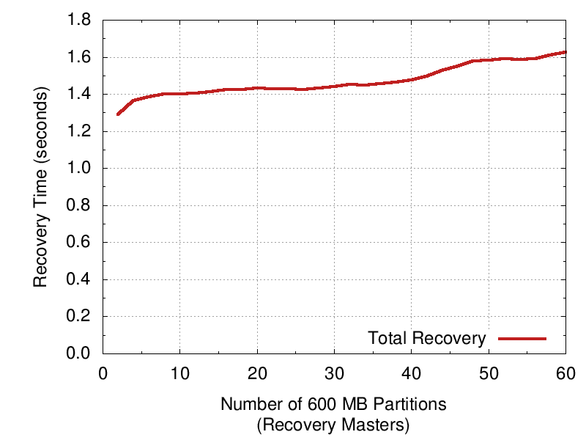
Results
60 Recovery Masters
120 SSDs: 31 GB/s
Recovered: 35 GB
2x270 MB/s SSDs, 60 machines

Slide 19
Key Issues and Solutions
Maximizing concurrency
Data parallelism
Heavily pipelined
Out-of-order replay
Balancing work evenly
Balancing partitions
Divide crashed master up at recovery time
Segment scattering
Random, but bias to balance disk read time
Avoiding centralization
Finding segment replicas
Detecting incomplete logs

Slide 20
Backup Recovery
Segment 1
Segment 2
Segment 3
Master
B17
B31
B68
B68
Replicas
B91
B1
B12
B72
Failures result in loss of segment replicas
Recreate replicas to maintain desired redundancy
Simple: Master uses same procedure as normal operation
Efficient: Use master’s in-memory copy
Concurrent: Work is divided up among all the hosts

Slide 21
Expected Backup Recovery Time
Backup could have 192 GB of data
1000 64 GB masters triplicating segments
Aggregate network bandwidth: 1000 GB/s
Aggregate disk bandwidth: 200 GB/s
~200 ms if backups have buffer space
~1,000 ms if not
Notes:
80 masters with 64 GB of data triplicated across 80 backups
Assume 2 x 150 MB/s SSDs
~8.2 s (192 GB / (2 x 150 MB/s))
Each master has ~24 replicas on a given backup

Slide 22
Massive Failures/Cluster Restart
Unavailability ok during massive/complete outages
Remain durable
Simplicity is the goal
Massive failures are expected to be rare
Shortest restart time is a non-goal (within reason)
Reuse master/backup recovery
Must make them work correctly under massive failure
Treat massive failure as a series of single failures
Notes:
Took 30 mins to get here.

Slide 23
Massive Failures/Cluster Restart
Masters
Backups
Must readmit replicas to cluster after mass failure
All master data is lost
Only replicas on backups’ disks persist
Start recovery when complete log becomes available
Determine if recovery can proceed as backups rejoin

Slide 24
Key Issues
Replica garbage collection
Dilemma when a replica rejoins the cluster
It may be needed for a recovery
It may be redundant; master has created new replicas

Slide 25
Fault-tolerant Distributed Log
Distributed log
Fast durability in normal case
Restores availability quickly during crashes
Clear strategy for maintaining durability
We’ve talked about how the log operates on a good day
Massive Failures
Fast Master Recovery
Distributed Log
Backup Recovery

Slide 26
Potential Problems
Detecting incomplete logs
Has a complete log been found for recovery?
Replica consistency
How are the inconsistencies due to failures handled?

Slide 27
Finding Replicas
Log segments created/destroyed rapidly across cluster
100,000s per second
Centralized log information too expensive
No centralized list of segments that comprise a log
No centralized map of replica locations
Broadcast on Master crash
Coordinator contacts each backup explicitly
Have to contact all backups anyway
Master’s segments are scattered across all of them
Collects a list of all available replicas

Slide 28
Detecting Incomplete Logs
Problem: Ensure complete log found during recovery
What if all replicas for some segment are missing?
Solution: Make log self-describing
Add a “log digest” to each replica when it is allocated
Lists all segments of the log
Reduces problem to finding the up-to-date log digest
S7
S19
S20
Digest
[S7, S19, S20]

Slide 29
Choosing the Right Digest
Solution: Make most recent segment of log identifiable (the “head”)
Segments are allocated in an “open” status
Mark “closed” when head segment fills up
Only use digests from head segment on recovery
Challenge: Safe transition between log heads

Slide 30
Preventing Lost Digests
Problem: Crash during head transition can leave no log head
Segment 19
Segment 20
Open
[7, 19]
Time
Closed
[7, 19]
Closed
[7, 19]
[7, 19, 20]
Open
Digest
Digest

Slide 31
Preventing Lost Digests
Problem: Crash during head transition can leave no log head
Segment 19 no longer head, segment 20 hasn’t been created
Segment 19
Segment 20
Open
[7, 19]
Time
Closed
[7, 19]
Crash
Closed
[7, 19]
[7, 19, 20]
Open
Digest
Digest

Slide 32
Preventing Lost Digests
Solution: Open new log head before closing old one
Segment 19
Segment 20
Open
[7, 19]
Time
Open
[7, 19]
[7, 19, 20]
Open
Closed
[7, 19]
[7, 19, 20]
Open
Digest
Digest

Slide 33
Inconsistent Digests
Problem: Crash during transition can leave two log digests
Solution: Don’t put data in new head until the old head is closed
If new log head has no data either is safe to use
Segment 19
Segment 20
Open
[7, 19]
Time
Open
[7, 19]
[7, 19, 20]
Open
Crash
Closed
[7, 19]
[7, 19, 20]
Open
Digest
Digest

Slide 34
Replica Consistency
Replicas can become inconsistent
Failures during (re-)creation of replicas
Must recover even with one only replica available for each segment
Can’t prevent inconsistencies
Make them detectable
Prevent recovery from using them
Open segments present special challenges

Slide 35
Failures on Closed Segments
Segment 19 on Master
Replicas for
Segment 19 on Backups
Time
Problem: Master may recover from a partial replica
Solution: Recreate replicas atomically
Backup considers atomic replica invalid until closed
Will not be persisted or used in recovery

Slide 36
Failures on Open Segments
Segment 19 on Master
Replicas for
Segment 19 on Backups
Write
starts
Time
Write
ends
Closed segment solution doesn’t work
Problem: Segment in Master’s RAM is changing
Lost replica may be useful for recovery one moment
A moment later it must not be used during recovery
Rare: Expect 3 Masters affected every 30 mins or longer

Slide 37
Failures on Open Segments
Segment 19 on Master
Replicas for
Segment 19 on Backups
Write
starts
Time
Open segment 20, close segment 19
Update Min Head Segment Id on Coordinator
Write
ends
Min Head Id: 20
Solution
Make valid replicas distinguishable (close them)
Notify coordinator to prevent use of open replicas

Slide 38
Fault-tolerant Distributed Log
Detecting incomplete logs
Broadcast to find replicas
Log digest provides catalog of segments
Head of log ensures up-to-date digest is found
Replica consistency
Atomic replica recreation for most segments
Centralized minimum head id invalidates lost replicas
No centralization during normal operation
Even during transitions between segments

Slide 39
What’s done
Normal operation
Low latency 5 µs remote access
Master recovery
1 - 2 s restoration of availability after failures
Backup recovery
Durability safely maintained via re-replication
[Fall 2009]
[Fall 2010]
[SOSP 2011]
[Feb 2012]

Slide 40
What’s left
Massive Failures/Cluster Restart
Replica garbage collection from backups
Master recovery on coordinator
Recoveries which can wait for lost replicas
Experiment with longer-lived RAMCloud instances
Work out kinks
Measure/understand complex interactions
e.g. Multiple recoveries, impact of recovery on normal operation, storage leaks, etc.
Explore strategies for surviving permanent backup failures
[Spring 2012]
[Apr 2012]
[May-June 2012]
[Summer 2012]

Slide 41
Summary
RAM’s volatility makes it difficult to use for storage
Applications expect large-scale storage to be durable
RAMCloud’s durability & availability solve this
RAMCloud provides general purpose storage in RAM
Low latency with large scale
Enables new applications which access more data
Simplifies development of large scale applications

