Slide 1
What happens when you try to build a low latency NIC?
Mario Flajslik

Slide 2
Overview
Motivation
Setup
Receive path NIC latency
Transmit path NIC latency
Results
Conclusion

Slide 3
RAMCloud Overview
Storage for datacenters
1000-10000 commodity servers
64 GB DRAM/server
All data always in RAM
Durable and available
Performance goals:
High throughput: 1M ops/sec/server
Low-latency access: 5-10µs RPC
Application Servers
Storage Servers
Datacenter

Slide 4
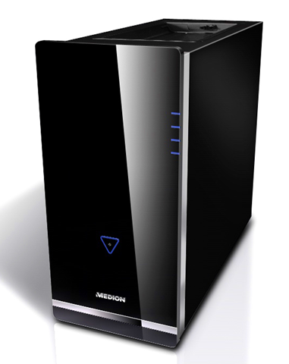
Datacenter network topology
. . .
Current low latency switches ~600ns
Next generation switches promise ~300ns

Slide 5
Test setup
RAM
CPU
MCH
DMA
rd/wr
ICH
PCIe 1.1 x1
DMA read latencies:
size | latency
64B | 2424 ns
128B | 2808 ns
256B | 3464 ns
512B | 4984 ns
xupv5
FPGA
NIC
ethernet

Slide 6
Receiving packets
RAM
Pre-allocate buffers (sk_buff) and give them to the NIC
On packet receive DMA data to the buffer, and notify the CPU
sk_buff
sk_buff
sk_buff
NIC
…
packet in
DMA write
meta
data
write length
interrupt
CPU

Slide 7
RX path
MAC 0
MAC 1
MAC 2
MAC 3
length (256ns delay)
other sources
CTRL
PCIe
core
TX/RX

Slide 8
PCIe RX latency breakdown
128B receive (+16B PCIe header)
PCIe 1.1: 250 MB/s -> 576 ns wire time for 144B
All times in nanoseconds
0
app
416
trn_tx
128
560
pcie_mim_wr
272
1156
pcie_mim_rd
580
wire
746
1322

Slide 9
Transmitting packets
RAM
NIC
sk_buff
CPU
sk_buff
reg write
sk_buff
DMA read
…
write back
packet out
meta
data
reg write:
rsvd(2)
end(1)
id(5)
size(16)
addr(40)
NIC writes back a flag that the packet has been sent and sk_buff can be deallocated. Data written back is the DMA read latency.

Slide 10
TX path
MAC 0
MAC 1
MAC 2
MAC 3
MEM
MEM
MEM
MEM
CTRL
PCIe
core
TX/RX

Slide 11
PCIe RX latency breakdown
0
96
app
128
trn_tx
240
pcie_mim_wr
pcie_mim_rd
272
446
510
wire
316
380
1424
1680
app
trn_rx
176
752
pcie_mim_rd
0
576
1376
1664
pcie_mim_wr
832
1120
wire

Slide 12
Results
RTT of DMA read from the NIC
Xilinx PCIe core latency (128B) = 2126 ns
Latency = 2000 ns + size * 6 ns
Smaller latency for x8 PCIe
size | latency
64B | 2424 ns
128B | 2808 ns
256B | 3464 ns
512B | 4984 ns

Slide 13
Evolution of PCI
PCI version | DMA read latency
33 MHz PCI | 324 ns
66 MHz PCI-X | 174 ns
133 MHz PCI-X | 84 ns
PCIe x1 | 2106 ns
PCIe x8 | 252 ns
Experiment done with register DMA reads (4 byte DMA reads)

Slide 14
PHY & MAC
10G NetFPGA NIC
10G NetFPGA NIC
MAC
XAUI
PHY
PHY
XAUI
MAC
109 ns
83 ns
211 ns
211 ns
83 ns
90 ns
0 ns
192 ns
403 ns
607 ns
819 ns
XAUI is interconnect protocol between virtex-5 and the PHY chip
Given times are for a copper cable
Optical cable times are a little better (~10ns better)

Slide 15
Conclusion
Current Intel 10G NICs (RX+TX): ~5μs
Current Intel 1G NICs (RX+TX): ~9μs
Infiniband (RX+TX): ~2.2μ
There is room for improvement

